Slide 1
Dynamic Load Balancing in Scientific Simulation
Angen Zheng

Slide 2
Static Load Balancing
No Communication among PUs.
PU 1
PU 2
Computations
PU 3
Initial Load
Initial Balanced Load Distribution
Unchanged Load Distribution
Distribute the load evenly across processing unit.
Is this good enough? It depends!
  No data dependency!
  Load distribution remain unchanged!

Slide 3
Static Load Balancing
PUs need to communicate with each other to carry out the computation.
PU 1
PU 2
Computation
PU 3
Initial Load
Initial Balanced Load Distribution
Unchanged Load Distribution
Distribute the load evenly across processing unit.
Minimize inter-processing-unit communication.

Slide 4
Dynamic Load Balancing
PUs need to communicate with each other to carry out the computation.
PU 1
PU 2
Iterative Computation Steps
Repartitioning
PU 3
Initial Load
Initial Balanced Load Distribution
Imbalanced Load Distribution
Balanced Load Distribution
Distribute the load evenly across processing unit.
Minimize inter-processing-unit communication!
Minimize data migration among processing units.

Slide 5
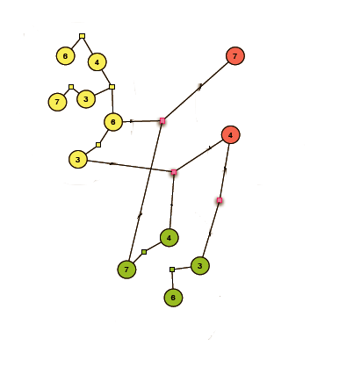
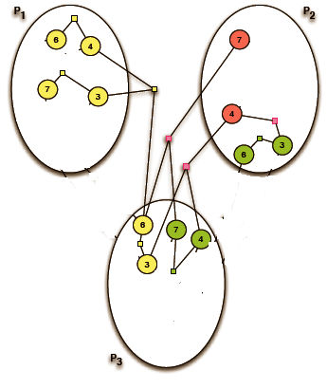
(Hyper)graph Partitioning
Given a (Hyper)graph G=(V, E).
  Partition V into k partitions P₀, P₁, … P_{k}, such that all parts
    Disjoint: P₀ U P₁ U … P_{k} = V and P_{i} ∩ P_{j} = Ø where i ≠ j.
    Balanced: |Pi| ≤ (|V| / k) * (1 + ᵋ)
    Edge-cut is minimized: edges crossing different parts.
Bcomm= 3

Slide 6
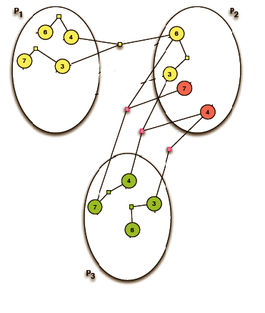
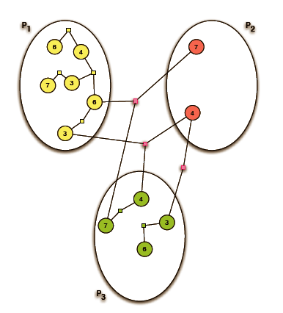
(Hyper)graph Repartitioning
Given a Partitioned (Hyper)graph G=(V, E) and a Partition Vector P.
  Repartition V into k partitions P₀, P₁, … P_{k}, such that all parts
    Disjoint.
    Balanced.
    Minimal Edge-cut.
    Minimal Migration.
Bcomm = 4
Bmig =2
Repartitioning

Slide 7
(Hyper)graph-Based Dynamic Load Balancing
PU1
PU2
Iterative Computation Steps
Repartitioning the Updated (Hyper)graph
PU3
Build the Initial (Hyper)graph
Initial Partitioning
Update the Initial (Hyper)graph
Load Distribution
After Repartitioning
6
6
3
3

Slide 8
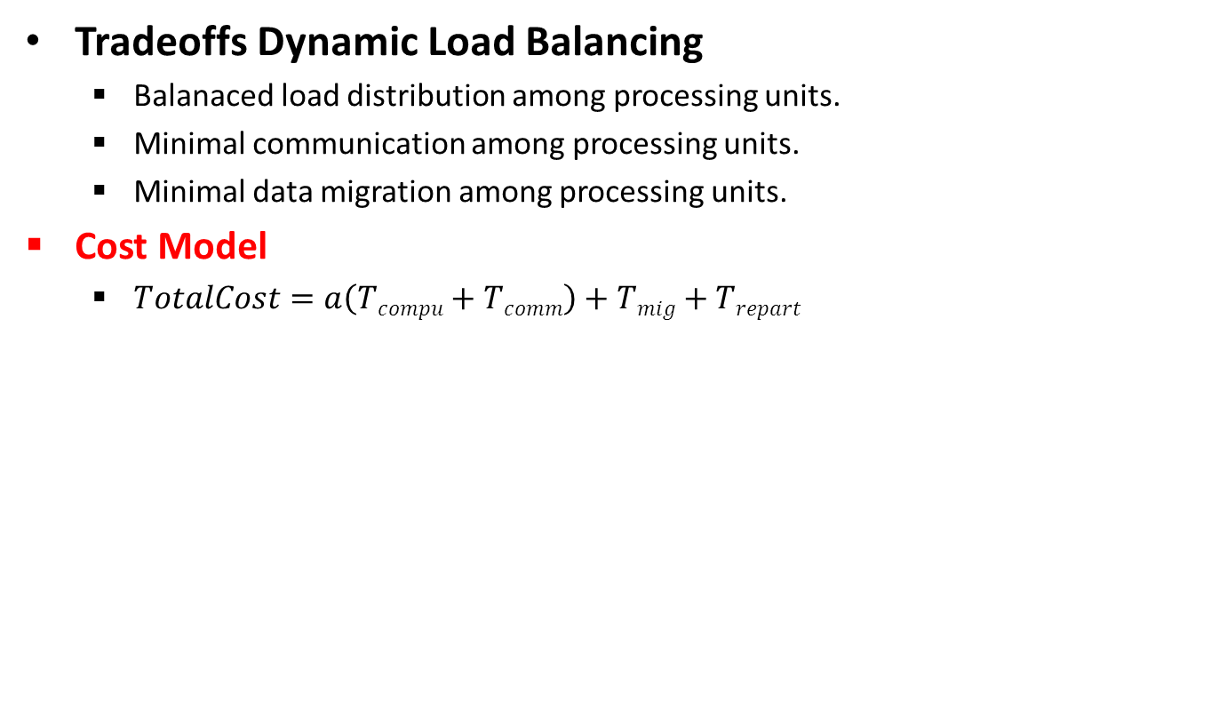
(Hyper)graph-Based Dynamic Load Balancing:
Cost Model
T_{compu} is usually implicitly minimized.
T_{repart} is commonly negligible.
T_{comm} and T_{mig} depend on architecture-specific features, such as network topology, and cache hierarchy

Slide 9
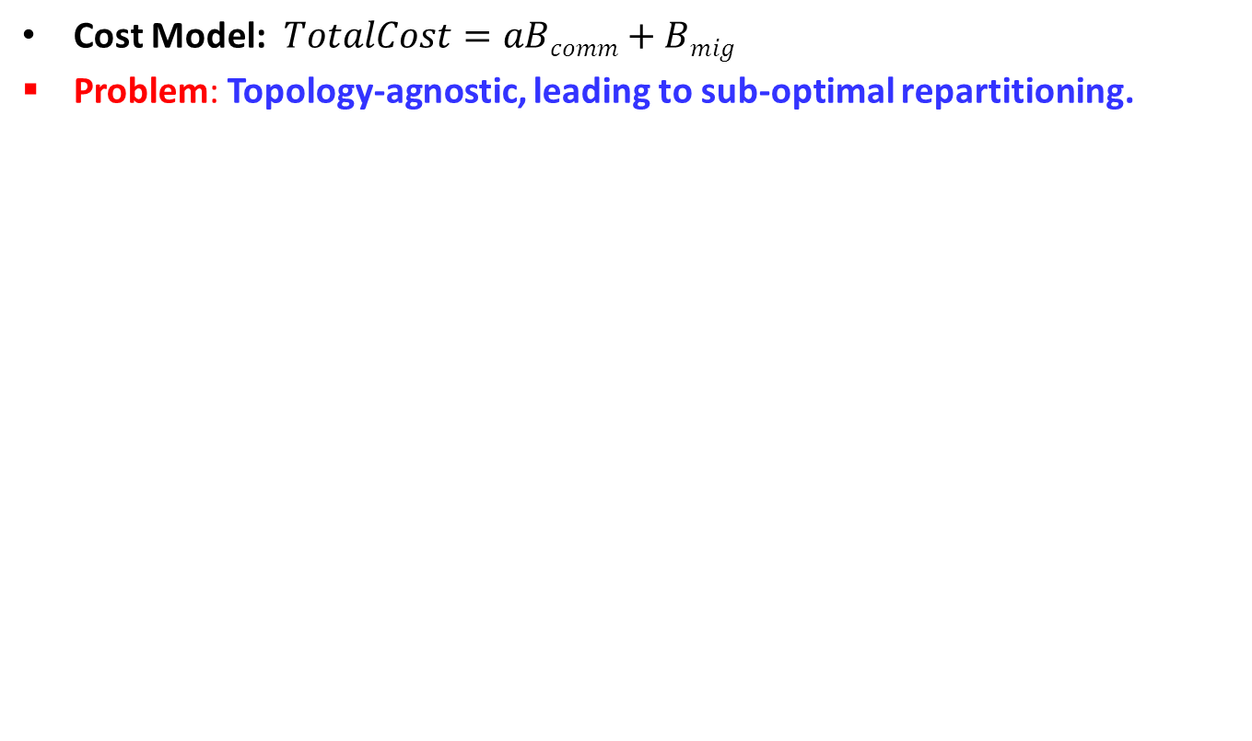
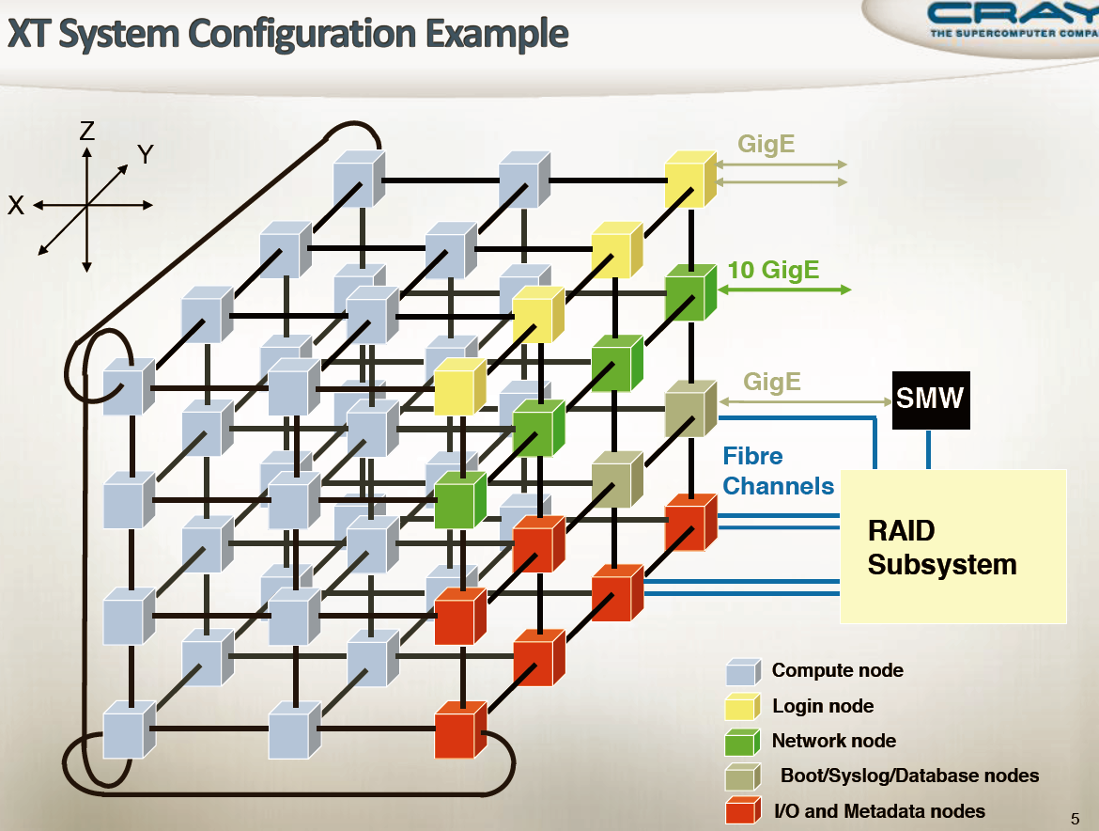
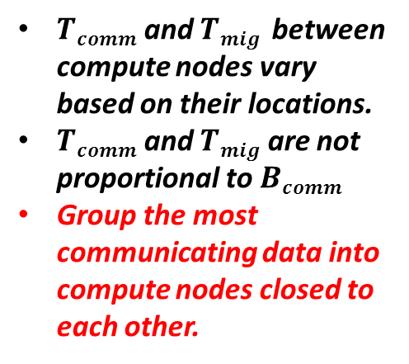
(Hyper)graph-Based Dynamic Load Balancing:
NUMA Effect

Slide 10
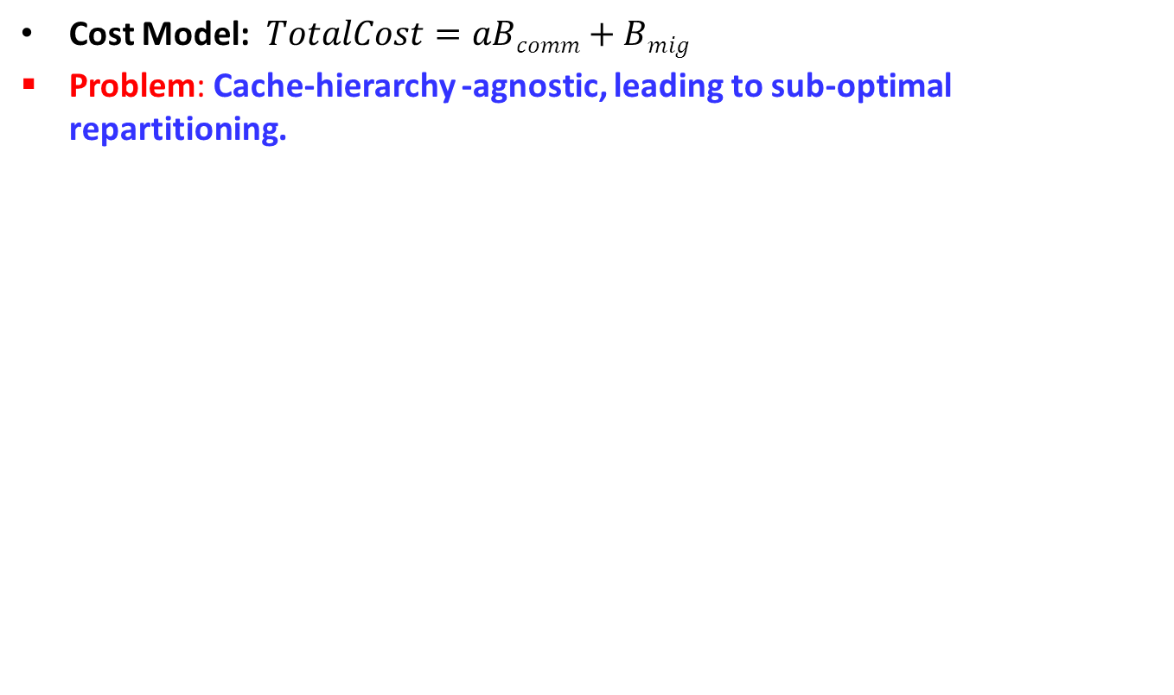
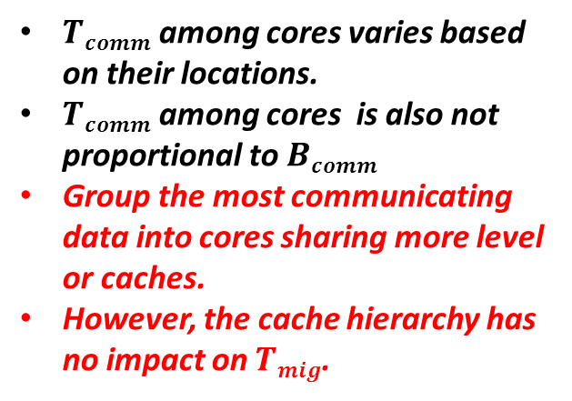
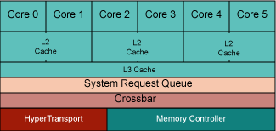
(Hyper)graph-Based Dynamic Load Balancing:
NUCA Effect
PU1
PU2
Iterative Computation Steps
Rebalancing
PU3
Initial (Hyper)graph
Initial Partitioning
Updated (Hyper)graph
Migration Once After Repartitioning

Slide 11
Hierarchical Topology-Aware (Hyper)graph-Based Dynamic Load Balancing
NUMA-Aware Inter-Node Repartitioning:
    Goal: Group the most communicating data into compute nodes closed to each other.
    Main Idea:
    Regrouping.
    Repartitioning.
    Refinement.
NUCA-Aware Intra-Node Repartitioning:
  Goal: Group the most communicating data into cores sharing more level of caches.
  Solution#1: Hierarchical Repartitioning.
  Solution#2: Flat Repartitioning.

Slide 12
Hierarchical Topology-Aware (Hyper)graph-Based Dynamic Load Balancing
Motivations:
    Heterogeneous inter- and intra-node communication.
    Network topology v.s. Cache hierarchy.
      Different cost metrics.
      Varying impact.
Benefits:
  Fully aware of the underlying topology.
  Different cost models and repartitioning schemes for inter- and intra-node repartitioning.
  Repartitioning the (hyper)graph at node level first offers us more freedom in deciding:
    Which object to be migrated?
    Which partition that the object should migrated to?

Slide 13
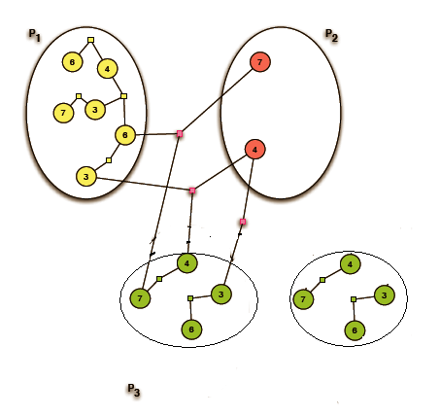
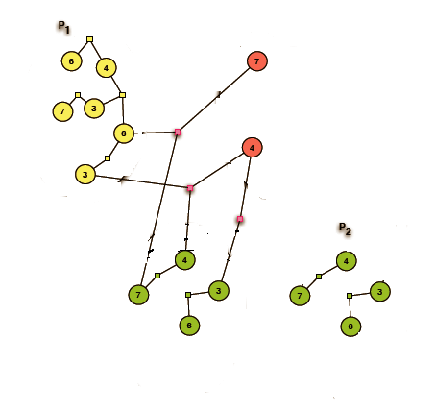
NUMA-Aware Inter-Node (Hyper)graph Repartitioning: Regrouping
Partition Assignment
P1 | P2 | P3 | P4
Node#0 |  | Node#1
Regrouping
P4

Slide 14
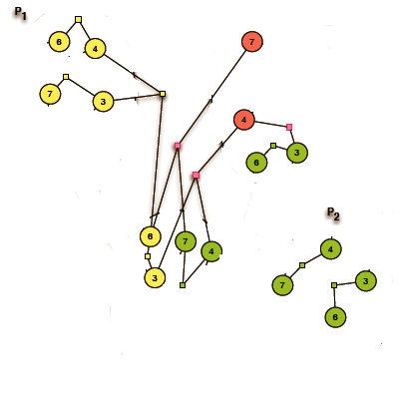
NUMA-Aware Inter-Node (Hyper)graph Repartitioning: Repartitioning
Repartitioning
0

Slide 15
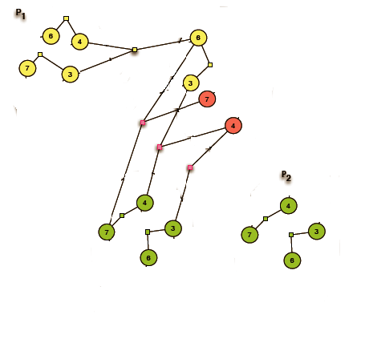
NUMA-Aware Inter-Node (Hyper)graph Repartitioning: Refinement
Migration Cost: 4
Comm Cost: 3
Migration Cost: 0
Comm Cost: 3
0
0
Refinement by taking current partitions to compute nodes assignment into account.

Slide 16
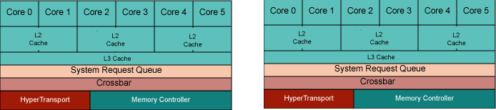
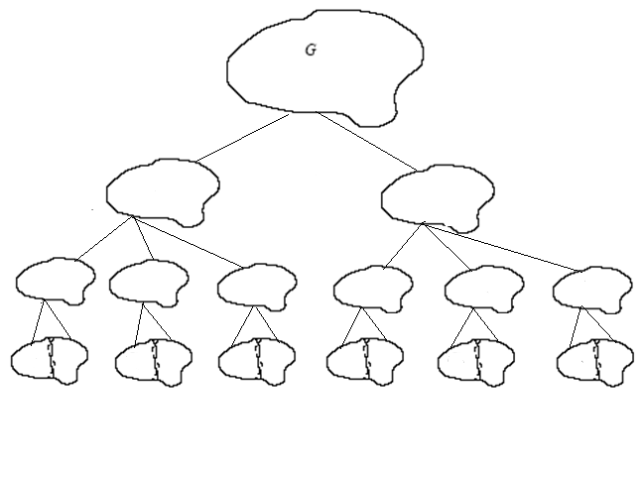
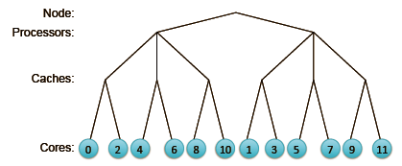
Hierarchical NUCA-Aware Intra-Node (Hyper)graph Repartitioning
Main Idea: Repartition the subgraph assigned to each node hierarchically according to the cache hierarchy.
0
1
2
3
4
5
0
1
2
3
4
5
0
1
2
3
4
5
0
1
2
3
4
5

Slide 17
Flat NUCA-Aware Intra-Node (Hyper)graph Repartition
Main Idea:
  Repartition the subgraph assigned to each compute node directly into k parts from scratch.
    K equals to the number of cores per node.
  Explore all possible partition to physical core mappings to find the one with minimal cost:
$$f\left(M\right)=a∗ ∑ⁿi=nBinter Li comm ∗TL(i+1)+Bmig ∗TLn$$

Slide 18
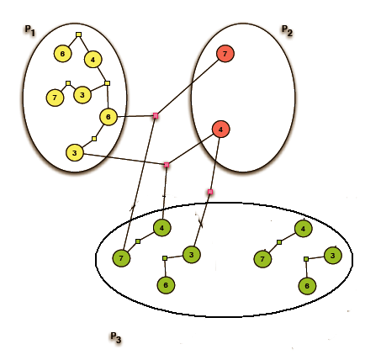
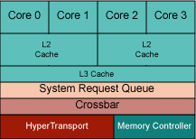
Flat NUCA-Aware Intra-Node (Hyper)graph Repartition
P1 | P2 | P3
Core#0 | Core#1 | Core#2
Old Partition Assignment
Old Partition

Slide 19
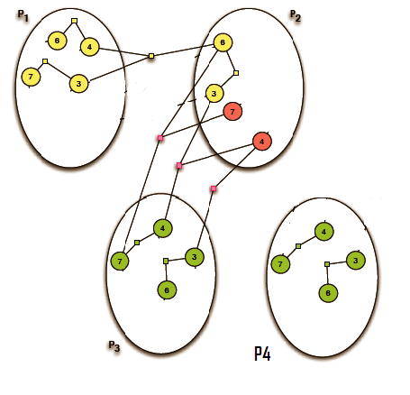
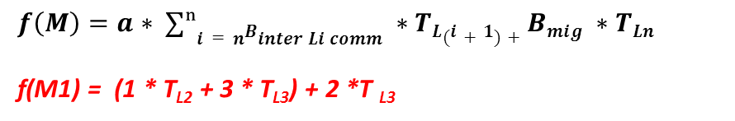
Flat NUCA-Aware Intra-Node (Hyper)graph Repartition
Old Assignment
Old Partition
New Partition
P1 | P2 | P3
Core#0 | Core#1 | Core#2
New Assignment#M1
$$f\left(M\right)=a∗ ∑ⁿi=nBinter Li comm ∗TL(i+1)+Bmig ∗TLn$$
f(M1) = (1 * T_{L2} + 3 * T_{L3}) + 2 *T _{L3}
P1 | P2 | P3 | P4
Core#0 | Core#1 | Core#2 | Core#3

Slide 20
Major References
[1] K. Schloegel, G. Karypis, and V. Kumar, Graph partitioning for high performance scientific simulations. Army High Performance Computing Research Center, 2000.
[2] B. Hendrickson and T. G. Kolda, Graph partitioning models for parallel computing," Parallel computing, vol. 26, no. 12, pp. 1519~1534, 2000.
[3] K. D. Devine, E. G. Boman, R. T. Heaphy, R. H.Bisseling, and U. V. Catalyurek, Parallel hypergraph partitioning for scientific computing," in Parallel and Distributed Processing Symposium, 2006. IPDPS2006. 20th International, pp. 10-pp, IEEE, 2006.
[4] U. V. Catalyurek, E. G. Boman, K. D. Devine,D. Bozdag, R. T. Heaphy, and L. A. Riesen, A repartitioning hypergraph model for dynamic load balancing," Journal of Parallel and Distributed Computing, vol. 69, no. 8, pp. 711~724, 2009.
[5] E. Jeannot, E. Meneses, G. Mercier, F. Tessier,G. Zheng, et al., Communication and topology-aware load balancing in charm++ with treematch," in IEEE Cluster 2013.
[6] L. L. Pilla, C. P. Ribeiro, D. Cordeiro, A. Bhatele,P. O. Navaux, J.-F. Mehaut, L. V. Kale, et al., Improving parallel system performance with a numa-aware load balancer," INRIA-Illinois Joint Laboratory on Petascale Computing, Urbana, IL, Tech. Rep. TR-JLPC-11-02, vol. 20011, 2011.

Slide 21
Thanks!

