Slide 1

HTT: A novel technique for automatic test case selection designed for regression testing
Zichuan (Jerry) Ye
2013.10.29
Department of Computer Science

Slide 2
Outline
1. Introduction
2. Proposed method
a. Tree Construction;
b. Path Computation;
c. Path Comparison;
Experiments and results
Summary
References
Acknowledgements

Slide 3
I. Introduction

Slide 4
Introduction
Regression testing by definition is any type of software testing that seeks to uncover new software bugs, or regressions, in existing functional and non-functional areas of a system after changes such as enhancements, patches or configuration changes, have been made to them.
Three types of modifications: process change, binding change and interface change.
Selection and generation of the test cases is essential in proposing an efficient and accurate regression testing.

Slide 5
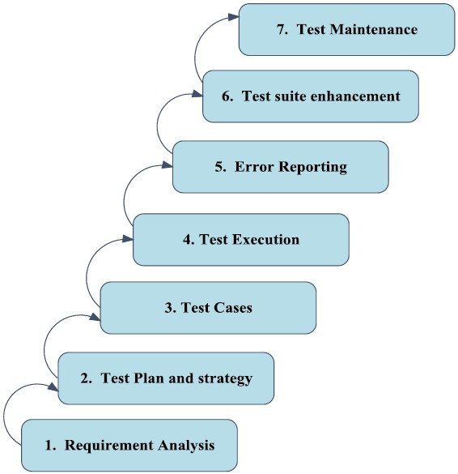
Introduction
Testing methods:
Time and Resource consuming!
Flow of regression testing

Slide 6
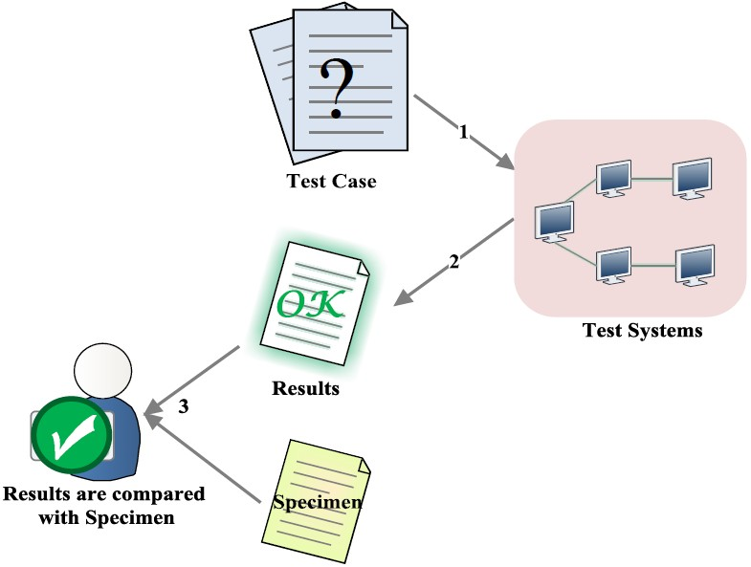
Introduction
Selected or generated from a set of case suites
Execution of regression testing

Slide 7
II. Proposed Method

Slide 8
Proposed method:
An easier and more efficient approach in regression testing was proposed using services of Business Process Execution Language (BPEL):
A hierarchical test tree is constructed;
Process change, binding change and interface change;
Changes before/after modifications were identified and studied;

Slide 9
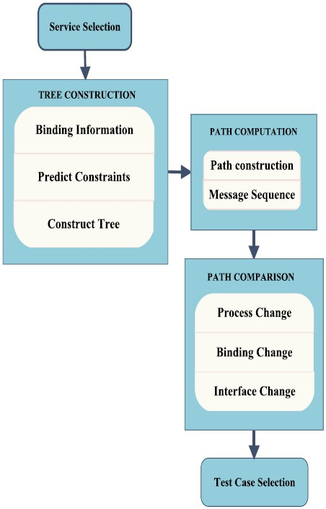
Proposed method:
A three-step approach to identify changes:
Tree construction;
Path computation;
Path comparison.

Slide 10
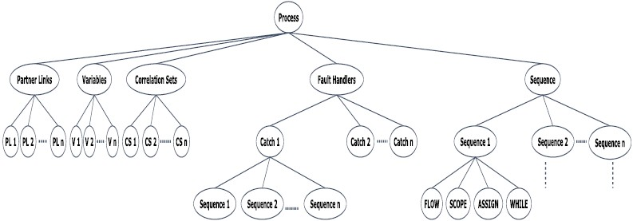
1. Tree construction:
General construction of hierarchical test tree (HTT)

Slide 11
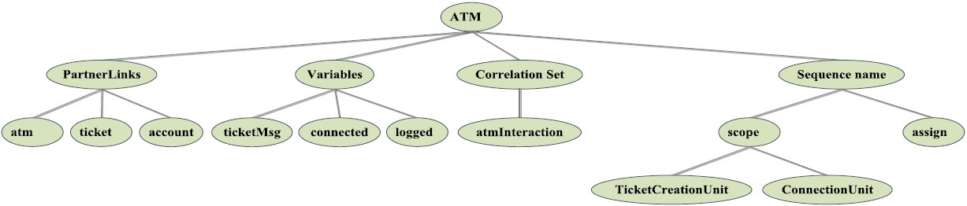
2. Path computation:
Example of an ATM business process execution language (BPEL) file

Slide 12
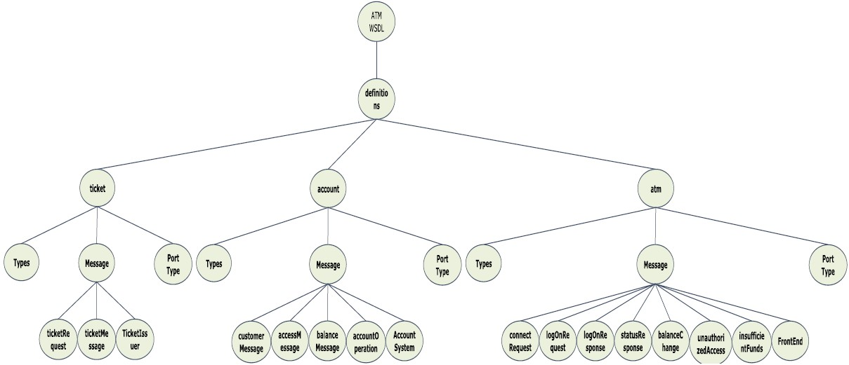
2. Path computation:
Hierarchical test tree (HTT) representation of message sequence, a parallel approach to identify interface change

Slide 13
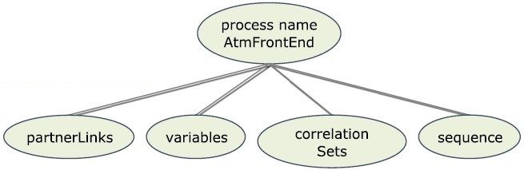
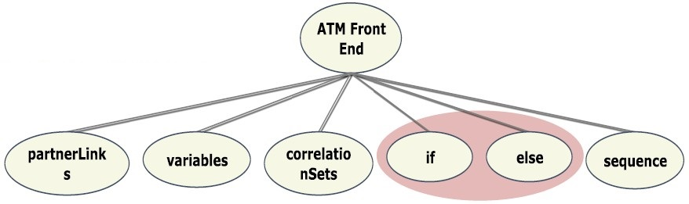
3. Path comparison:
Process change and Binding change:
Before modification:
After modification:

Slide 14
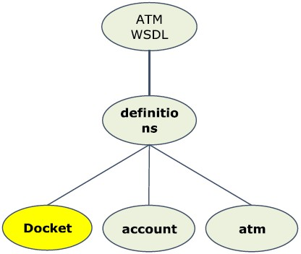
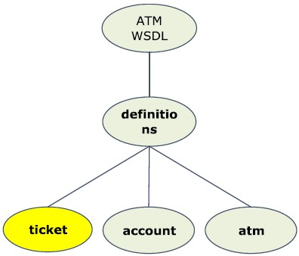
3. Path comparison:
Interface change:
Before modification:
After modification:

Slide 15
III. Experiments and Results

Slide 16
Experiments and results:
The proposed method (HTT) was tested by comparing with an existing graph-based technique called “extensible BPEL ﬂow graph (XBFG)” in the following aspects:
Time for test cases selection;
Time for fault detection in test cases;
Processing memory usage.

Slide 17
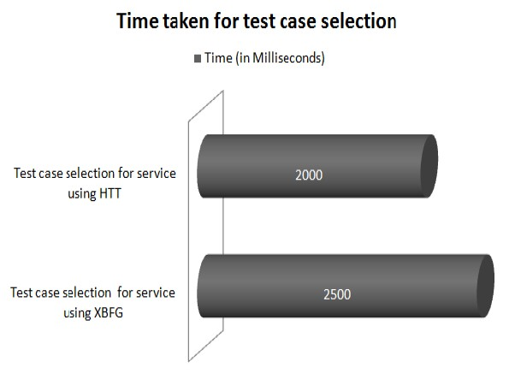
Experiments and results:
20% shorter runtime for test case selection

Slide 18
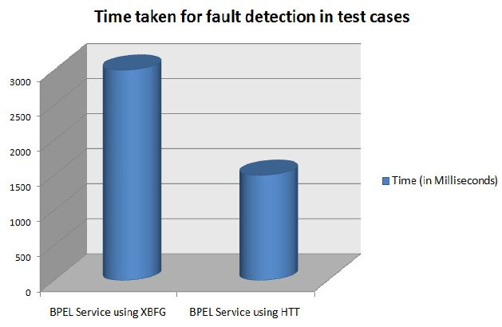
Experiments and results:
40% shorter runtime fault detection

Slide 19
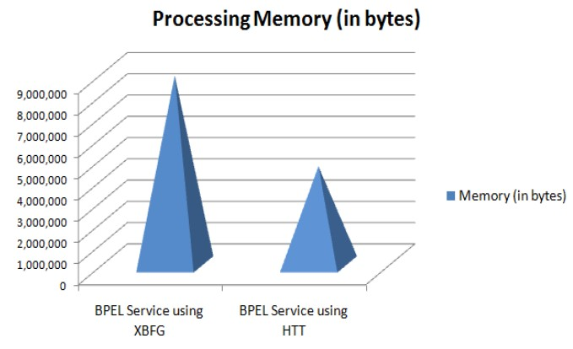
Experiments and results:
More than 50% less memory usage

Slide 20
IV. Summary

Slide 21
Summary:
A hierarchical test tree was proposed as a new technique in regression testing;
A three-step approach of HTT is introduced including tree construction, path computation and path comparison;
Experiments and results showed that HTT successfully enhanced the performance of regression testing

Slide 22
V. References:
[1] Binxin Li, Dong Qiu, Hareton Leung, and Di Wang, “automatic test case selection for regression testing of composite service based on extensible BPEL flow graph,” Journal of Systems and Software, Vol.85, Issue 6, 1300-1324, 2012
[2] D.Jeyamala and V.Mohan, “Automated Software Test Optimization Framework - an Artificial Bee Colony Optimization based Approach”, International Journal - IET - Software, Vol.4, No.5, 334-348, 2010
[3] W.L. Dong, H. Yu, W.B. Zhang, “Testing BPEL-based web service composition using high-level Petri nets”, Proceeding of the 10th IEEE International Elbaum, 2006

Slide 23
VI. Acknowledgements

Slide 24
Acknowledgements:
Dr. Shi-Kuo Chang
Mr. Guy M. Gadola
And all fellow students in CS-2310.

