Slide 1
Social Media as Sensors
-- Yao Yao

Slide 2
Crowd-Sourced Sensing and Collaboration Using Twitter
Written by Murat Demirbas, Murat Ali Bayir, Cuneyt Gurcan Akcora, Yavuz Selim Yilmaz
Intro:
This paper designed and implemented crowd-sourced sensing and collaboration system over Twitter.
Idea behind:
Give the community a tool than to give the tool a community

Slide 3
Crowd-Sourcing
Crowd-sourcing means distributing a
query to several Twitter users in order to gather and aggregate the results and exploit the wisdom-of-crowds effect.

Slide 4
Crowd-Sourcing
Examples:
Rent-a-coder
Assigning programming tasks to freelance programmers.
Open Mind
Non-expert internet users collaborate to create intelligent software.
SeeClickFix
City inhabitants to report the problems.

Slide 5
Social Collaboration
Require back-and-forth interaction than crowd-sourcing
Examples:
m-Dvara 2.0
Visitors can comment on the art pieces, the new visitors can see which are recommended.

Slide 6
Crowd-sourcing system architecture
Askweet
Askweet accepts a question, and tries to answer the question based on the data from Twitter.
Sensweet
Sensweet sense the surrounding environment and sen these data to the Twitter

Slide 7
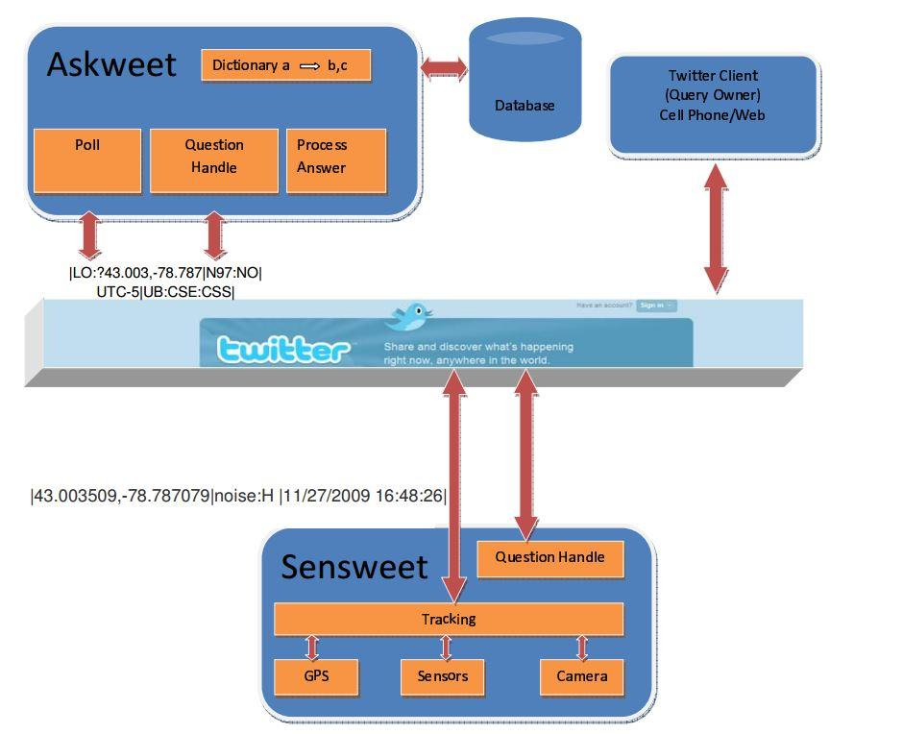
Crowd-sourcing system architecture

Slide 8
Case Study: Weather Radar
Two sub-task:
Obtains the current weather condition
from users
Obtains guesses from the users about the next day’s weather condition

Slide 9
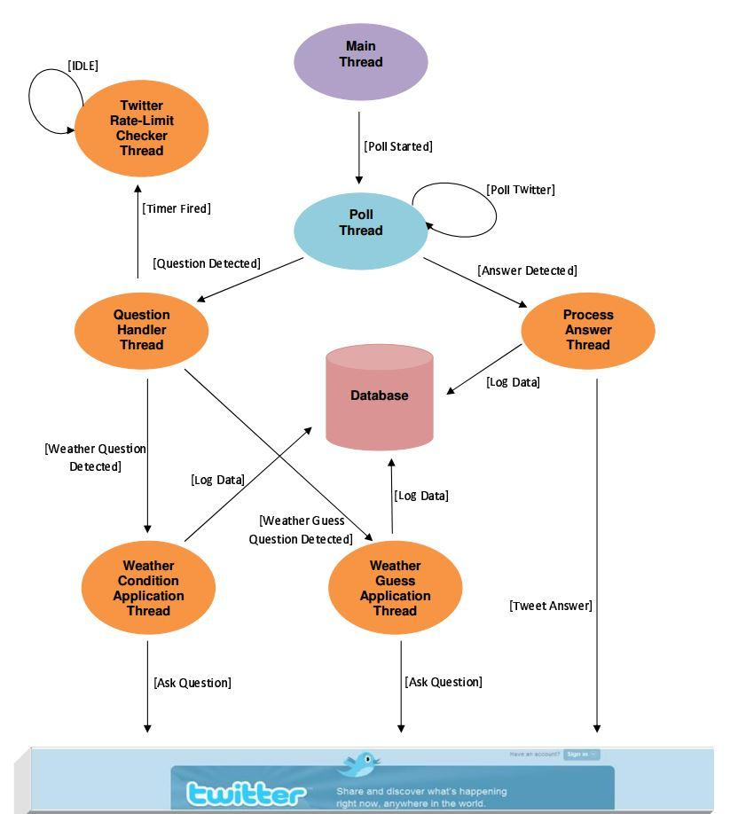

Slide 10
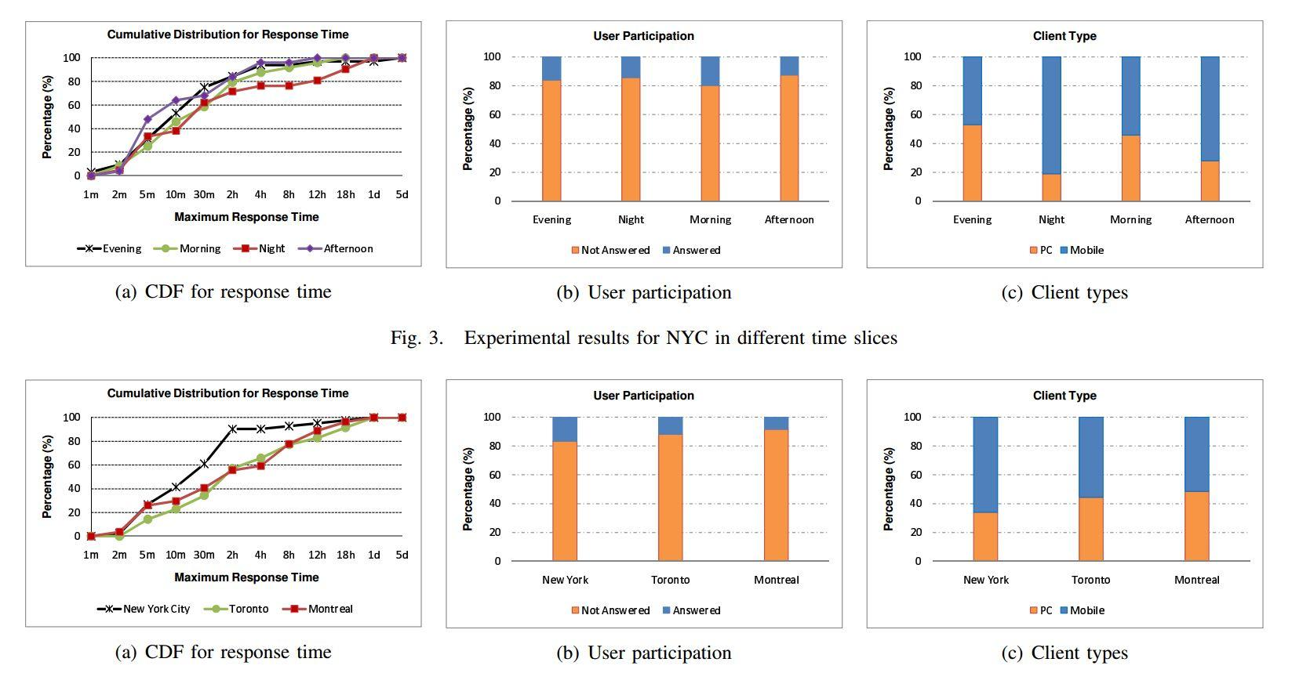
Experiment Results

Slide 11
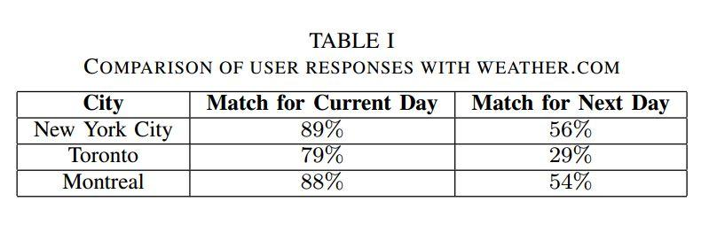
Experiment Results

Slide 12
Case Study:
Smartphone Enabled Noise Map
Measure the noise level of the surrounding environment via GPS enabled smartphones and provide a noise level querying service over Twitter.
Askweet
Any Twitter user can send query
Sensweet
Detects the noise level and forwards to Twitter.

Slide 13
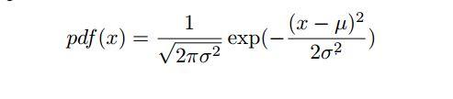
Case Study:
Smartphone Enabled Noise Map
Sensweet
record a one second noise sample and parse the sample to get the mean value in
{Low, Medium, High} using the normal distributions.

Slide 14
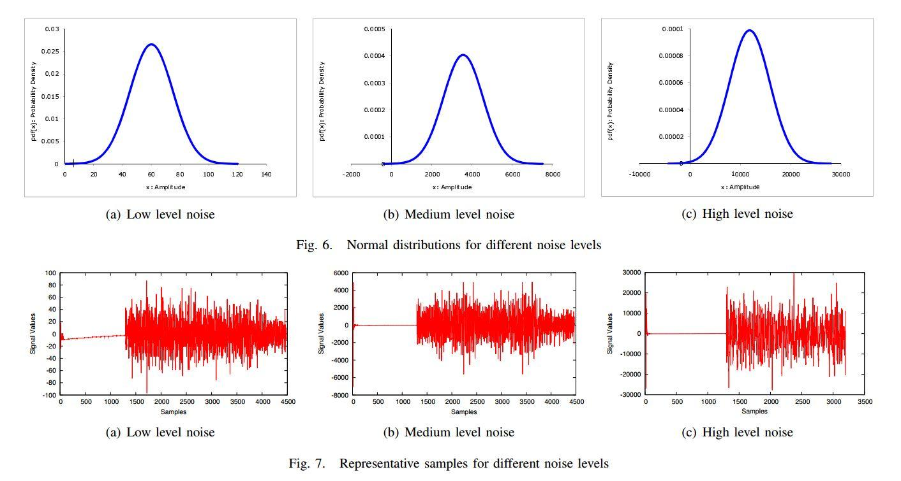
Case Study:
Smartphone Enabled Noise Map

Slide 15
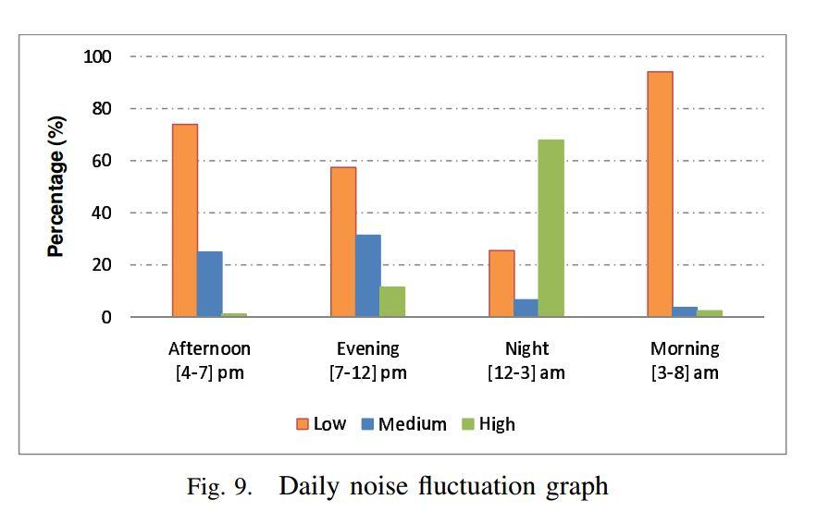
Case Study:
Smartphone Enabled Noise Map

Slide 16
Summary
Volunteer
Crowd-sourcing experiments with 15% replay rates.
Low Latency
50% in 30 minutes and 80% in 2 hours
Mobility
Most replies are from smartphones.

Slide 17

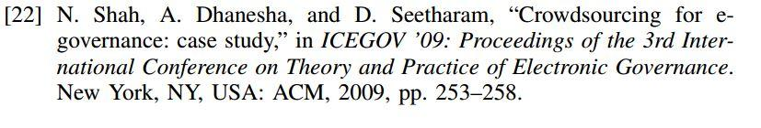
Related papers

