Slide 1
A Survey on Context-aware System
Authors: Matthias Baldauf, Schahram Dustdar, and Florian Rosenberg
Haifeng Xu
Nov. 19, 2013

Slide 2
Outline
Context-aware systems Basics
  Context-aware systems
  Definition of Context
  Classification of Context
  Classification of Architecture
  Abstract Layer Architecture
  Context Models
Existent context-aware systems
  Architecture
  Resource discovery
  Sensing
  Context model
  Context processing
  Historical context data
  Security and privacy

Slide 3
Context-aware systems
Are able to adapt their operations to the current context without explicit user intervention
Aim at increasing usability and effectiveness by taking environmental context into account

Slide 4
Definition of Context
Location, identities of nearby people and objects and changes to those objects
The user’s location, the environment, the identity and the time
The aspects of the current situation
The elements of the user’s environment that the computer knows about
Any information that can be used to characterize the situation of entities (i.e. whether a person, place or object) that are considered relevant to the interaction between a user and an application, including the user and the application themselves

Slide 5
Classification of Context
External (physical)
  Context that can be measured by hardware sensors
  Ex) location, light, sound, movement, touch, temperature, air pressure, etc.
Internal (logical)
  Mostly specified by the user or captured by monitoring the user’s interaction
  Ex) the user’s goal, tasks, schedules, emotional state, etc.

Slide 6
Classification of Architecture (I)
(Contextual information acquisition)
Direct sensor access
  Tightly coupled
  No extensibility
Middleware
  Hiding low-level sensing details
  Extensible
Context server
  Permit multiple clients access to remote data sources
  Relieve clients of resource intensive operations
  Has to consider appropriate protocols, network performance, quality of service parameters
Notes:
Architecture is the most important and also complex part when discussing a context-aware system.
On how to acquire contextual information

Slide 7
Classification of Architecture (II)
(Processes and components coordination)
Widgets (process-centric view)
  Exchangeable
  Controlled by a widget manager
  The tightly coupled widget approach increases efficiency but is not robust to component failures
Networked services (service-oriented view)
  Resembles context server architecture
  Not as efficient as a widget architecture due to complex network based components but provides robustness
Blackboard model (data-centric view)
  Processes post messages to a shared media, blackboard
  Simplicity of adding new context sources
  Easy configuration
  A centralized server
  Lacks in communication efficiency (2 hops per communication are needed)
Notes:
On how to coordinate multiple processes and components
As we can conclude from these different categories of c-a architecture, to improve extensibility and reusability of systems, it’s necessary to separate detecting context from using context

Slide 8
Abstract Layer Architecture
application
storage/management
preprocessing
raw data retrieval
sensors
Notes:
So in general, we have this abstract layered architecture As you can see it’s quite similar to network layers. All the systems we analyzed in this paper implement most of the layers of the conceptual framework
the word ‘sensor’ not only refers to sensing hardware but also to every data source which may provide usable context information

Slide 9
Abstract Layer Architecture (cont’d)
Sensors
  Physical sensors
    Camera, microphone, accelerometer, GPS, touch sensor, thermometer
  Virtual sensors
    From software: browsing an electronic calendar, a travel booking system, emails, mouse movements, keyboard input
  Logical sensors
    Combination of physical and virtual sensors with additional information from databases: analyzing logins at desktop pcs and a database mapping fixed devices to location information
Raw data retrieval
  Drivers and APIs
  Query functionality (ex: getPosition())
  Exchangeable (ex: RFID, GPS)
Notes:
Logical sensors usually combine different sensors to get extra information. For example, detect an employee’s current position by analyzing logins at desktop PCs and a database mapping of devices to location information.
Drives of physical sensors and APIs of virtual or logical sensors

Slide 10
Abstract Layer Architecture (cont’d)
Preprocessing
  Reasoning and interpreting
  Extraction and quantization operations
  Aggregation or compositing
    Statistical methods and training phase is required
  Ex) not the exact GPS coordinates, but the name of the location
Storage/Management
  Public interface to the client
  Synchronous (pull/polling) and asynchronous (push/subscription)
Applications
  Actual reaction on different events and context-instances is implemented

Slide 11
Context Models
Goals when designing a context ontology
  Simplicity: the used expressions and relations should be as simple as possible to simplify the work of applications developers
  Flexibility and extensibility: the ontology should support the simple addition of new context elements and relations
  Genericity: the ontology should not be limited to special kind of context atoms but rather support different types of context
  Expressiveness: the ontology should allow to describe as much context states as possible in arbitrary detail
Context Atom Attributes
  Context type (Temperature)
  Context value (70°)
  Time stamp (01-23-13 12:23:30)
  Source (Temp sensor #1)
  Confidence (90%)

Slide 12
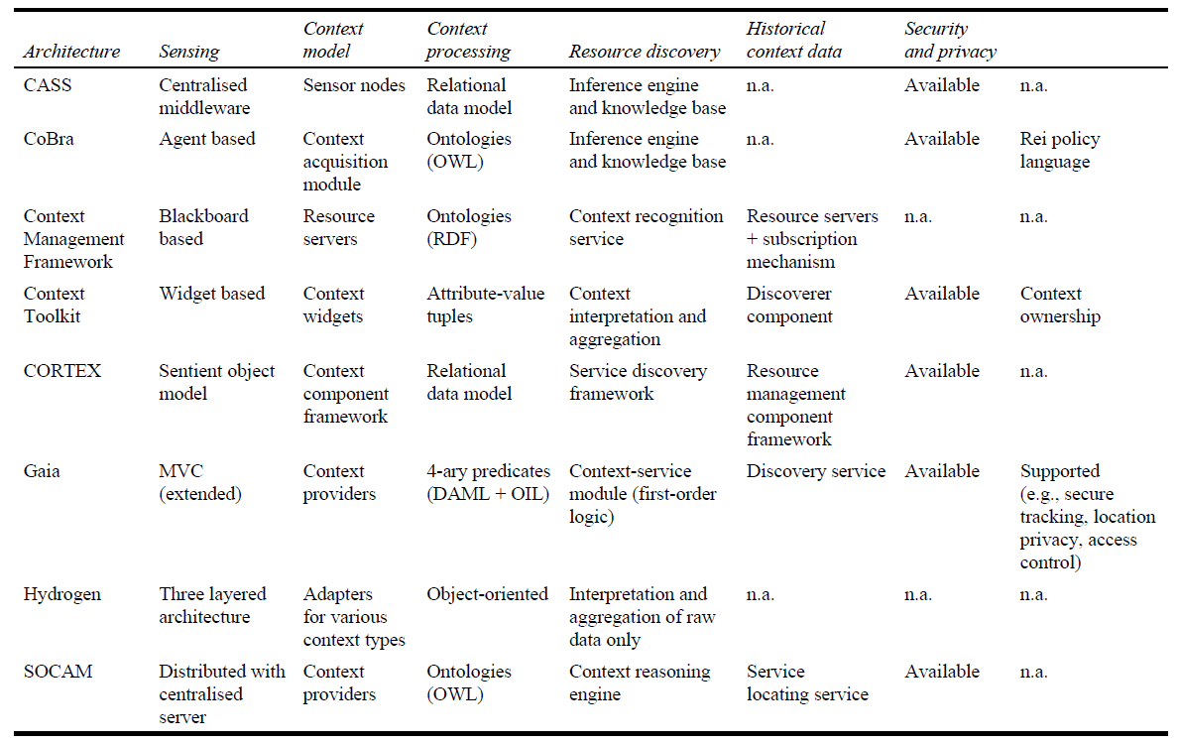
Existent systems and framework
Notes:
We introduce and compare different context-aware frameworks based on various design criteria (resource discovery, sensing, context model, context processing historical context data, security and privacy)

Slide 13
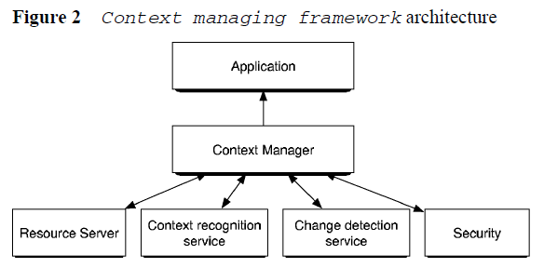
Architecture: Context Managing Framework
Centralized Context Manager
Pros
  Overcome memory and processor constraints of
  small mobile devices
Cons
  One single point of failure
Notes:
The context manager manages a blackboard, it’s different from Resource Server.
Inefficient due to 2-hop communication

Slide 14
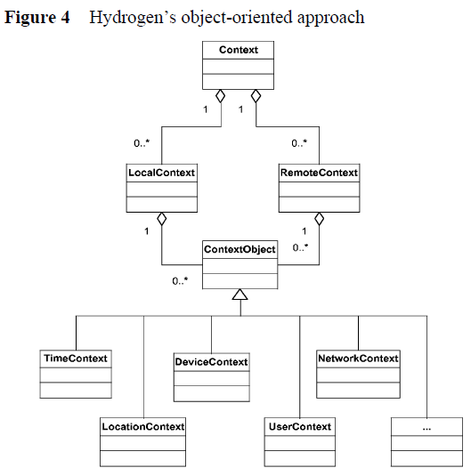
Architecture: Hydrogen
Specializing in mobile devices
  Remote context and local context
Context sharing
  In a peer-to-peer manner
Object-oriented approach
  Superclass Context Object
Notes:
Doesn’t have a centralized component.
The remote context is information another device knows about, the local context is knowledge our own device knows about.
It’s convenient to add new context types by inheritance

Slide 15
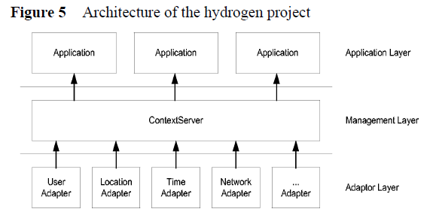
Architecture: Hydrogen (Con’d)
3 layers, all on the same device
Context Server
  Synchronous and asynchronous methods
All inter-layer communication is based on a XML-protocol

Slide 16
Resource Discovery
Discoverer [Context Toolkit]
  A white page lookup (via names)
  A yellow page lookup (via attributes)
Service locating service [SOCAM]
Registry component [Gaia]
Pure p2p context-aware system only uses local built-in sensors [Hydrogen]
Notes:
As sensors in a distributed network may fail or new ones may be added, a discovery mechanism to search for and find appropriate sensors at runtime is important.

Slide 17
Sensing
“The separation of acquisition and use of context”
  Context Widgets [Context Toolkit]
  Sensor nodes [CASS]
  Context providers [SOCAM]
  Resource servers [Context Managing Framework]
  Context acquisition components [CoBrA]

Slide 18
Context Model
Attribute-value-tuples [Context Toolkit]
Object-oriented context model [Hydrogen]
Ontologies [SOCAM, CoBrA, Context Managing Framework]
4-ary predicates [Gaia]
  (<ContextType>, <Subject>, <Relator>, <Object>)
  Used for both representing context and forming inference rules

Slide 19
Context Processing
Context aggregators, context interpreters [Context Toolkit]
Resource servers, context manager, context recognition services [Context Managing Framework]
Context Reasoning Engine [SOCAM]
Inference Engine [CoBrA]
Inference engine and knowledge base [CASS]
Sentient Objects [CORTEX]
Context Service Module [Gaia]
  First order logic: quantification, implication, conjunction, disjunction, and negation
Leave the higher-level abstraction for the applications’ layer [Hydrogen, Owl]
Notes:
Hydrogen only has 3 layers and the context processing function is integrated in the application layer, so is Owl.
Other architectures they all have specific components to do context processing

Slide 20
Historical context data
A centralized high-resource storage component is needed
  Database, SQL [Context Toolkit, CoBrA, CASS, SOCAM, CORTEX, Owl]
  Context Knowledge Base [CoBrA, CASS]
No persistent storage due to limited memory resources [Hydrogen]

Slide 21
Security and Privacy
Context ownership [Context Toolkit]
  Mediated Widgets, Owner Permissions, a modified BaseObject and Authenticators
Role Based Access Control (RBAC) [Owl]
Rei, an own flexible policy language [CoBrA]
Notes:
As we know, context may include sensitive information of people. Their location and their activity, it is necessary to have the certain mechanism to protect privacy.

Slide 22
Thanks!

