Slide 1
An Effective Fuzzy Clustering Algorithm for Web Document Classification: A Case Study in Cultural Content Mining
Nils Murrugarra

Slide 2
Outline
Introduction
Document Vector
Clustering process
Experiment Evaluation
Conclusions

Slide 3
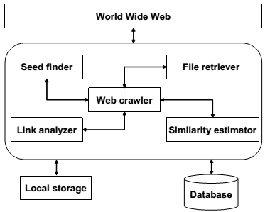
Introduction
  Web Crawler
    Are programs used to discover and download documents from the web.
    Typically they perform a simulated browsing in the web by extracting links from pages, downloading the pointed web resources and repeating the process so many times.
  Focused Crawler
    It starts from a set of given pages and recursively explores the linked web pages. They only explore a small portion of the web using a best-first search
3
1
2
4

Slide 4
Introduction
  Clustering
    Refers to the assignment of a set of elements (documents) into subsets (clusters) so that elements in the same cluster are similar in some sense.
  Purpose
    The article introduces a novel focused crawler that extracts and process cultural data from the web
      First phase: Surf the web
      Second phase: WebPages are separated in different clusters depending on the thematic
        Creation of Multidimensional document vector
        Calculating the distance between the documents
        Group by clusters

Slide 5
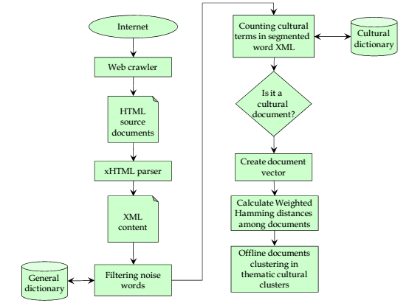
Retrieval of Web Documents and Calculation of Documents Distance Matrix

Slide 6
Document Vector
a b a b a c c d d c c d d c c d d c c
[3a, 2b, 8c, 6d]
[8c, 6d, 3a, 2b]
T = 2
[8c, 6d]

Slide 7

Document Vectors Distance Matrix
  Let’s consider 2 strings S1 = {x1, x2, …, xn} and S2 = {y1, y2, y3, …, yn}, and the distance will be defined as:
  DV1 = [3a, 4b, 2c]
  DV2 = [3a, 4b, 8c]
  DV3 = [a, b, c]
  DV4 = [d, e, f]
  H(DV1, DV2) = |3-3| + |4-4| + |2-8| = 6
  H(DV3, DV4) = |1-0| + |1-0| + |1-0| + |0-1| + |0-1| + |0-1|= 6

Slide 8


Document Vectors Distance Matrix
WH(S1, S2) =
xi є S2 | yi є S1 |  | wi
0 | 0 |  | 1
0 | 1 |  | c
1 | 0 |  | c
1 | 1 |  | c
  DV1 = [3a, 4b, 2c]
  DV2 = [3a, 4b, 8c]
  DV3 = [a, b, c]
  DV4 = [d, e, f]
  H(DV1, DV2) = 0.5 * |3-3| + 0.5 * |4-4| + 0.5 * |8-2| = 3
  H(DV3, DV4) = 1 * |1-0| + 1 * |1-0| + 1 * |1-0| + 1 * |0-1| + 1 * |0-1| + 1 * |0-1|= 6

Slide 9



Clustering Process
  Get the document vectors for all the documents
  Calculate the potential of a i-th document vector
Note: A document vector with a high potential is surrounded by many document vectors.

Slide 10

Clustering Process
  Set n = n +1
  Calculate the maximum potential value.
  Select the document Ds that corresponds to this Z_max
  Remove from X all documents that has a similarity with Ds greater than β and assign them to the n-th cluster
  If X is empty stop, Else go to step 3
Appealing Features
  It’s a very fast procedure and easy to implement
  No random selection of initial clusters
  Select the centroids based on the structure of the data set itself

Slide 11
Clustering Process

Slide 12
Clustering Process
  How to decide the values for α and β ?
    Perform simulations for all possible values (time consuming)
    Approach: set α = 0.5 and calculate the best value for β with a validity index
  Validity Index
    It uses 2 components:
      Compactness measure: The members of each cluster should be as close to each other as possible
      Separation measure: whether the clusters are well-separated ?

Slide 13
Clustering Process
  Compactness
  Separation

Slide 14
Experimental Evaluation
  It was performed in 1000 WebPages
  The categories were:
    Cultural conservation
    Cultural heritage
    Painting
    Sculpture
    Dancing
    Cinematography
    Architecture Museum
    Archaeology
    Folklore
    Music
    Theatre
    Cultural Events
    Audiovisual Arts
    Graphics Design
    Art History

Slide 15
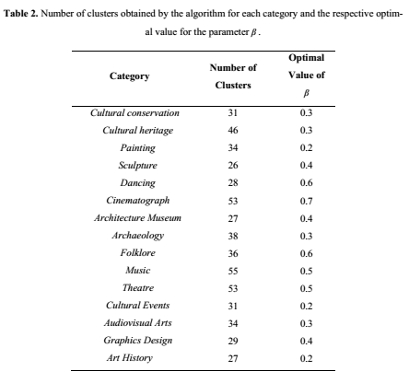
Experimental Evaluation

Slide 16

Experimental Evaluation
Train
Download 1000 WebPages
20% of their content is cultural terms?
Select the 200 most frequent words
Frequency of word w in all documents
Number of documents of the whole collection
For each word
Create clusters
T = 30
Maximum frequency of any word in all documents
Number of documents that includes word w
Centroids
Note: Words that appear in the majority of the documents, they will have less weight

Slide 17
Experimental Evaluation
Test
Download Webpage
20% of their content is cultural terms?
Select the 200 most frequent words
Find the minimum distance for each category
For each word
Get Feature Vector (FV)
T = 30
Centroids
Select the category with minimum distance
Assign Category.

Slide 18
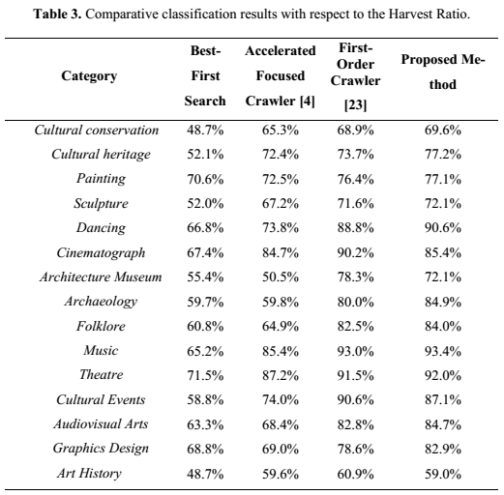
Experimental Evaluation

Slide 19

Conclusions
Conclusions
The authors have shown how cluster analysis could be incorporated in focus web crawling
Future Work
The T parameter should be determined automatically considering the frequency variance of the documents.
They will improve the focus of their crawler (e.g. reinforcement learning and evolutionary adaptation).

Slide 20

Questions

Slide 21
References
D. Gavalas and G. Tsekouras. (2013). An Effective Fuzzy Clustering Algorithm for Web Document Classification: A Case Study in Cultural Content Mining. International Journal of Software Engineering and Knowledge Engineering. Volume 23, Issue 06
G.E. Tsekouras, C.N. Anagnostopoulos, D. Gavalas, D. Economou (2007). Classification of Web Documents using Fuzzy Logic Categorical Data Clustering, Proceedings of the 4th IFIP Conference on Artificial Intelligence Applications and Innovations (AIAI’2007). Volume 247, pages. 93-100.

