Slide 1

Implementation of Ubiquitous Health Care System for Active Measure of Emergencies
Dong-Wook Jang, BokKeum Sun, Sang-Yeon Cho, Sergon Sohn and Kwang-Rok Ham
Ping Lang
pil8@pitt.edu
Notes:
Ubiquitous refers to the circumstance which allows users to be able to have service at anytime in anywhere.

Slide 2
Content
About the paper
  Motivation
  Solution
  Design of Ubiquitous Health Care System
  Experimental Results
  Conclusion
My point of views
Comparison with other papers
Notes:
Content includes 3 parts. The main part is about the paper and the 2nd part is my point of views towards the paper. Last is the comparison with other papers.

Slide 3
Motivation
Rapid development of ubiquitous technology
People are expecting ubiquitous technology to spread to every part of human life
Increasing number of chronic disease, heart disease and other new diseases
Rising death number caused by these diseases while lives can be saved if the emergences are will coped
Notes:
Motivation for the authors to implement the system includes

Slide 4




Solution
This paper implemented a Personal Health Care System (PHCS) based on Ubiquitous Sensor Network (USN)
  Monitors patients’ condition continuously
  Ubiquitous Health Care System (UHCS)
    When emergency happens, sends a text message containing the emergency code and location information to the caregiver and hospital to get prompt first-aid treatment
Notes:
In order to solve problems, this paper implemented a Personal Health Care System based on Ubiquitous Sensor network. To monitor patients’ condition continuously and when emergency happens, sends a text message containing the emergency code and location information to the caregiver and hospital to get prompt first-aid treatment.

Slide 5
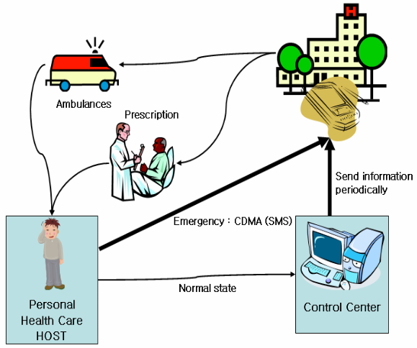
Design of Ubiquitous Health Care System
----System Configuration
The structure of UHCS
Personal Health Care Host
  Measures and analyzes data about the patient
Control Center
  Collects patients’ condition data and stores them
Ubiquitous hospital & Caregiver
  Gets reports on patients’ conditions periodically and takes prompt actions in emergency
Notes:
The paper first introduced a design of the UHCS. As we can see from the picture, the system contains a Personal Health Care Host which measures and analyzes data about the patient. In the normal state, control center collects patients’ condition from the personal health care host, stores them and sends to hospital and caregiver periodically. But when emergency happens, the emergency alert is sent from PHCH to Hospital and caregiver directly through CDMA. Hospital and caregiver takes prompt actions in emergency.

Slide 6
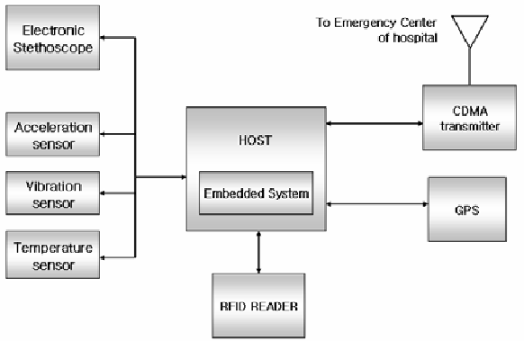
Design of UHCS
----Core part of UHCS: PHCH
Functional diagram of personal health care host
Notes:
The core part of UHCS is the personal health care host. Including the sensor network, an embedded system, rfid module, cdma module and GPS module. Radio-frequency identification (RFID) is the wireless non-contact use of radio-frequency electromagnetic fields to transfer data, for the purposes of automatically identifying and tracking tags attached to objects. The tags contain electronically stored information.

Slide 7
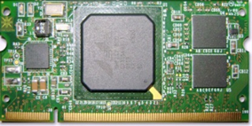
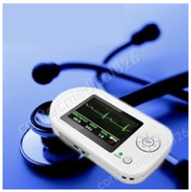
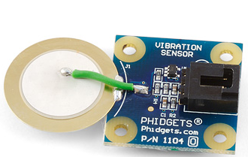

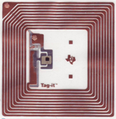
Design of UHCS
----Core part of UHCS: PHCH
PHCH is built as an embedded system using Intel Xscale CPU
  It receives data from each module and sends data to Control Center
Electronic stethoscope module
  Records and processes patients’ heart sound and bowel sound using an electronic stethoscope
Wireless sensors
  Monitors patient condition using USN such as accelerometers and vibration sensors
Position tracking module (GPS)
  Collects patient location information
Communication Module (CDMA)
  Send GPS information and patients’ emergency information to hospital and caregivers
  RFID
  Stores and manages patients’ basic information in a RFID tag
Notes:
PHCH is built as a embedded system using Intel Xscale CPU. It receives data from the sensor module, the CDMA module, the GPS module, and the RFID reader. It analyzes data from wireless sensors, and processes the signals of the patient’s heart sound, pulmonary sound and bowel sound received from the electronic stethoscope. The patient’s basic information necessary for analysis is obtained from data stored in the RFID tag. If an emergency is detected from the sensors and the electronic stethoscope, the host sends the hospital and the caregiver a text message containing the emergency code and location information from the GPS module using the CDMA module and, at the same time, it sends information on the patient’s condition to the Control Center. Even if not emergency, report on the patient’s condition is made periodically to the Control Center.

Slide 8
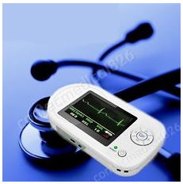
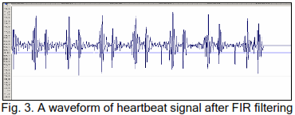
Design of UHCS
---- Implementation of Electronic stethoscope Module
Electronic stethoscope is connected to PHCH by USB interface and the signal is amplified over 15 times by using operational amplifier
Noises are removed using a FIR filter
Notes:
I will briefly introduce every module. First, he electronic stethoscope module. Electronic stethoscope is connected to PHCH by USB interface and the signal is amplified over 15 times by using operational amplifier. Noises are removed using a FIR filter. The picture is the a waveform of heartbeat signal.

Slide 9
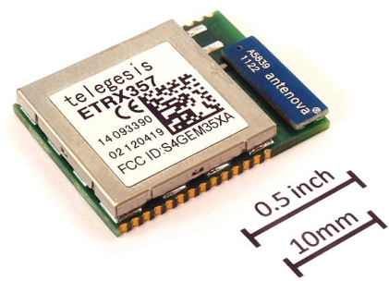
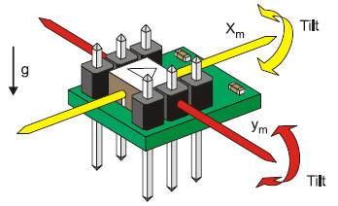
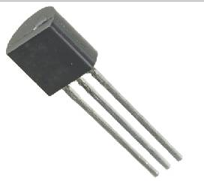
Design of UHCS
----Implementation of Patient state monitoring module
Patient state monitoring module analyzes data obtained from the sensor network including vibration sensor, acceleration/inclination sensor and temperature sensor
USN and PHCH communicate with each other through Zigbee
The module detects emergency based on received data
Vibration sensor
Acceleration sensor
Temperature sensor
Zigbee module
Notes:
ZigBee is widely used in applications that require a low data rate, long battery life, and secure networking. ZigBee has a defined rate of 250 kbit/s, best suited for periodic or intermittent data or a single signal transmission from a sensor or input device.
ZigBee is a specification for a suite of high level communication protocols used to create personal area networks built from small, low-power digital radios.

Slide 10
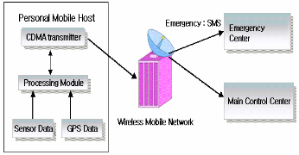
Design of UHCS
----Implementation Communication module
Communication routes for emergency test messages in ubiquitous environment
In emergency, PHCH connects to the data line of a telecommunication carrier through CDMA and sends a text message to the designated hospital.
Notes:
In emergency, PHCH connects to the data line of a telecommunication carrier through CDMA and sends a text message to the designated hospital.

Slide 11
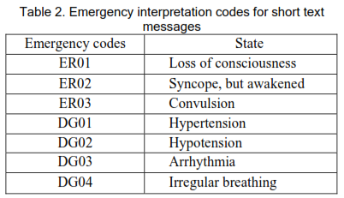
Design of UHCS
----Emergency codes
Due to the short text message limitation, some interpretation codes are proposed to indicate specific situation of the patients.
Notes:
Due to the short text message limitation, some interpretation codes are proposed to indicate specific situation of the patients.

Slide 12
Design of UHCS
----Control Center and Emergency Center of Hospital
CC stores data of the patients sent from PHCH. Emergency center of hospital receives the text messages, decodes the emergency interpretation codes and informs people to take prompt actions.

Slide 13
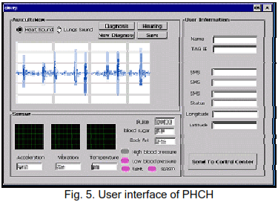
Experimental Results for Ubiquitous e-Health System
----Emergency Monitoring

Slide 14
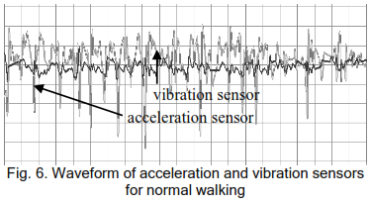
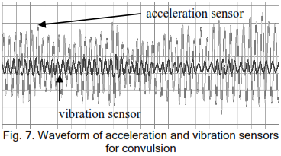
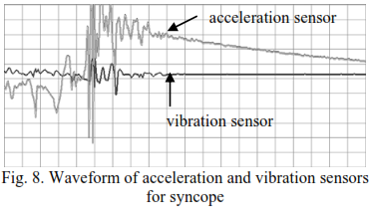
Experimental Results for Ubiquitous e-Health System
----Emergency Monitoring
Waveform of acceleration and vibration sensors for normal walking
Waveform of acceleration and vibration sensors for convulsion
Waveform of acceleration and vibration sensors for syncope
Notes:
The three waveform pictures show the difference between normal walking, convulsion and syncope. We can easily understand when convulsion happens, the waveform amplitude of acceleration sensor and vibration sensor increases. When syncope happens the both of them turns to be steady.

Slide 15
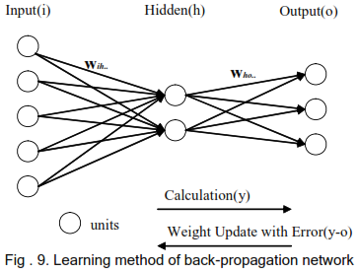
Experimental Results for Ubiquitous e-Health System
----Emergency Detection Based on Sensor Data
Back-propagation Network Learning
Notes:
This study used the back-propagation network model in order to detect emergent situations using input data on patients’ state from USN sensors

Slide 16
Back-propagation Network Learning
Two Key points of the model: 1. Sufficient input data 2. Training times
More units can pass more information
Calculated output
- = e
The more input units the more sufficient input data
Desired output
Reference: Beiye Liu Miao Hu ; Hai Li ; Zhi-Hong Mao ”Digital-assisted noise-eliminating training for memristor crossbar-based analog neuromorphic computing engine” Design Automation Conference (DAC), 2013 50th ACM / EDAC / IEEE
Notes:
If the hidden layers are given a sufficient number of units, the back-propagation network model can learn for a continuous function model. As in Figure 9, output(y) is produced if the weight of neural network are multiplied by and added to input (i). Here, output(y) is different from desired output(o) given in learning data. There is an error e (y-o) in the neural network, and the weight of the output layer is updated in proportion to the error and then the weight of the hidden layer is updated. The direction of weight update is the opposite of the direction of neural network processing. This learning process is repeated until error e reaches the adequate level.

Slide 17
Experimental Results for Ubiquitous e-Health System
----Emergency Detection Based on Sensor Data
Back-propagation Network Learning
Assuming sufficient number of units, the model can learn for a continuous function model
Calculated output
- = e
Patients’ state received from USN sensors
Desired output
Notes:
In this paper, the input is the patients’ state received from usn sensors. Outputs are different situations.

Slide 18
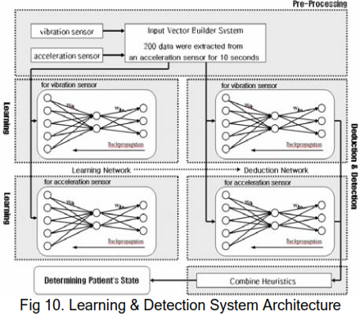

Experimental Results for Ubiquitous e-Health System
----Emergency Detection Based on Sensor Data
Learning & Detection System Architecture
The parameter values of back-propagation network
Notes:
In order to create the input vector of the back-propagation network, 200 data were extracted from an acceleration sensor for 10 seconds, and were divided at one-second time intervals. Another input vector was also prepared with data from a vibration sensor in the same.
For the learning of the back-propagation network, the paper collected 100 data for each of the three and trained the network with the data. An input vector from a sensor was designed to have 200 input nodes and to use one of three output nodes. The three output nodes mean normal situation, syncope situation and convulsion situation, respectively. AS in Table 3, the number of hidden layers in the learning network and the values of the internal parameters were set at experientially optimal values.

Slide 19
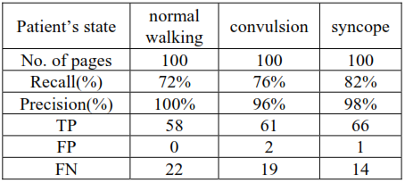
Experimental Results for Ubiquitous e-Health System
----Emergency Detection Based on Sensor Data
Evaluations
The recall ratio is not very high
The precision is not 100% accuracy
More optimized internal parameters through additional experiments are needed
* Statistical measurement methods are introduced on next slide
Notes:
To evaluate the results, the paper measured recall and precision. I’ll introduce a little bit about the statistical measurement methods in case some people don’t know it already.

Slide 20
Sensitivity and specificity
Sensitivity and specificity are statistical measures of the performance of a binary classification test, also known in statistics as classification function.
Sensitivity (also called the true positive rate, or the recall rate in some fields) measures the proportion of actual positives which are correctly identified as such
Specificity measures the proportion of negatives which are correctly identified as such
For example: A study evaluating a new test that screens people for a disease. Each person taking the test either has or does not have the disease. The test outcome can be positive (predicting that the person has the disease) or negative (predicting that the person does not have the disease).
True positive: Sick people correctly diagnosed as sick
False positive: Healthy people incorrectly identified as sick
True negative: Healthy people correctly identified as healthy
False negative: Sick people incorrectly identified as healthy
Reference: http://en.wikipedia.org/wiki/Sensitivity_and_specificity
H. Witten and E Framk, "Data Mining: Practical Machine Learning Tools and Techniques with Java Implementations", Morgan Kaufmann Publishers, 1999.

Slide 21
Experimental Results for Ubiquitous e-Health System
----Emergency Detection Based on Sensor Data
Evaluations
True Positive: Emergency happens and detected
False Positive: No emergency happens but fake emergency detected
False Negative: Emergencies happens but detected as no emergency
The recall ratio is low
The precision is not 100% accuracy
More optimized internal parameters through additional experiments are needed

Slide 22
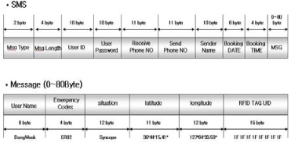
Experimental Results for Ubiquitous e-Health System
----Communication Protocol
Text messages are sent to the emergency center via the wireless mobile network using CDMA air interface
Messages includes GPS information of the PHCH which is carried by the patients
Communication protocol between CDMA communication module in PHCH and emergency center in hospital
Notes:
When emergency is detected, the emergency information together with location information is sent via the wireless mobile network using CDMA to hospital.

Slide 23
Conclusion
The paper present a study discussed a ubiquitous health care system using USN, GPS, CDMA and RFID modules
With the system, a hospital can diagnose patients’ condition remotely by using and electronic stethoscope and transmitting patients’ heart, chest and bowel sound.
Using USN, the system can detect chronic disease patients’ emergencies such as syncope and convulsion.
Experimental results are delivered.

Slide 24

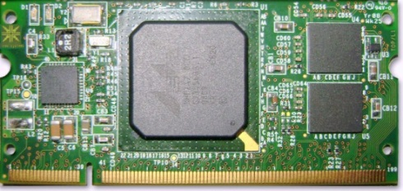
My point of view
Superiorities of this paper:
  Using Back-propagation Network Learning to detect the emergency situation is more accurate and scientific
  Using vibration sensor to detect convulsions is creative
  Using both acceleration sensor and vibration sensor enhanced the accuracy
Weakness
  Power consumption about the Personal Health Care Host (carried by the patients) is not mentioned
  USB connection between the embedded system and E-stethoscope is not very practical
  The emergency codes are totally not useful or helpful
  The accuracy about the false positive (test cases are not well covered)
Power consumption
Gild the lily
Not convenient
Accuracy

Slide 25
Experimental Results for Ubiquitous e-Health System
----Emergency Monitoring
Waveform of acceleration and vibration sensors for normal walking
Waveform of acceleration and vibration sensors for convulsion
Waveform of acceleration and vibration sensors for syncope

Slide 26
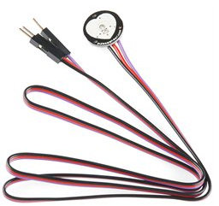
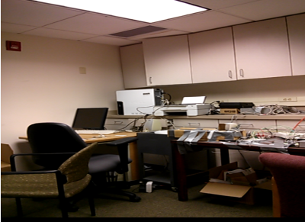
Comparison with other papers
Good ideas from other paper:
  Using an independent host to collect data from sensors and do the emergency detection to solve the power consumption problem
  Using heart-rate sensor rather than electronic stethoscope to be more convenient for patients to wear
  Using both outdoor and indoor location to get the position of a patient
  Add more sensors (gravity vector & magnetic field vector)to detect more emergency situations, eg. fall-down issue
  Having a camera in the system to have detailed info about the emergency situation
  Using wifi to transfer data when wifi signal is detected
Y
X
Z
Y
Normal condition
Y
X
X
Y
Z
Z
Z
X
Fall condition I
Fall condition II
Fall condition III

Slide 27
Reference
http://en.wikipedia.org/wiki/Sensitivity_and_specificity
H. Witten and E Framk, "Data Mining: Practical Machine Learning Tools and Techniques with Java Implementations", Morgan Kaufmann Publishers, 1999.
Beiye Liu; Miao Hu ; Hai Li ; Zhi-Hong Mao “Digital-assisted noise-eliminating training for memristor crossbar-based analog neuromorphic computing engine” Design Automation Conference (DAC), 2013 50th ACM / EDAC / IEEE
Baiyi Chen; Chengliu Li; Zhi-Hong Mao “Designing a wearable computer for lifestyle evaluation” Bioengineering Conference (NEBEC), 2012 38th Annual Northeast
Ryu Gyeong-sang, “Development Trend and Prospect of Ubiquitous Society,” Ubiquitous Research Series No. 1, National Information Society Agency, p3, 2006

