Slide 1
KnowWE: a Semantic Wiki for Knowledge Engineering
Joachim Baumeister, Jochen Reutelshoefer, Frank Puppe
University of Würzburg, Institute of Computer Science
Presented by Guy Gadola

Slide 2
Outline
Introduction
Two Dilemmas of Knowledge Engineering
Lightening the Two Dilemmas via KnowWE
KnowWE’s Workflow and Architecture
Knowledge Acquisition
Conclusion

Slide 3
Intelligent Decision-Support Systems
Examples
  “A Diagnostic Expert System for Structured Reports, Quality Assessment, and Training of Residents in Sonography”
  “Travel Medicine and Infectious Disease”
  “SmartCare™ -Automated Clinical Guidelines in Critical Care”
Critical Challenge:
  Development and
  Maintenance of the knowledge bases

Slide 4
Challenge Previously Met via Comprehensive Methodologies and Corresponding Tools
  Methodologies
  CommonKADS
  The On-To-Knowledge Methodology
  DILIGENT
  The Agile Methodology
  Tools
  OntoEdit
  Protégé
  KnowME
These tools limit the developer to a specific knowledge representation.
Notes:
Specific knowledge representations include: technical documents, construction plans, sheets, and experiences
of human experts, and also rules and models

Slide 5
Two Dilemmas of Knowledge Engineering
  The Flexibility/Productivity Dilemma
  Current state–of–the–art tools are often tailored to a specific knowledge representation
  Thus, these tools are not sufficiently flexible to map the mental model of the domain specialists
  But, if the tool is very flexible, it is difficult to use
  The Single/Multiple Experts Dilemma
  The motivation and sophistication of a single domain specialist is often driving force of success
  But, his or her availability is often limited
  Multiple experts can share the load, but can decrease the overall quality of the formalized knowledge
  Distributed collaboration is often not sufficiently supported

Slide 6
How to Lighten The Two Dilemmas
  Certainly, these dilemmas cannot be easily solved, but can be lightened by the introduction of
  agile and
  extensible
  tools that adapt to the present situation.
  One such tool is the Semantic Wiki KnowWE, a knowledge engineering environment for decision-support systems.
Notes:
The key feature of a wiki is its ability to change and refine content in a fairly simple way: Every wiki article is presented in a web browser in the corresponding view mode. The user can easily modify/extend the content of the article by changing into the edit mode of the article
Being Web-based weakens the single/multiple experts dilemma because the Web lends itself to distributed work
It tries to weaken the flexibility/productivity dilemma because it allows for the integration of knowledge at different levels of formality
To the knowledge of the authors, KnowWE is the first implementation of a Se-mantic Wiki that integrates strong problem-solving knowledge into the wiki context.
The wiki is extended by the possibility to capture and share strong problem-solving methods for the classification task. Thus, it not only provides interfaces for the engineering of ontologies, but also interfaces for more expressive knowledge such as rules and fault models.

Slide 7
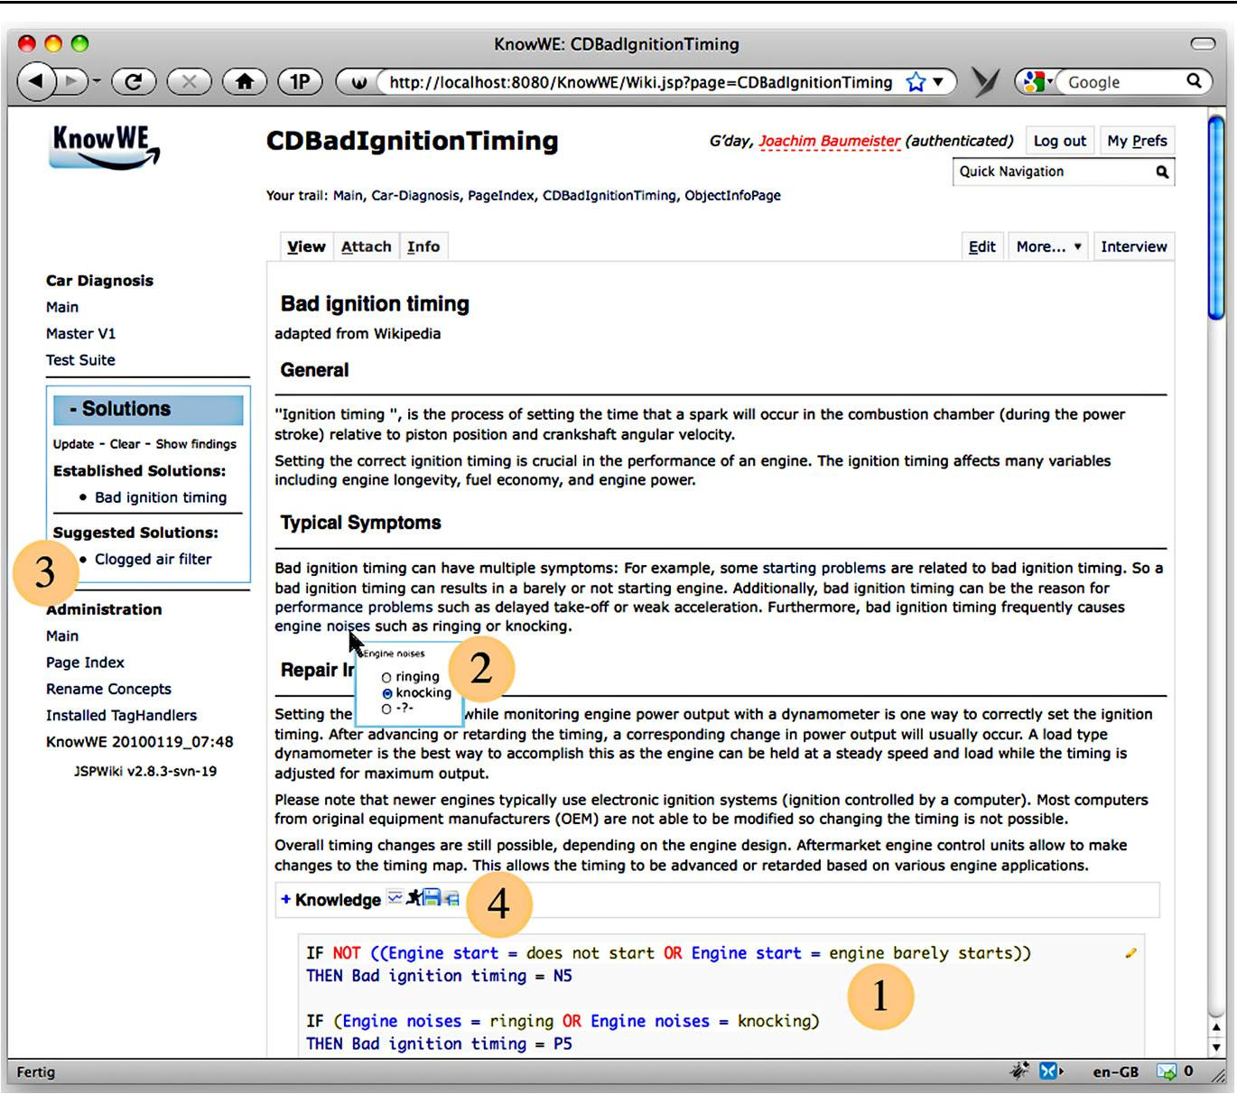
Notes:
Example
1. At (1), two heuristic rules of the rule base are displayed that describe derivation knowledge of the solution.
2. In (2), we see an example of what the authors call inline answers for problem-solving in wikis. In (2) the text phrase “engine noises” was annotated by the corresponding concept Engine noises available in the knowledge base. (Note that the user selected “knocking.” As we explain in the following sections, the reasoning process of KnowWE enables that all registered knowledge bases contained in the wiki are notified about this new finding and suitable states of the solutions are derived.)
3. In the solutions pane of the wiki—see (3)—we see that the solution Bad ignition timing is derived with a high certainty, whereas the alternative solution Clogged air filter was also derived and is considered as a possible solution. Both solutions were derived on the basis of this finding and previously entered findings.
4. Alternatively, the user is able to download an executable version of the knowledge base by clicking the download but-ton, see (4). Then, the knowledge base of the article is provided as download in the d3web format. The system d3web is a freely available runtime reasoning engine.

Slide 8
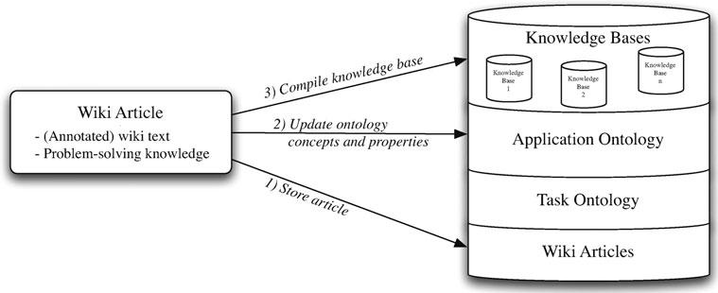
Transformation of Wiki Articles to Knowledge Bases: Workflow
Notes:
When saving the currently edited article, the content is saved as a standard wiki page
Semantic annotations— included in the text—are identified and the domain ontology is updated accordingly.
Additionally, dedicated parsers process the problem-solving knowledge found in the text into an executable knowledge base.
The foundational layer of all represented knowledge is the Task Ontology. It is used to connect the described concepts and the problem-solving knowledge elements. The functioning of the task ontology is described in the next section.
Note: Knowledge is stored redundantly in all formats that are required by the particular reasoners (e.g., the authors use OWLIM for OWL reasoning and the d3web engine for processing the problem-solving knowledge).

Slide 9
The Task Ontology
  The task ontology of KnowWE is the foundation of the system because it represents the general entities of all applications built with the system.
  For example, it includes the definitions of findings and solutions that are the basic elements of a problem-solving task, i.e., findings are used to derive particular solutions.

Slide 10
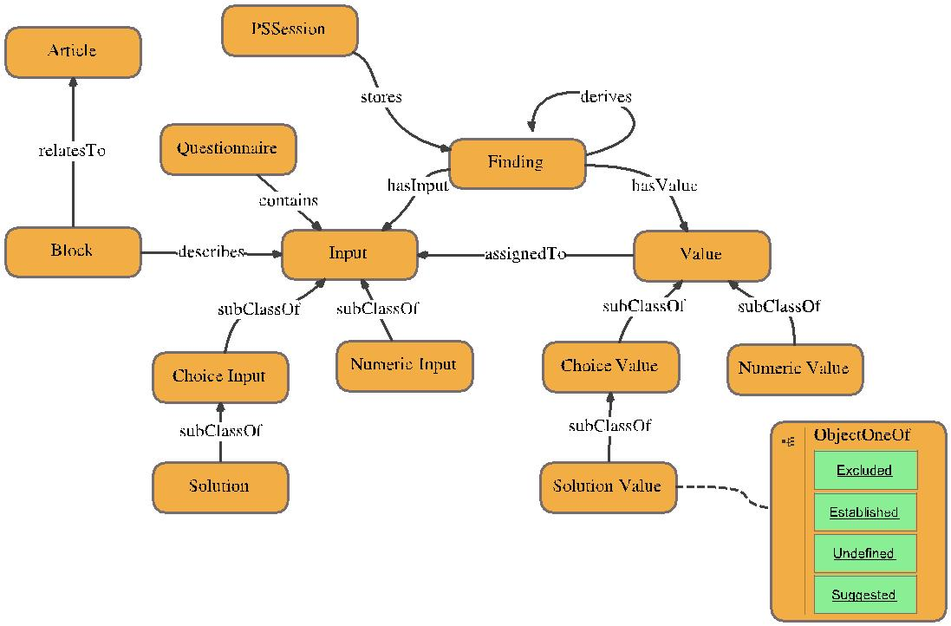
The Task Ontology: Integrating problem-solving knowledge into a Semantic Wiki
Concepts of the task ontology are depicted in rounded rectangles, whereas instances are given by non-rounded rectangles (green)
Notes:
This figure shows the most important concepts of the task ontology: the key concept Finding holds a Value, that is assigned to an Input. Different inputs are structured into meaningful groups by the concept Questionnaire.
Choice Input and Numeric Input define attributes with discrete (named) values and numerical value ranges, respectively. An appropriate class of values for every input is defined by subclassing the concept Value, accordingly.
The state of a solution is represented by a discrete finite value domain (Solution Value ); its current value is not entered by the user but derived by problem-solving knowledge. The value range of a solution is restricted to one of the individuals Established, Suggested, Un-defined, and Excluded.
For a new knowledge engineering project the domain specialist defines the basic concepts (findings and solutions)

Slide 11
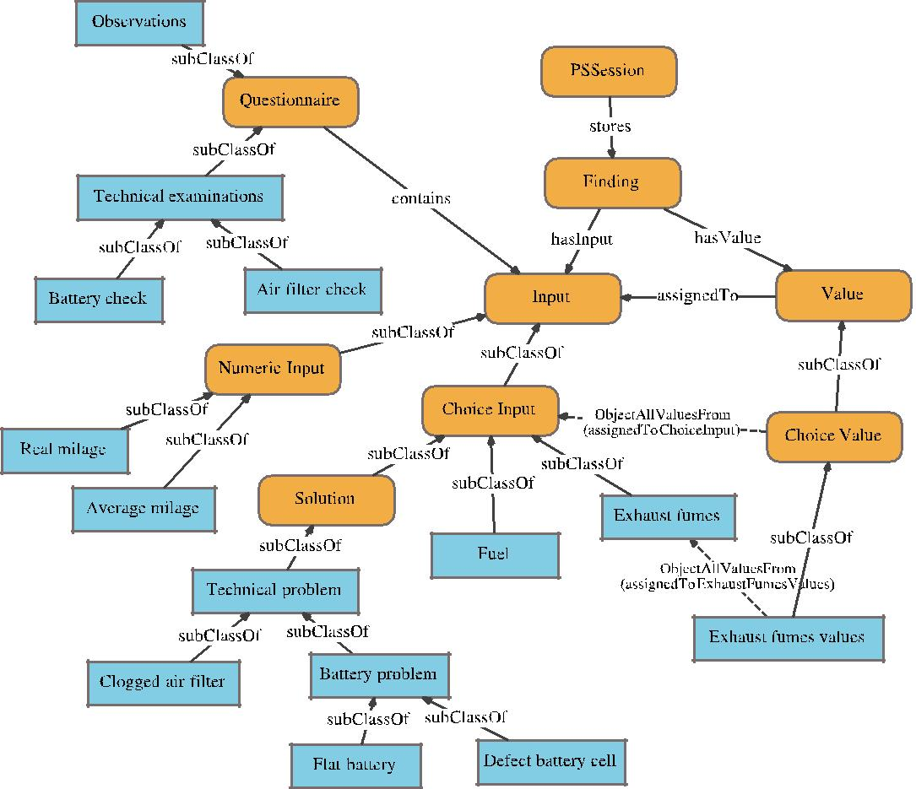
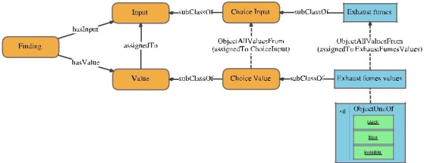
Connecting the Application Ontology with the Task Ontology by Subclassing
Notes:
For a new knowledge engineering project the domain specialist defines the basic concepts (findings and solutions)

Slide 12

Subclassing the Concept Exhaust fumes in the Application Ontology
Notes:
Detail

Slide 13
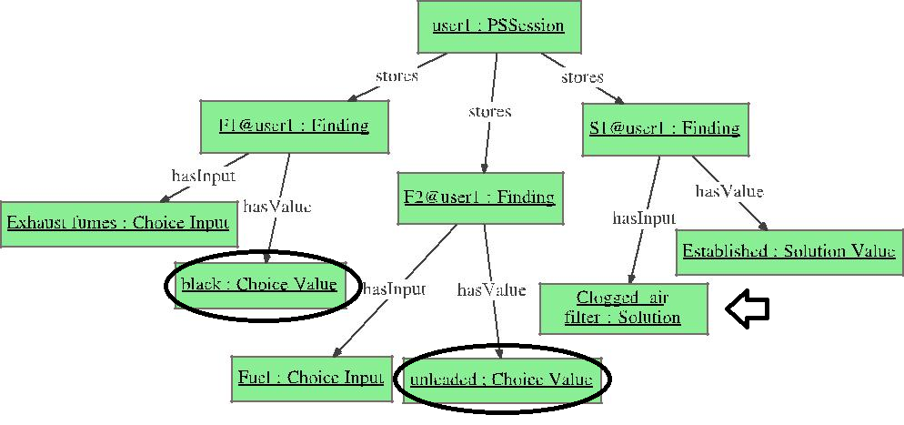
Problem-Solving Session
Notes:
For this problem-solving session, the user inputs two findings: the exhaust color=black and the fuel type=unleaded. The system establishes the solution to the problem of what is wrong (Clogged air filter=established).
Currently, the system mostly utilizes external reasoners (rule engines, model-based systems, etc.) to derive solutions

Slide 14
KnowWE’s Intertwining of Task and Application Ontologies: Pro and Con
  Pro: Requires less effort than approaches that use a separate mapping ontology between a method ontology and a domain ontology; The authors’ approach automatically aligns the concepts
  Con: Limits the knowledge acquisition to diagnostic reasoning

Slide 15
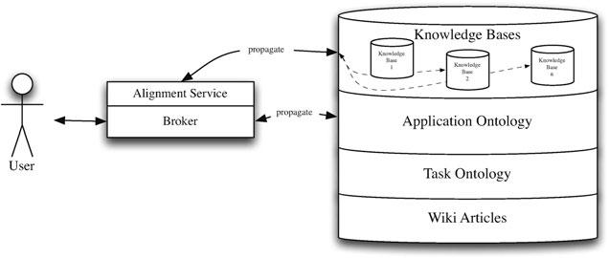
How New Facts Are Derived by Problem-Solving Knowledge
For example, the instance Exhaust fumes = black is mapped to the corresponding knowledge base object Exhaust fumes that has the possible value black. Based on this alignment the new fact is propagated to all registered knowledge bases.
Notes:
Some knowledge bases are able to use this fact to derive new facts, that are again propagated to the broker for further distribution.

Slide 16
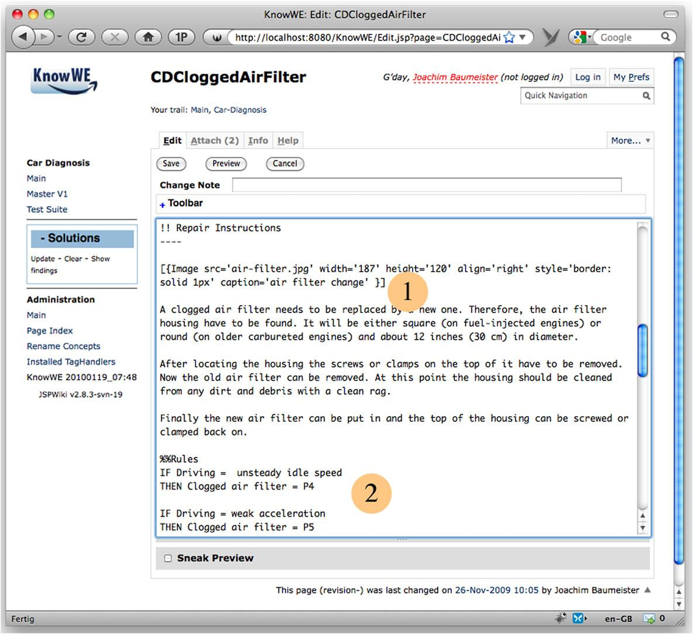
Knowledge Acquisition with Textual Markups
Notes:
For an effective use, the authors propose to seamlessly integrate the acquisition of problem-solving knowledge into the standard authoring process of the wiki. For this reason, the authors embed the knowledge formalization into the edit pane of the wiki article, i.e., specialized textual markup is used to enter explicit knowledge inline with the wiki text.
Besides standard wiki markup for defining the content of text and images (see (1)), also a rule base for deriving the solution Clogged air filter is included, see (2).
It is possible to structure the wiki by solutions, i.e., each solution or group of related solutions defines a distinct wiki article. The authors also recommend including the corresponding problem-solving knowledge in the articles.
The definition of the terminology is an exceptional case; here, we propose to define the possible inputs and their structure on a page, that is different from the pages describing its solution’s derivation knowledge. That way, every article of a new solu-tion can reuse the terminology for describing the problem-solving knowledge.

Slide 17
How to Define the Application Ontology
Create a dash-tree in the wiki within the edit pane of the wiki
Observations - Fuel [oc] -- unleaded -- diesel - Exhaust fumes [oc] -- black -- blue -- invisible | Technical problem - Clogged air filter - Battery problem -- Flat battery -- Defect battery cell
- Current fuel consumption [num] - Average fuel consumption [num]
Notes:
The authors provide two hierarchies to define the elementary facts of the diagnostic task: (User) inputs and solutions. Both hierarchies are defined by so-called dash-trees.
The marker [oc] denotes, that this input is defined as a Choice Input, i.e., an input with a discrete value range, where only one value can hold at a time. Current fuel consumption and Average fuel consumption are defined as Numerical Input by the marker [num].
The right side of the markup example shows the defini-tion of the solution taxonomy. With Technical problem as the root solution, we define is-a relations to other solutions by dashes.
We see, that the dashes have different semantics for the input trees and the solutions trees; they represent the most common organization property for each hierarchy (contains vs. subClassOf).
The terminology of inputs and solutions can be defined anywhere in the wiki article, but both trees have to be wrapped by the tag %% Questions ...% and %%Solutions ...%, respectively, so that the system can identify the explicit terminology definitions.

Slide 18
How to Define Problem-Solving Knowledge (1)
Add annotations inline.
[Bad ignition timing is a technical problem <=> subClassOf:: TechnicalProblem] that can be solved... !! Typical Symptoms Bad ignition timing can have multiple symptoms: For example, ... or weak acceleration. Furthermore, bad ignition timing frequently causes [engine noises <=> asks:: Engine noises], such as ringing or knocking.
Notes:
Ontological concepts can be simply linked by the definition of ontological properties. The annotation itself states that the annotated text phrase documents/justifies the given relation.
(All annotations are represented in the application ontology and can be queried using a SPARQL endpoint. SPARQL queries are em-bedded into the wiki text, and the results of the queries are shown in the view mode of the article.)
In the second-last line, we see that the text phrase “engine noises” is annotated by the property asks with the concept Engine noises as value. This annotation yields the pop-up menu shown in Fig. 1, where the user can enter a new finding instance related to the concept Engine noises.

Slide 19
How to Define Problem-Solving Knowledge (2)
KnowWE provides a specialized markup for the definition of rule-based knowledge. Rules are certainly the most popular knowledge representation for building knowledge bases. A rule
r = r.c ⇒ r.a
derives facts as defined in its consequent (rule action) r.a, if the specified rule condition r.c is satisfied.
// Abstraction rule r1: // Fuel consumption in percent to usual consumption IF Average fuel consumption > 0 AND Current fuel consumption > 0 THEN Fuel Evaluation = (Current fuel consumption / Average fuel consumption) * 100.0 // Scoring rule r2 // For an increased fuel consumption we increase the // possibility of a clogged air filter. IF Fuel Evaluation > 140 THEN Clogged air filter = P4
Notes:
KnowWE provides a specialized markup for the definition of rule-based knowledge. Rules are certainly the most popular knowledge representation for building knowledge bases.
For the sake of simplicity, we distinguish two basic types of rules, that can be used in the wiki:
abstraction rules for deriving new instances of findings, and
scoring rules for deriving a new state of a solution in-stance.

Slide 20
Conclusion
The authors identified two knowledge engineering dilemmas:
The single/multiple domain specialists dilemma and
the flexibility/productivity dilemma.
The paper claims that a flexible Semantic Wiki tailored to knowledge engineering tasks can help to relax these dilemmas.
The paper introduces the Semantic Wiki KnowWE, which provides the possibility to represent and use strong problem-solving knowledge for classification tasks.
The authors show how classification knowledge is integrated into the semantic layer of the wiki and described the combined reasoning process of the ontology with the problem-solving knowledge.
Notes:
KnowWE provides a specialized markup for the definition of rule-based knowledge. Rules are certainly the most popular knowledge representation for building knowledge bases.
For the sake of simplicity, we distinguish two basic types of rules, that can be used in the wiki:
abstraction rules for deriving new instances of findings, and
scoring rules for deriving a new state of a solution in-stance.

Slide 21
Acknowledgement and Reference
Thanks go to Wen Gao for switching presentation dates
Baumeister, Joachim, Jochen Reutelshoefer, and Frank Puppe. "KnowWE: a Semantic Wiki for knowledge engineering." Applied Intelligence 35.3 (2011): 323-344.

