Slide 1
International Services and Tools for Content, Metadata and IPR Management
Wen Gao
Department of Computer Science
10/24/2013

Slide 2
Outline
Introduction
Related work
ECLAP Architecture and Workflow
IPR Model and Wizard
Result of Trial Use
Conclusion
References

Slide 3
1. Introduction
Background
Most digital libraries and museum services become rapidly obsolete and were constrained to rapidly change.
Integrated multimedia back office is urgently required for the online digital libraries and cultural heritage institutions such as ACM, and IEEE.
Content aggregators have to cope with the complexity of heterogeneous sources. Clearance and formalization of intellectual property issues need to be solved.

Slide 4
1. Introduction
Contribution of the article
The identification of the Content Aggregator requirements and needs, and thus the definition and realization of a distributed architecture and workflow solution satisfying them.
The formalization of intellectual property rights (IPR), modeling and management for shortening the activities of IPR resolution and avoiding the assignment of conflicting right/permissions.

Slide 5
2. Related work
Automation of Content Management and Workflow for Content Aggregators
AXCP provides an integrated approach to perform both content management and semantic computing [Bellini et al., 20011]
MmGrid supports interactive applications with graphics, rendering, streaming, and tele-immersion [Basu et al., 2003].
GridCast is a service-oriented architecture for broadcasting media via IP [Harmer etal., 2005].
etc.
Some important aspects such as text processing, semantic computing have not been considered
Limitation

Slide 6
2. Related work
IPR Management and Conditional Access for Cultural Heritage Content
Right clearance: identification of the rights that effectively owned by the distributors and content provider.
Formalization of the right profile: the right profiles for a given content on the web service and archives have to be defined.
Right enforcement: formalization of (2), specific technological protection solutions are used.
Far from defining the whole rules to be applied to a content.
The complexity of technological protection solutions is increased.
Limitation

Slide 7
3. ECLAP Architecture and Workflow
General Requirement
Ingest: acquire both metadata and content files, link them together, collect them on a storage and ingest IPR information.
Manual content enrichment: allow skilled personnel to perform it, such as metadata language translation and validation. Thus there is need to grant different authorizations to various users.
Automated activities: estimation of technical parameters, extraction of content descriptors, indexing, automated tranlations, etc.
Back office: cope with large amount of transactions on metadata information and activities in the back office per day.
Harmonization of the activities of human and automated processing.
IPR model formalization, assignment and verification.

Slide 8
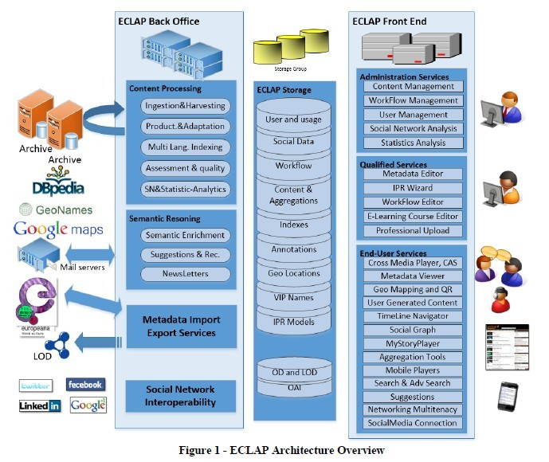
3. ECLAP Architecture and Workflow
ECLAP Architecture Overview

Slide 9
3. ECLAP Architecture and Workflow
ECLAP Architecture – Three main layers
ECLAP Back office.
Distributed storage shared with the several servers and processes.
Content Processing: ingestion & harvesting, production and adaptation, multilingual indexing, quality assessment.
Semantic Reasoning: semantic enrichment allows enriching the metadata by using natural language processing algorithms; computing similarities among users and content.
Metadata Import Export services
Social Network Interoperability

Slide 10
3. ECLAP Architecture and Workflow
ECLAP Architecture – Three main layers
(3) ECLAP Front End
The administration Services: management of content, users, workflow, social network, statistics and metric analysis rendering tools.
The Qualified Services: a set of tools at displosal of qualified personnel, such as the group administrators and the trusted users.
The End-User Services: provide support of final users’ activities on web and mobile.
User Generated Content: provides a service to the final users which intend to upload content on the portal. This service is connected to the back office ingestion service.

Slide 11
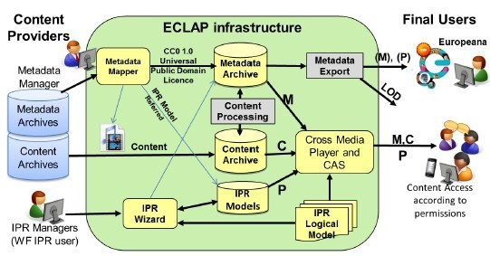
4. IPR Model and Wizard
ECLAP Infrastructure
  The IPR managers use the IPR Wizard to formalize the IPR Models (which allows defining the permissions and restrictions, and the coherent identification of the Europeana.rights)

Slide 12
4. IPR Model and Wizard
ECLAP Infrastructure
IPR Models Definition
Europeana.rights vs. Permissions and Restrictions
Two groups:
>Publicly accessible content
>content access with some restrictions
Classification of Users vs. Permissions
Permissions are associated with a specific group of users.
The main categories are: Trusted users, CPGroup members, Public.
Relationships among right permissions and users’ kinds.
IPR Logical Model: relations among user kinds; relations among permissions.

Slide 13
5. Trial Use Report
Statistics
It is currently in use by 31 institutions
29 workflow qualified users.(24 enrichers, 6 validators, 23 IPR users and 9 publishers).
By 2013 April, 1,036,406 workflow transitions have been handled for 173,562 content items with an average of 6 transitions per content and maximum 139 transitions for a single content.

Slide 14
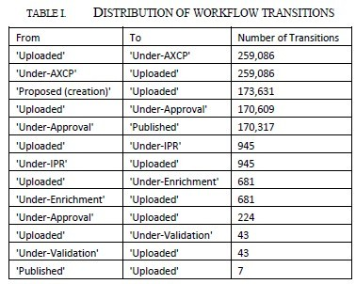
5. Trial Use Report
IPR Wizard has been much more used than the metadata editing tool!
Back-office services: content and MetaData ingestion
Back-Office Services: MetaData analysis for assessment or automated translation
Back-Office Services: Metadata validation every time content passed the metadata analysis.
Back-Office Services: Content Publication: Under-approval to Published state
Front-office tools: 681 for enrichment and 43 for validation

Slide 15
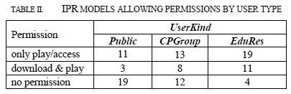
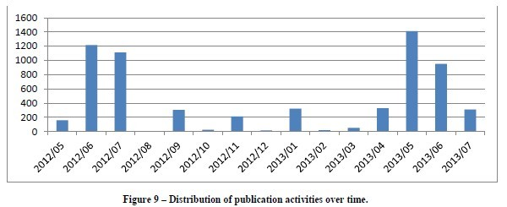
5. Trial Use Report
The table shows for three user types, how many IPR Models allow only play/access of the digital resources or allow the download and play of it or no permission are provided.

Slide 16
6. Conclusion
Discussed the requirements, design and validation of ECLAP, thus a specific Workflow Model for content aggregation and enrichment management is needed to integrate both human and automated back office activities for semantic computing.
Formalization of IPR Model and solution that allow shortening the activities of IPR resolution and avoiding the assignment of conflicting rights/permissions.
Finally, the usage analysis puts in evidence the whole activities of ECLAP on content, metadata and IPR until July 2013.

Slide 17
7. References
1. Pierfrancesco Bellini, Ivan Bruno, Paolo Nesi, Michela Paolucci. “Institutional Services and Tools for Content, Metadata and IPR Management”.
2. Antonietta Spedalieri, Albert Sinfreu, Giuseppe Sisto, Pablo Cesar, Ishan Vaishnavi, Dario Melpignano. "Multimedia content management support in next generation service platforms". Proceeding of MobiMedia '07 Proceedings of the 3rd international conference on Mobile multimedia communications
Article No. 14

Slide 18
Thank you!

