Slide 1
Software engineering on semantic web and cloud computing platform
Xiaolong Cui
Computer Science

Slide 2
Outline
Introduction
Contribution
Semantic Web and Cloud Computing
  Background
  Benefits
  Challenges
Solution
Conclusion
Notes:
First I am going to briefly introduce the problem that the author tries to solve and summarize the contributions, so that you can have a high level vision of what will be going on in the next 30 minutes.
Next I will spend some time introducing the context, talking about SW and CC and how they will influence the future SE
Then I will introduce a proposed innovative software development model and last part will be the conclusion

Slide 3

Paradigm Shift
Web service
  Semantic web
  Cloud computing
Notes:
Today we are going through a paradigm shift where traditional local application are transformed into web services. For example, we used to play games locally, but now more people are involved in online games. Which is more convenient and portable.
Change the way we use sw, and develop sw
The basic problem authors focus on is to understand the paradigm shift and adapt to it from SE perspective.

Slide 4
Contribution
Analyze the impact of semantic web and CC on SE
  Benefits
  Challenges
Propose an innovative agile process model
  Extreme cloud programming
Notes:
So, the contribution of this paper is like this: Firstly they analyze the impact of sw and cc on se in both benefits and challenges.
Based on this
Secondly, propose an agile process model that absorb the benefits as well as mitigate the challenges
OK, now let’s look into the details of this paper

Slide 5
Semantic Web
Web 1.0
  Static webpages
Web 2.0
  All resources seen as data
  Interaction
Web 3.0 (Semantic web)
  A global database of structured, linked data
  Both human consumption and machine processing
  Intelligent information
Notes:
First let’s talk about sw. At the very end of last century, the first generation of www is released. At that time, all online resources are static webpages. There is no search engines, no online games, no VOD. Now we in the second generation of www, called web 2.0. With XML, all resources can be seen as data. This feature is very important in that it makes apps interoperable. The second is interaction. This make the internet so much fun. We have fb, twitter. Are we satisfied? I think every one has such experience: when you google something, it returns to you 10s of pages. When you looked through the first few results you find they are not quite what you want and finally you gave up.

Slide 6
Semantic Web
What are the benefits?
  Interoperability
  Reuse of existing components
What are the challenges?
  Everyone has to agree on the meaning of web contents
  Documentation and annotation

Slide 7
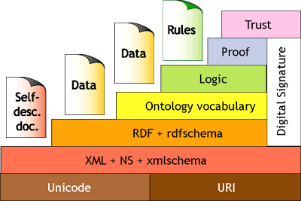
Semantic Web
Protocol stack

Slide 8
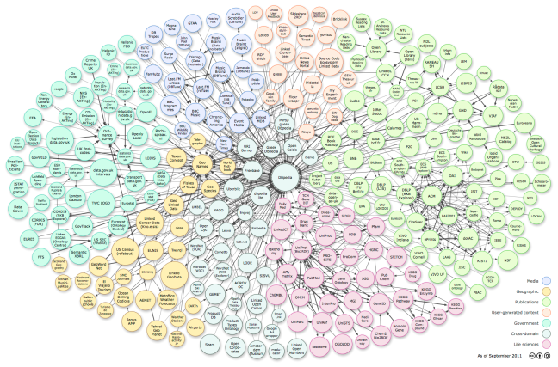
Semantic Web
Linking open data cloud diagram (as of 2011)
Notes:
As of 2011, there are 4.7 billion RDF triples and they are linked by 142 million RDF links

Slide 9

Cloud Computing

Slide 10
Cloud Computing
What is cloud computing?
  Server, storage, network, software technologies be purchased over the internet
  As and when required
  Just like utility

Slide 11

Cloud Computing
What are the benefits
  No capital expenditure or complexity of maintenance
Notes:
Why do they like cc so much

Slide 12
Cloud Computing
What are the benefits
  No capital expenditure or complexity of maintenance
  Shorter time to market
  Scalability
  Flexibility
Notes:
For these reasons, more and more IT companies are transferring their computing to the cloud.

Slide 13
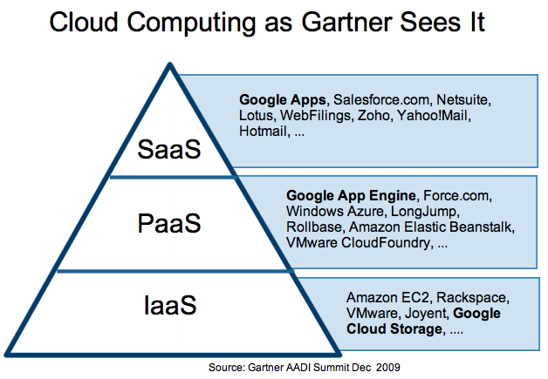
Cloud Computing
Delivery model

Slide 14
Cloud Computing
Challenges
  Heterogeneous platform
  Distributed web services
SDLC needs cloud provider in every stage
Notes:
observe

Slide 15
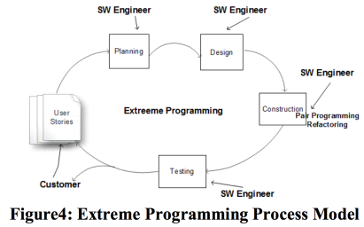
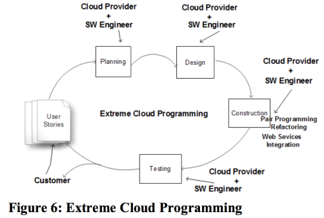
Extreme Cloud Programming
Notes:
Based on the analysis of the benefits and challenges of semantic web and cloud computing, the authors propose an innovative agile process model called ECP, which is an extension of XP.

Slide 16
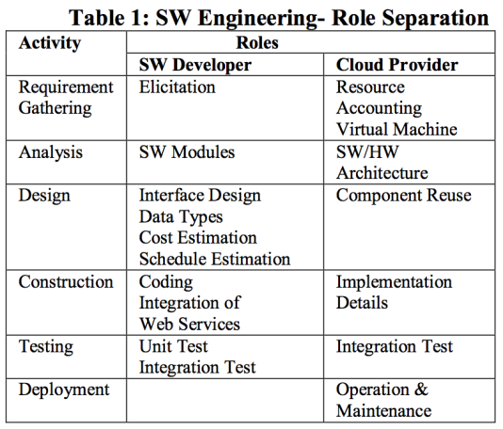
Extreme Cloud Programming

Slide 17
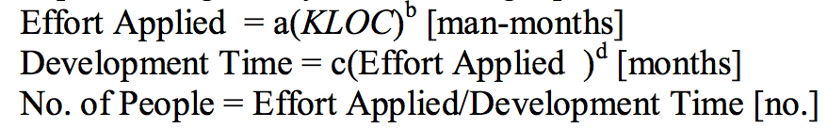
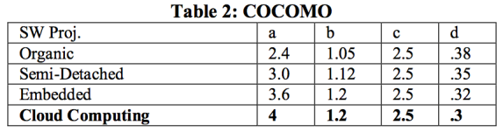
Extreme Cloud Programming
Effort estimation of SW development
  Constructive cost estimation model (COCOMO)

Slide 18
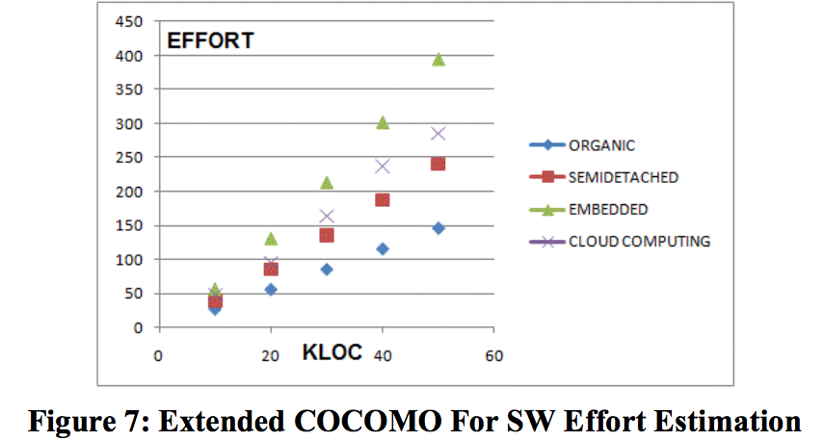
Extreme Cloud Programming

Slide 19
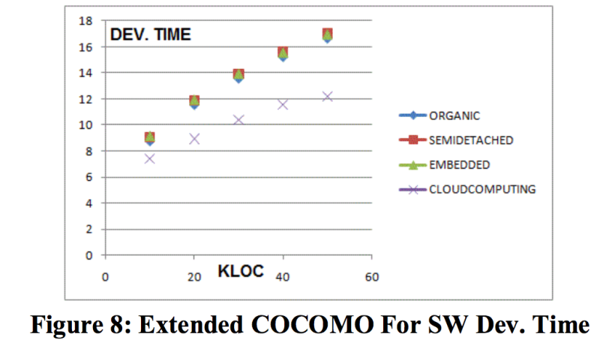
Extreme Cloud Programming

Slide 20
Conclusion
Web service is a paradigm shift
Automatic discovery and integration with web service will reduce the amount of work for SE
SW artifacts need to be semantic web ready
SW engineers need to interact with cloud providers
Reference
  Radha Guha, “SOFTWARE ENGINEERING ON SEMANTIC WEB AND CLOUD COMPUTING PLATFORM”, people.cs.pitt.edu/~chang/231/y11/papers/cloudSE.pdf, 2011
  Guha, R.; Al-Dabass, D., "Impact of Web 2.0 and Cloud Computing Platform on Software Engineering," Electronic System Design (ISED), 2010 International Symposium on , vol., no., pp.213,218, 20-22 Dec. 2010 doi: 10.1109/ISED.2010.48

Slide 21
Thank you!

Slide 22
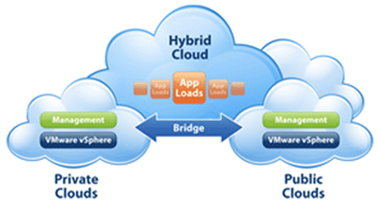
Cloud Computing
Public vs Private

