Slide 1
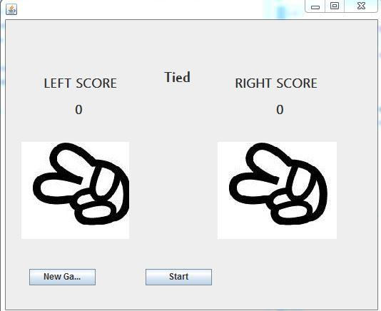
Leap Motion Gesture Recognition And Rock-paper-scissors game
Milestone 2
Preliminary algorithm to recognize hand shape: Based on several video frame and relative coordinates to tell which shape is( rock, paper, scissor)
A simple UI for two player to play against each other. The program will recognize two hand shape and tell the winner.
Following work
Tune up the algorithm and verify the algorithm the Developer's SIS testbed.

