Slide 1

Product/Service Customization System: conceptual design and implementations
Zichuan (Jerry) Ye
2013.12.5
Department of Computer Science

Slide 2
Introduction
Difficulty in implementing a product/Service system:
Dynamically-managed inventory
Over promise
Under deliver
Information transparency

Slide 3
Multiple decision cycles:
Multiple decision cycles can handle complex situations and generate optimal services.
Decision cycle 1: row information combination
Decision cycle 2: availability/classification of items
Decision cycle 3: new attributes (budget, brand…)
Decision cycle 4: decision adjustments
.
.
.

Slide 4
Implementation example
Kitchen decoration:
Provider:
Items sources
Availability
Price
Customer:
Items quantity
Brands
budget…

Slide 5
Implementation example
Decision cycle 1:
Provider:
Insource items = {closet, sink, stove, fridge}
Outsource items = {dinning table, silver-ware, microwave}
Customer:
Want-list = {stove, fridge, microwave, glassware}

Slide 6
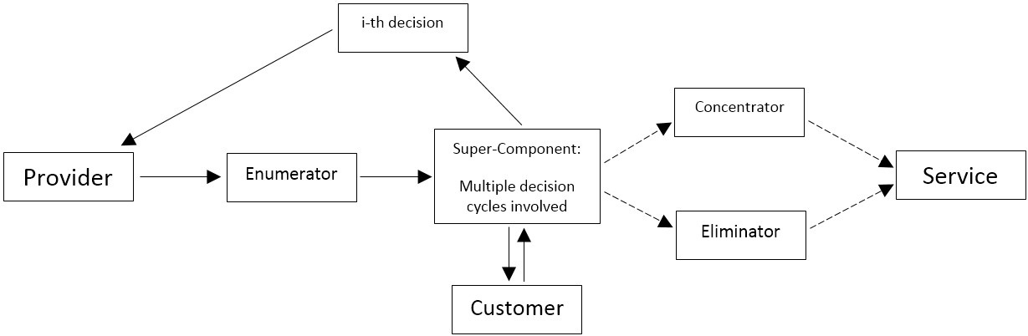
Block diagram:

Slide 7
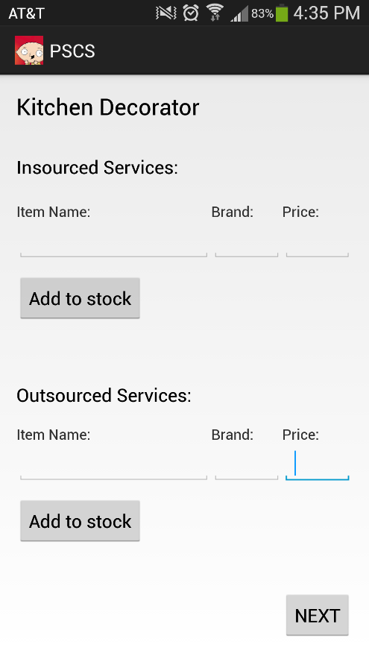
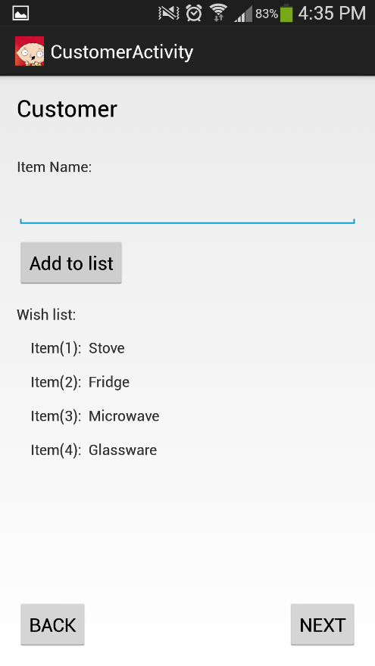
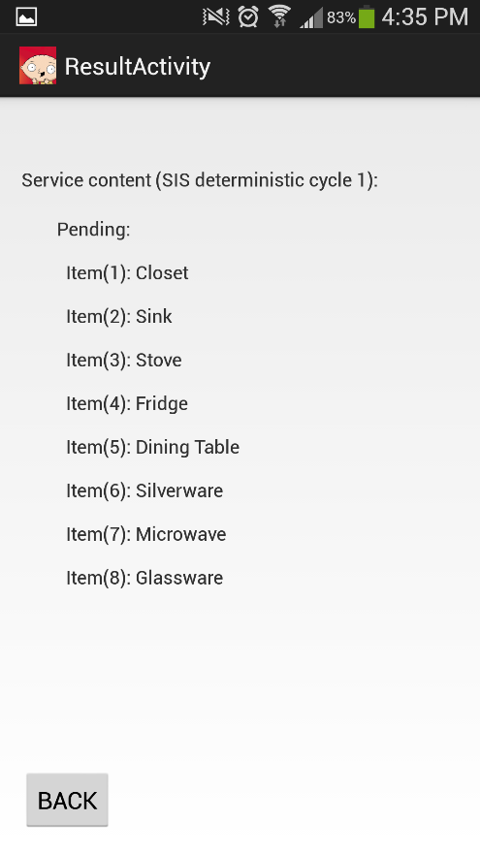
Implementation: interface
Provider interface
Customer interface
Result interface

Slide 8
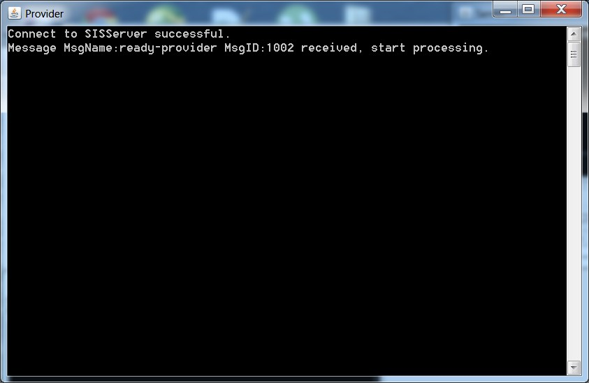
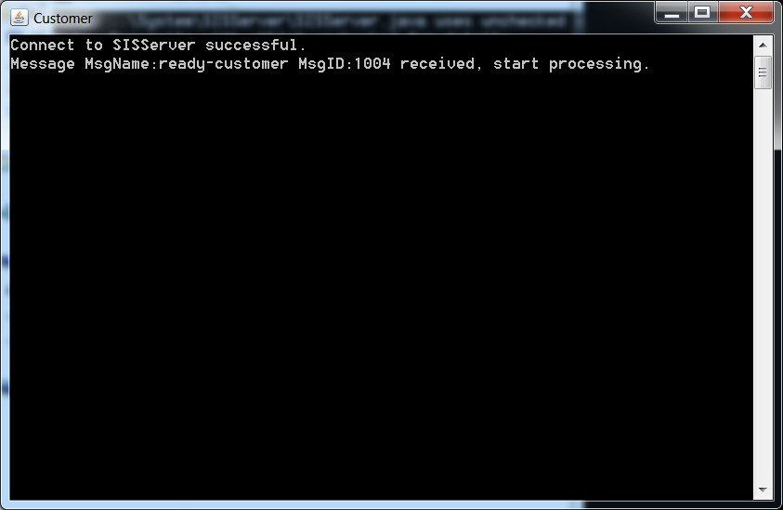
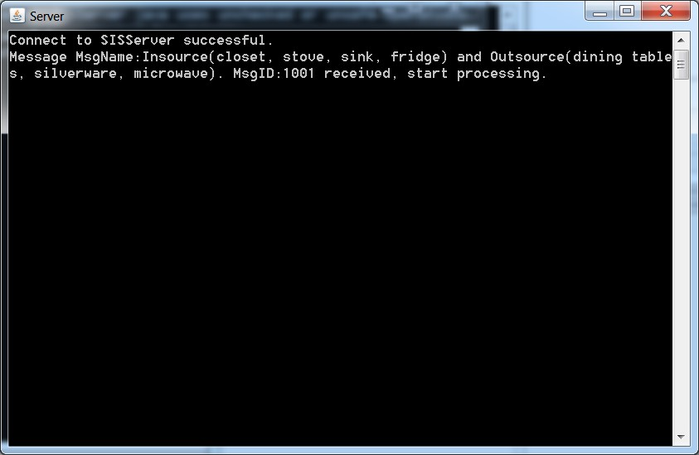
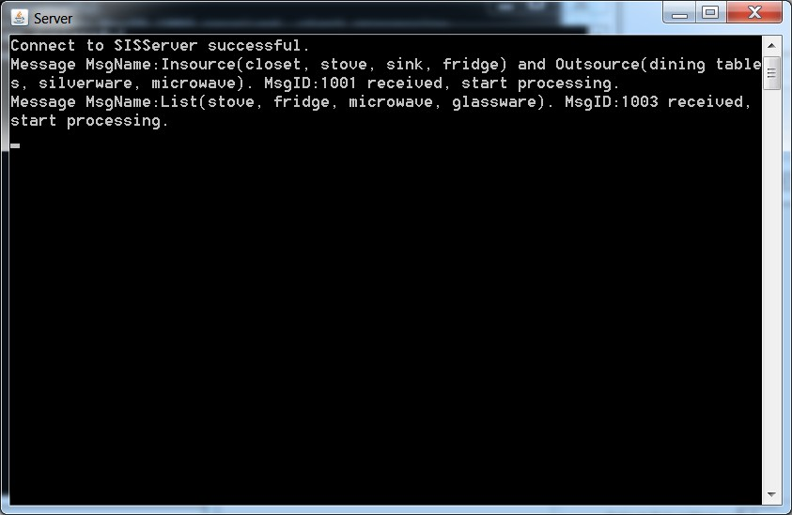
Implementation on SIS testbed

Slide 9
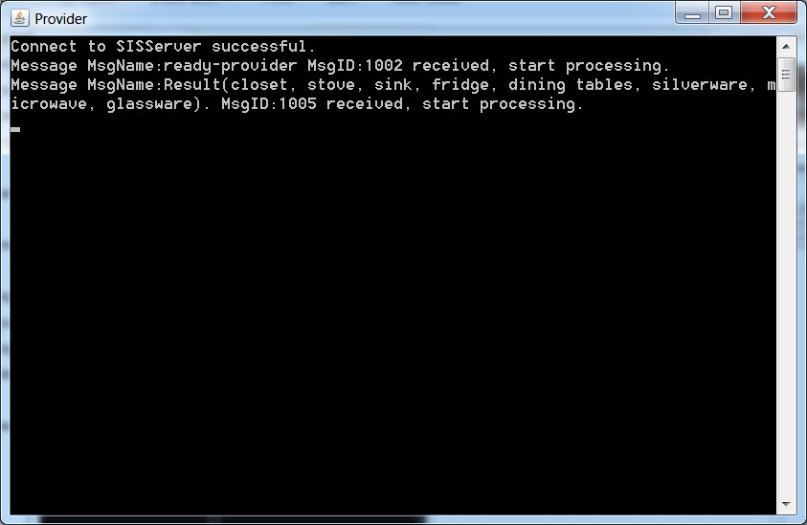
Implementation on SIS testbed
Provider receives the result from decision cycle 1

Slide 10

Acknowledgements:
Many thanks to:
Dr. Shi-Kuo Chang
And all fellow students in CS-2310.

