Slide 1
CS 2310 Final Project
-Driving Behavior Monitor
Haifeng Xu
Dec. 5, 2013

Slide 2
Project description
To design and implement an application that monitors users’ driving behaviors in real time, using on-device sensors
  GPS data is used to calculate the driving speed and road conditions (highway or local) if possible
  Gyroscope and accelerometer combined are used to detect moving trajectories such as making turns, changing lanes, etc.
Two components
  Driving data collector runs on Android
  Algorithm for evaluating driving behavior runs in SIS

Slide 3
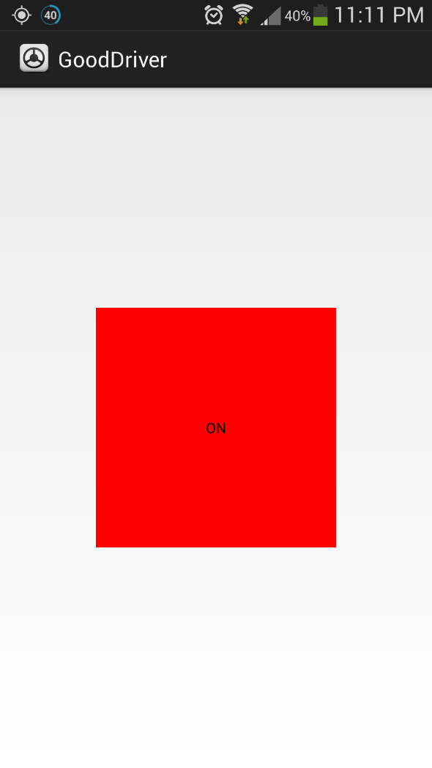
Android driving data collector

Slide 4
Evaluation algorithm
Composite values are used
  acc = sqrt(accX*accX + accY*accY + accZ*accZ)
  rot = sqrt(rotX*rotX + rotY*rotY + rotZ*rotZ)
Four unsafe patterns and empirical thresholds
  Hard acceleration/deceleration (Acc)
  High speed turn (Acc * Rot, & V)
  Swing between lanes (Rot * V)
  Cellphone use (Rot & V)
5s evaluation window

Slide 5
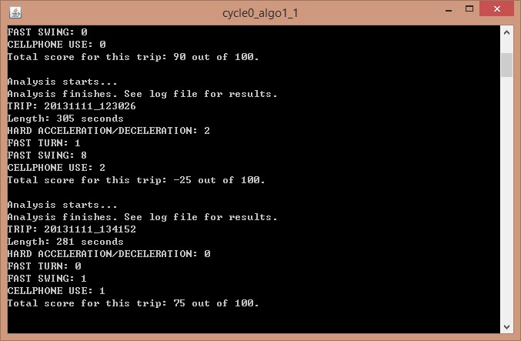
Running results in SIS

Slide 6
Thanks!

