Slide 1
Image Tagger using audio tags
Nils Murrugarra

Slide 2


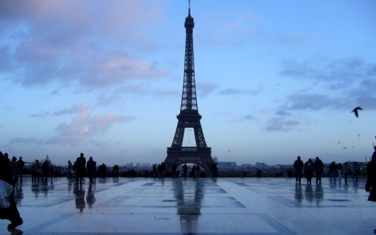

Motivation
Text Tags
AudioTags
Emotions
People
Places

Slide 3
Diagram
Audio Recognizer
(tags, nameImage)
Saver
Click tag
nameImage
User
Click Search
Audio Recognizer
tags
Searcher

Slide 4
Diagram – Audio
(tags, nameImage)
Begin
Begin Tagger
Audio received
Audio recognized
click_tag
nameImage
clickSearch
(tags)
Begin Recognizer
Audio received
Audio recognized

Slide 5

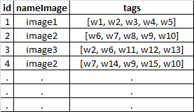
Search
[w7, w1, w9, w10, w16 ]
Image2 = 6
Image1 = 1
Image3 = 0
1
3
0
3

Slide 6

Demo

Slide 7

Questions

Slide 8


