Slide 1
Software Engineering Project
Fruit Recognition
Zheng Liu

Slide 2
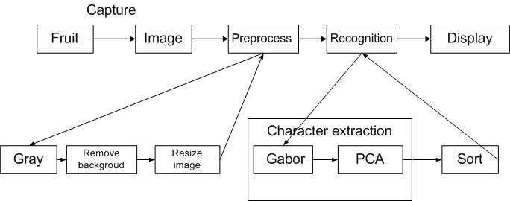
Block Diagram

Slide 3
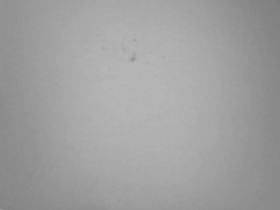
Preprocess
Change to gray image.
  cvCvtColor(srcImg,grayImg,CV_BGR2GRAY);
Remove background:
  cvAbsDiff(grayImg,bgdImg,difImg);
Resize to a 64*64 matrix.
Background image

Slide 4
Character extraction
Gabor filter
  I: image; : Gabor core function.
PCA dimensionality reduction.

Slide 5
Sort
K-nearest neighbor algorithm:
  Calculate distance between the vector of recognizing image and database vector.
  Compare the distance.
  Assign to a kind of fruits.

Slide 6
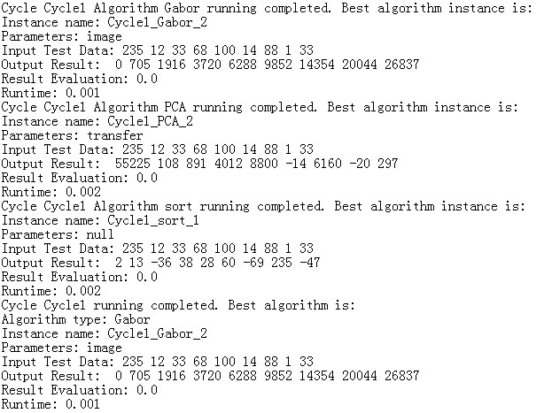
SIS Test bed
Input: a 3*3 matrix.
Imitate the process of the character extraction
SIS test bed output result

Slide 7
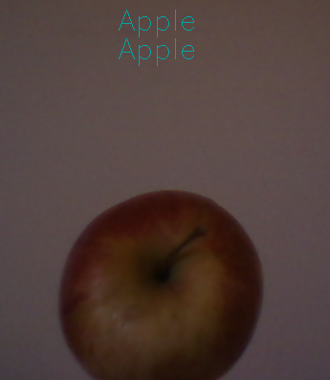
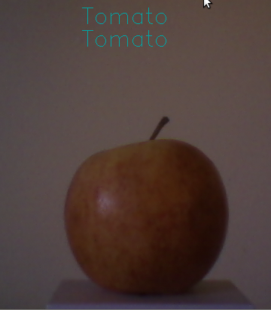
Bug
A pure white background is needed.
  Shade and other noise may be recognized as eggplant, because of deep color.
Fruit has to be in a particular pose.

