Slide 1
---- Ping Lang
Term Project
Super Component of Blood Sugar Monitor
Description: Monitoring patients blood sugar, based on different knowledge bases, to generate a customized alert & alert messages.
Deliverables:
Different data patterns for different people --- Done with different kb
Algorithm(s) to detect blood sugar alert ---- Done
Different alert messages to inform patients to have further medical examination ----- Done
Using HealthCare SIS test bed to replace the regular component with the super component ---- Done
Demo to show different outputs based on different inputs (using different algorithms) ----- Done using different knowledge bases

Slide 2
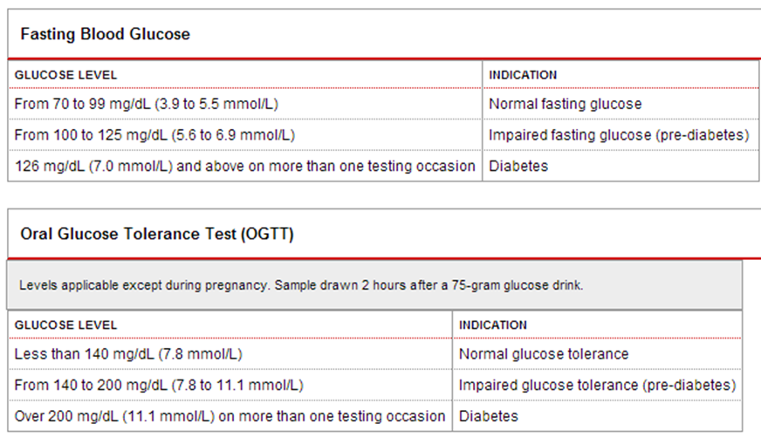
---- Ping Lang
Term Project
Super Component of Blood Sugar Monitor
Diabetes patients & Normal people blood glucose level ranges

Slide 3
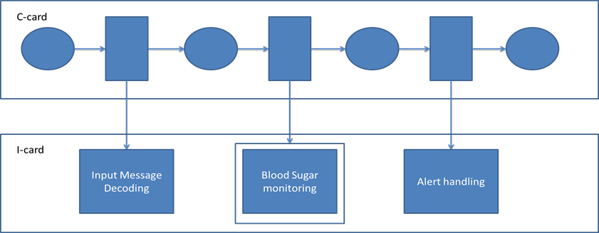
---- Ping Lang
Term Project
Super Component of Blood Sugar Monitor
Super Components Design:

Slide 4
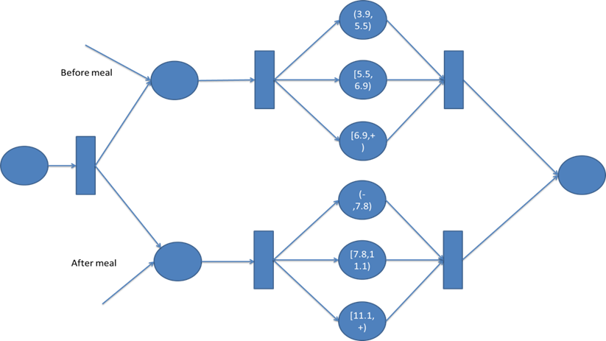
---- Ping Lang
Term Project
Super Component of Blood Sugar Monitor
Super Components Design for normal people:

Slide 5
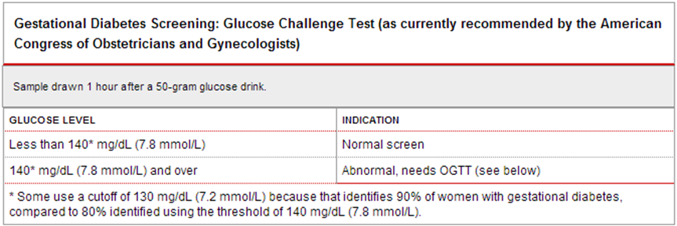
---- Ping Lang
Term Project
Super Component of Blood Sugar Monitor
Super Components Design for Gestation:
Pre-test:

Slide 6
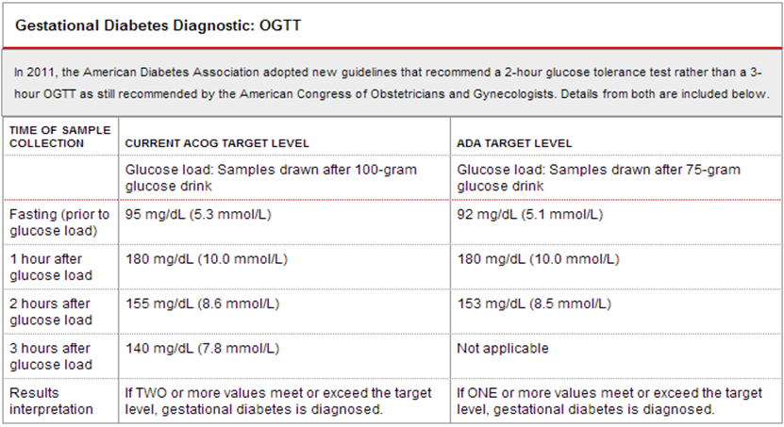
---- Ping Lang
Term Project
Super Component of Blood Sugar Monitor
Super Components Design for Gestation:
OGTT test:

Slide 7
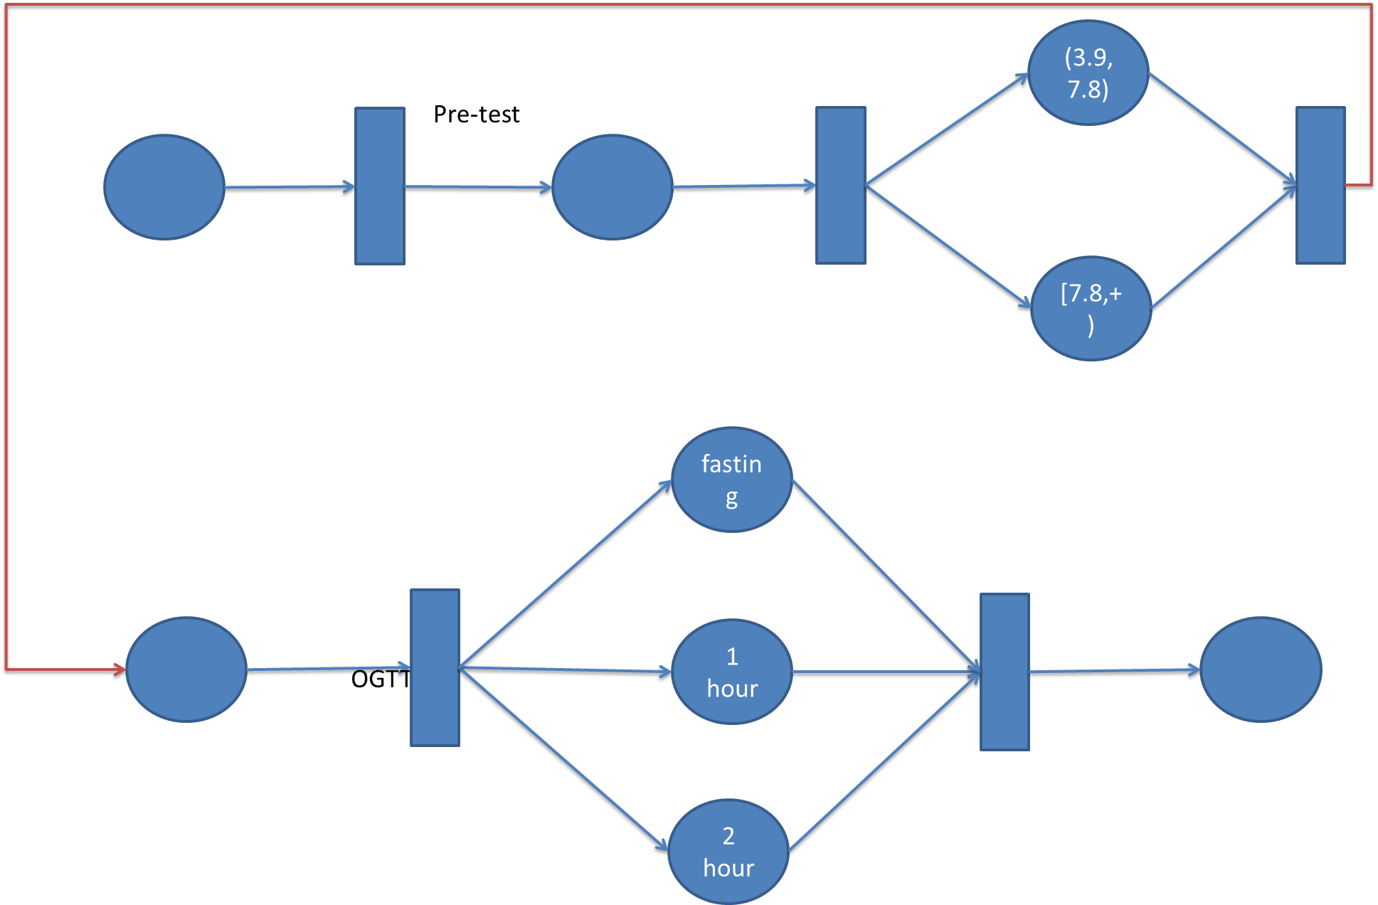
---- Ping Lang
Term Project
Super Component of Blood Sugar Monitor
Super Components Design for Gestation:

Slide 8
---- Ping Lang
Term Project
Super Component of Blood Sugar Monitor
Demo

