Slide 1
Real Social Experience Computing
University of Pittsburgh
Presented by: Xiaoyu Ge

Slide 2
What’s Real Social Experience Computing (RSE)?
The final goal of this project is to create a platform which can allow industry organizations, such as companies or Non-Profit Organization to post their current project or challenges on the platform, and students can login to the platform to take look those projects provide by industry. If there is a project that currently looking for students, and the student meets the requirements of this project, this student can apply for the project and experiencing the feeling of solving real world problem.
This approach can greatly increase students’ real world experience. As well as, a good chance for companies and organizations to demonstrate their work to the general society, moreover for some organizations this platform may really help them to solve some problems which those organizations are facing right now. Some project can even have sponsors so students working on a certain project can get financial aids.

Slide 3
Patterns for RSE:
Pattern: Enhance Student Working Experience
Pattern: Solve Problems for Industrial organization
Pattern: Prove a demonstration platform for Industrials
Pattern: Get financial support for students
Pattern: Real social experience computing Main platform

Slide 4
Pattern: Enhance Students’ Working Experience
Problem: How to enhance students’ real working experience?
Context: Now days, technology growing extremely fast so a gap occurs between real industrial needs and materials covered in schools. Therefore we need a good way to solve this issue.
Solution: Go to real social experience computing platform, so students can understand what real world’s doing and then choose an appropriate project to gain the real experience.

Slide 5
Pattern: Solve Problems for Industrial organization
Problem: In what way, can industrial organizations to efficiently find more human resources to solve their problem?
Context: Some organizations may be looking for more helpers, so they need a good way to address this issue.
Solution: Go to real social experience computing platform so organizations can post their current challenges onto the website, if students are interesting in their project, then Industrial organizations can find way to gain help from student with appropriate skills.

Slide 6
Pattern: Prove a demonstration platform for Industrials
Problem: How to prove a demonstration platform for Industrials, so that general people can understand what they are doing?
Context: Some industrial organizations may do some amazing works, but most of them don’t have a good chance to demonstration that to the general society, therefore we also want to prove them with chances to demonstration their work
Solution: For general people they can login to real social experience computing platform, so that people can understand what each Industrial organization are doing and understand how educations combined with Industrial needs can change their life.

Slide 7
Pattern: Get financial support for students
Problem: How to let students to get more financial aid support for their tuition?
Context: Some students are doing great jobs in schools, and they accrued some useful skills, so maybe they can use these skills to support their academic career.
Solution: Student working on working on certain project may apply for financial aid using sponsor functions in the real working experience platform.

Slide 8
Pattern: Real social experience computing Main platform
Problem: How to accommodating all types of request from student and industrial?
Context: Student and industrial both have some needs and requests, many of those can be solved together, and therefore a win-win solution is needed.
Solution: Create a platform to accommodate all types of request from both students and industrial (ex: enhance student-working experience and prove industrial with platform to demo their work).

Slide 9
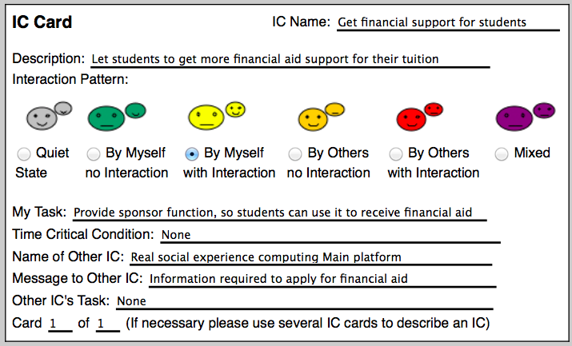
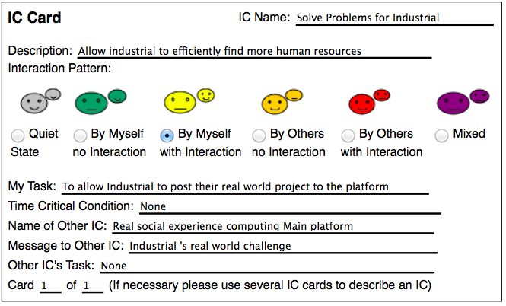
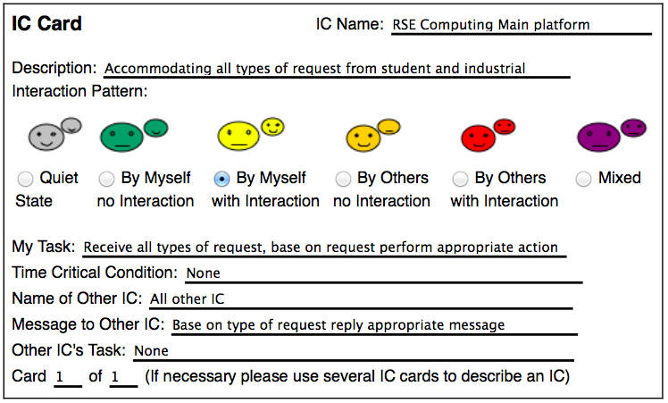
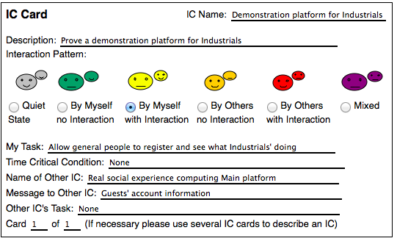
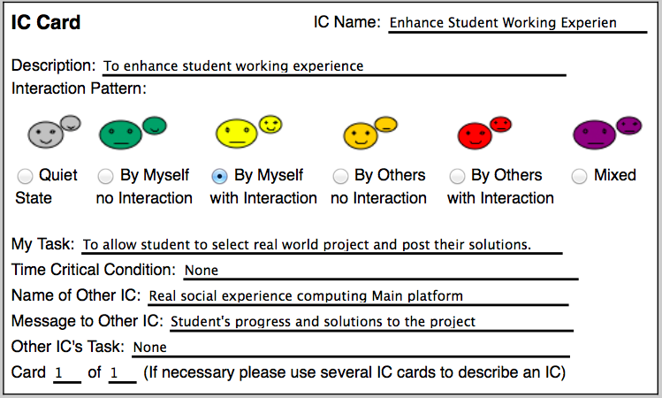
Relation between IC Cards

Slide 10
Next: DEMO

