Slide 1
Low-Frequency-Noise Manager
Guy Gadola

Slide 2
Purpose of Fully-Functional Version
Help companies and individuals comply with their own or external noise policies
  Identify the cause of low frequency sound source (e.g., train, exhaust fan, truck) from indoors
  Record the sound in a database along with certain properties
  If noise is beyond accepted thresholds, then recommended ways to mitigate noise

Slide 3
Properties of Low-Frequency Sound
“as low-frequency sound encounters less absorption as it travels through the air than higher frequency sound, it persists for longer distances”
“the amount of sound transmitted from the outside to the inside of buildings is greater at low than at high frequencies”
http://partner.mit.edu/projects/low-frequency-noise-study

Slide 4
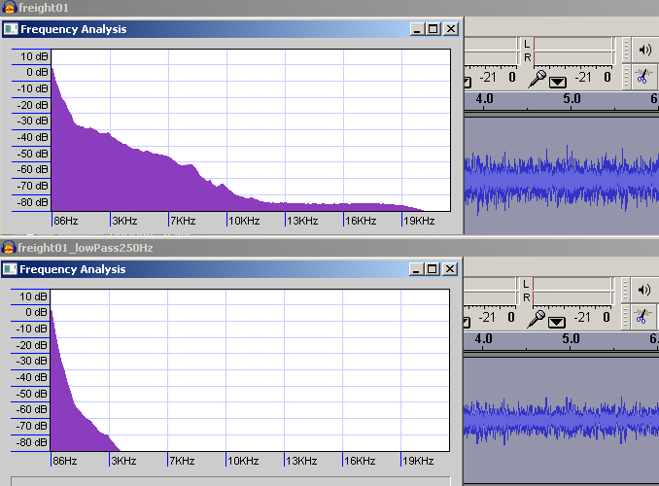
A Building Is a Low-Pass Filter

Slide 5
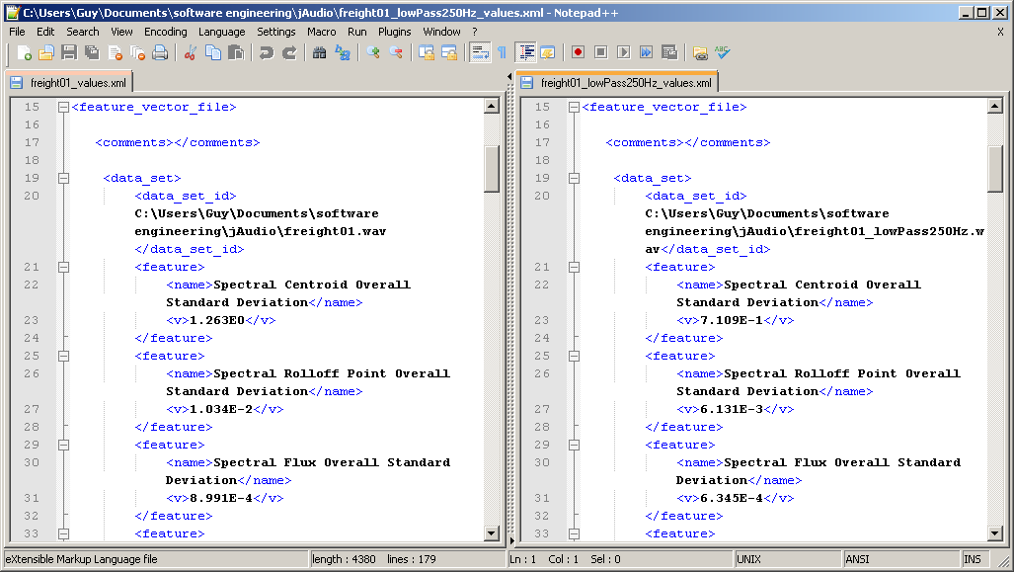
jAudio-Produced XML Versions for Ontology
The Outdoor Sound Is a Reference
The Indoor Sound Is to Be Identified

Slide 6
SIS Compares Indoor Sound to Reference XML Files

Slide 7
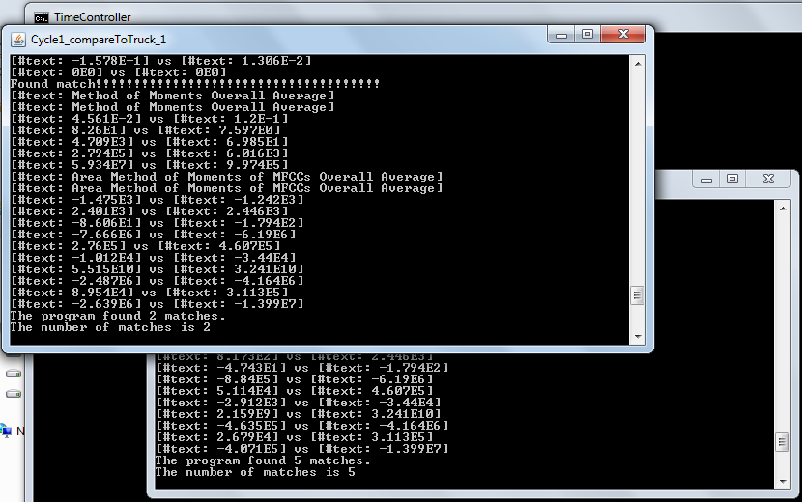
Screenshot from Demo
Train Identified

Slide 8
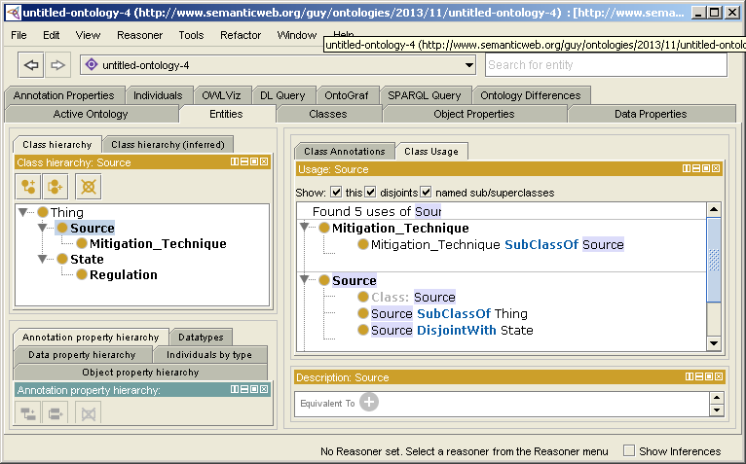
Quick Start of Noise Regulation and Mitigation Technique Ontology

Slide 9
Acknowledgment
Thanks go to Angen Zheng for helping me to get my SIS installation to work
References
http://partner.mit.edu/projects/low-frequency-noise-study
http://www.freesound.org
McKay, Cory, Ichiro Fujinaga, and Philippe Depalle. "jAudio: A feature extraction library." In Proceedings of the International Conference on Music Information Retrieval, pp. 600-3. 2005.
http://protege.stanford.edu

