Slide 1
Visualization of multithreading software using slow intelligent system
Xiaolong Cui
Computer Science

Slide 2
Outline
Introduction
Demo
Acknowledgement

Slide 3
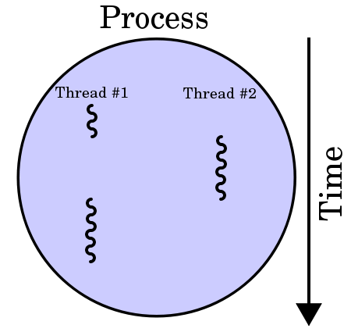
Introduction

Slide 4

Introduction

Slide 5
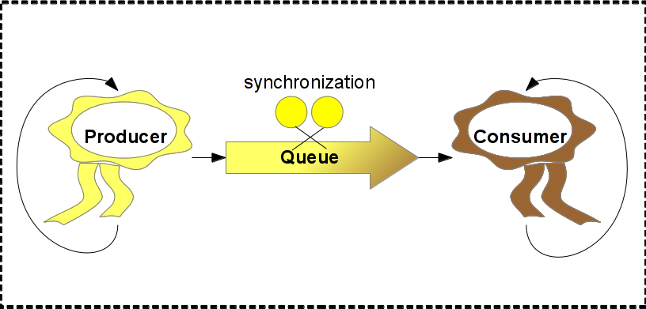
Introduction

Slide 6
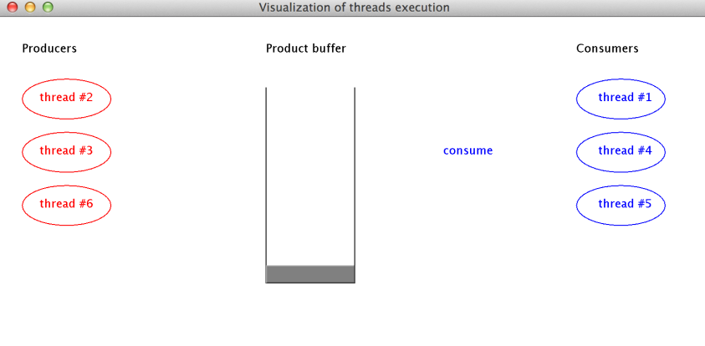
Demo

Slide 7
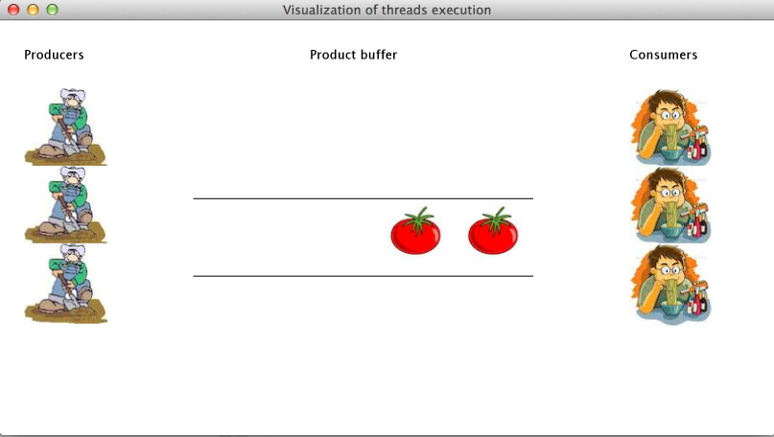
Demo

Slide 8
Thank you!

Slide 9
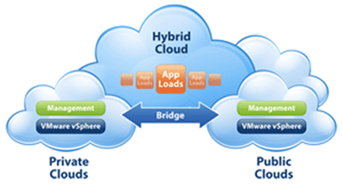
Cloud Computing
Public vs Private

