Slide 1
Data Mining Recommender
Yoonjung Choi

Slide 2
Description
The Knowledge Discovery in Databases (KDD) is concerned with the development of methods and techniques for making sense of data.
One of the important step in KDD is data mining
  The most difficult step since there are many kinds of methods and algorithms.
Goal: modeling and simulating data mining Recommender

Slide 3
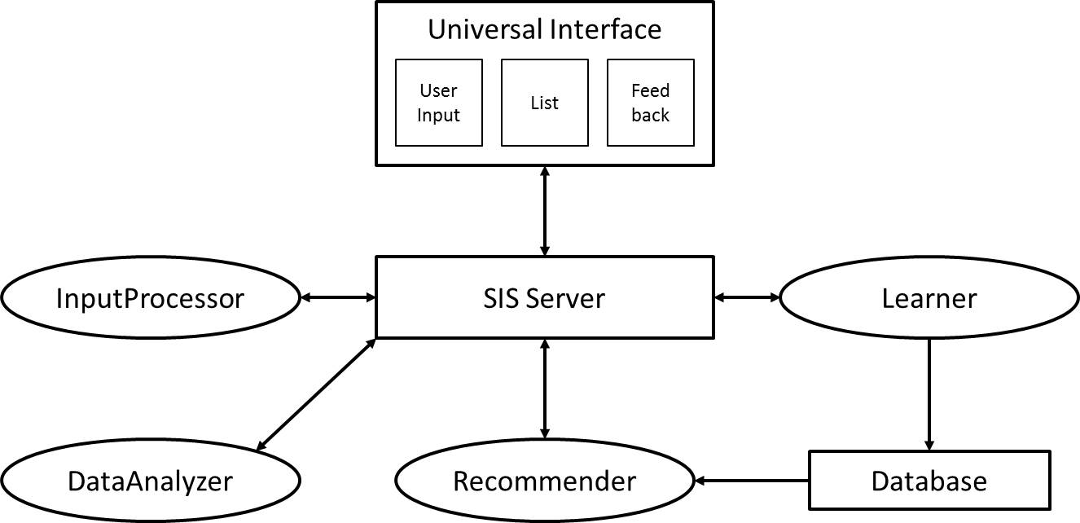
Recommender System

Slide 4
System Component (1/2)
Universal Interface: It is for testing the system.
SIS Server: The SIS Server processes messages.
Database: It saves all data mining algorithms with result information.

Slide 5
System Component (2/2)
InputProcessor: It processes a user input.
DataAnalyzer: It analyzes data and extracts meta-information.
Recommender: It recommends data mining algorithms.
Learner: It learns the new experience with its corresponding solution.

Slide 6
Data Analysis
Class types
  Nominal class
  Numeric class
Feature types
  Only nominal features
  Only numeric features
  Both nominal and numeric features
  String feature

Slide 7
InputProcessor
Input: User Input
  Information about task, data, and restrictions
Output
  Task: classifier or cluster
  Data: path of data source
  Restrictions: which measures are important
    Classifier with nominal class: precision, recall, etc.
    Classifier with numeric class: mean absolute error, etc.
    Cluster: the percent of incorrectly clustered instances

Slide 8
DataAnalyzer
Input: Data
Output: Meta-information
  Filename: filename of input data
  Class type: nominal class or numeric class
    In clustering, only nominal class is accepted.
  Feature type: only nominal features, only numeric features, both nominal and numeric features, or string feature
    In clustering, string feature is not accepted.

Slide 9
Recommender (1/2)
Input: Task, Restrictions, and Meta-information
Output: Recommended algorithm with results
Method
  1. find all data in database which have the same class type and feature type
  2. choose an algorithm which satisfy restrictions
    e.g., Algorithm which has higher f-measure and lower mean absolute error

Slide 10
Recommender (2/2)
Data Mining Algorithms
  Weka: A collection of machine learning algorithms for data mining tasks.
  14 Classification algorithms: AdaBoostM1, IBk, J48, LinearRegression, Logistic, MultilayerPerceptron, NaiveBayes, SMO, etc.
  5 clustering algorithms: Cobweb, EM, HierarchicalClusterer, etc.
  Sample data are used to construct the database.

Slide 11
Learner
Input: Feedback and Recommended data mining algorithm with results
If the user feedback is “accept”, the result of recommended algorithm is saved in database.
If not, the result is not saved.

