Slide 1
Ambient Intelligence based home care systems
Boyu Sun
University of pittsburgh

Slide 2
Prologue
“The most profound technologies are those that
disappear. They weave themselves into the
fabric of everyday life until they are indistinguishable from it”
--Mark Weiser

Slide 3
A quick look at ambient intelligence
ambient intelligence (AmI) refers to electronic environments that are sensitive and responsive to the presence of people, which is built upon:
  Ubiquitous computing
  Profiling practices
  Context awareness
  human-centric computer interaction design

Slide 4

Typical Context
Home environment
  Stable communication infrastructure
  Well defined types of context information
  Reliable quality and reachability of services

Slide 5
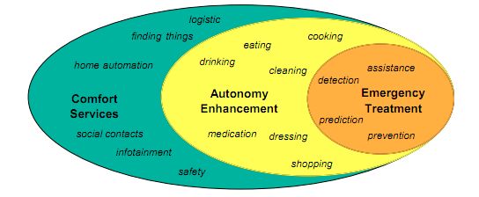
Classification of the Home Care System(HCS) Domain
Notes:
Emergency Treatment services aim at early prediction of and recovery from critical conditions that might result in an
emergency and safe detection and alert propagation of emergencies. Examples of emergencies are sudden falls, heart
attacks, strokes, panics, etc.
Autonomy Enhancement services make it possible to abandon previous manual care given by medical and social
care personnel or relatives and replace it by adequate system support. An example for this type of services are cooking or
for people with visual defects. The appropriate instrumentation of a stove may enable those persons to cook
safely without the need for assistance by social care workers.
Comfort Services cover all areas that do not fall into the
previous categories. Examples of comfort services are social contact assistance, infotainment assistance, logistics
assistance,

Slide 6
Problem with current HCS
Low acceptance of health assistance solutions
Technology focus – ignore usability issues
Low assistance and quality
  Rely on single modality for sensing having great limitation
Not aware of context
  Difference between a person just climbed stairs and sitting in a chair for a long time
Static, unnatural interface
  requires some learning and results in a higher probability of misoperation with growing age

Slide 7
Characteristics of AmI system
AmI is characterized by systems and technologies that are:
  embedded: many networked devices are integrated into the environment
  context aware: these devices can recognize you and your situational context
  personalized: they can be tailored to your needs
  adaptive: they can change in response to you
  anticipatory: they can anticipate your desires without conscious mediations
Notes:
Talking about the same thing, adjustment of system in response to users
Personalized: short
Adaptive: moderate period of time
Anticipatory: very long time

Slide 8
How could AmI help
AmI has huge potential in the area of living assistance for handicapped and elderly people suffering from all kinds of disabilities, detecting:
  Gait changes
  Neurological alternations
  Visual acuity changes
  Spontaneous fractures and falls
  Sudden changes in blood pressure

Slide 9
Goal
The ultimate goal of any emergency treatment system must be:
  high recall: detecting every real emergency immediately, and high precision to prevent invalid emergency detections and alerts as a consequence of misinterpretations. High recall is mandatory to provide a trustworthy service quality to the assisted persons in case of emergency situations.
  High precision is essential for economical reasons, since invalid emergency alerts may decrease trustworthiness unacceptably and increases care costs.

Slide 10
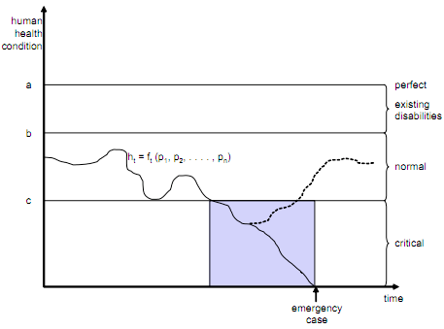
Human Capability Model (HCM)
provide a precise notion for critical situations and emergency cases
must allow personalizing the service
  taking the existing disabilities of a person into account

Slide 11
Trace and situations
Trace: An approximation of this(HCS) model which is achieved by continuously acquiring data about a persons' vital functions such as temperature, blood pressure, and pulse together with data on his short-term, medium-term, and long-term behavior.
Situations: The current situation of an entity can be characterized by means of logical predicates denoted as situations
Notes:
(a) defines a fictive
perfect health condition of a human without any disabilities,
(b) defines a particular person's best possible health condition
regarding existing disabilities, and (c) defines the borderline
between normal and critical health conditions. T

Slide 12
Example
Simple situations examples:
  Person X has a blood pressure of 178
  Person X is sleeping
  Person X has not taken medicine M for 2 days
Complex ones
  (Person X has fallen down) AND (Person X has not responded to call for 30 seconds)
Use inference rules for action suggestion
  (Person X has fallen down) → (Call Person X)
  (Person X has fallen down) AND (Person X has not responded to call for S seconds) → (Issue emergency call)

Slide 13
Architecture consideration
On the highest level of abstraction, an AHCS appears as some kind of closed loop controller that senses its environment and especially the persons living therein and influences the environment with its actuators
On a detailed level, core functionality can be decomposed into six functional units as:
  Sensing
  Perception
  Identification
  Assisting
  Controlling
  Acting

Slide 14
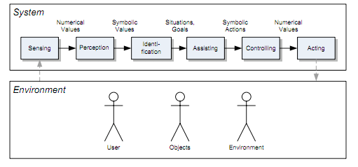
Functional Blocks of AHCS

Slide 15

Real life application -- AMICA
Designed at the Fraunhofer Institute for Experimental Software Engineering (IESE) in Kaiserslautern, Germany
Follows the AHCS vision,
Iteratively developed
Shall be evolved into a full-fledged
AHCS prototype within the next
two to three years.

Slide 16
Current features
Monitored Drinking: computerized cup (iCup) the amount of fluids consumed by the person handling the cup is measured potential thus dehydration can be detected and signaled to the care givers
Monitoring Food Quality: An RFID-based system built into a refrigerator
Location Tracking: By means of RFID labels embedded in the carpet, and mounted to the ceiling
Fall detection: Gyro sensors built into wrist badges, walking aids, or other body mounted devices

Slide 17
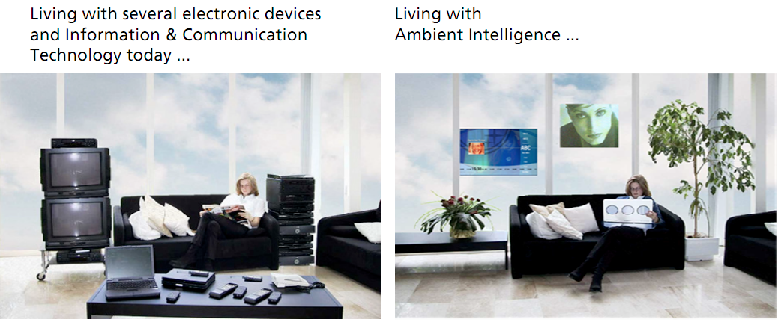
Thank you

Slide 18
Reference
Becker, Martin; Werkman, Ewoud; Anastasopoulos, Michalis; Kleinberger, Thomas; , "Approaching Ambient Intelligent Home Care Systems,"Pervasive Health Conference and Workshops, 2006 , vol., no., pp.1-10, Nov. 29 2006-Dec. 1 2006
Jurgen Nehmer, Martin Becker, Arthur Karshmer, and Rosemarie Lamm. 2006. Living assistance systems: an ambient intelligence approach. In Proceedings of the 28th international conference on Software engineering (ICSE '06). ACM, New York, NY, USA
Aarts, E.; , "Ambient intelligence: a multimedia perspective," Multimedia, IEEE , vol.11, no.1, pp. 12- 19, Jan.-March 2004

