Slide 1
Graph Transformations and Software Engineering: Success Stories and Lost Chances - Highlights
Giovanni Toffetti, Mauro Pezze
Presented by Mengmeng Li
CS Department
University of Pittsburgh

Slide 2
Outline
Introduction
Graph transformation in software engineering
Application examples
Academic and industrial impacts

Slide 3
How to represent concepts in software engineering?
Textual notations
  e.g. Formal string grammars (Chomsky)
  Application: compiler
Diagrammatic notations
  Introduce new dimensions
  e.g. Graph transformation

Slide 4
Birth of graph transformation
For most activities in the software process, a variety of visual notations have been proposed, including state diagrams, structured analysis, control flow graphs, UML languages.
Theses notations produce models that can be easily seen as graphs, and thus graph transformations are involved.

Slide 5

General advantages of graph transformations
“Graph transformation has originally evolved in reaction to shortcomings in the expressiveness of classical approaches to rewriting, like Chomasky grammars and term rewriting, to deal with non-linear structures.”
——Heckel

Slide 6
Development of GT
60s, 70s
  Pfaltz: first example – web grammars
  Pratt: pair grammars
80s
  Dolado: generate Forrester diagram
  Gottler: derive diagram editors from GT
90s
  Software architectures
  Reconfiguration for fault tolerance

Slide 7
Formal definition
Graph transformation, or graph rewriting, concerns the technique of creating a new graph out of an original graph using some automatic machine.
  ➔
  GT defines transformations over graphs by means of rules.
Graph & rules

Slide 8
Graph
A graph is a set of nodes and (directed or undirected) edges.
Both nodes and edges can be typed to represent different concepts.
E.g.
  A person or an object can have attributes, defined as name and value pairs.

Slide 9
Rules
A GT system consists of a set of graph rewrite rules of the form
  L → R
  L: pattern graph (the left-hand side)
  R: replacement graph (right-hand side of the rule)
A rule is applied to the host graph by searching for an occurrence of the pattern graph, and by replacing the found occurrence by an instance of the replacement graph.

Slide 10
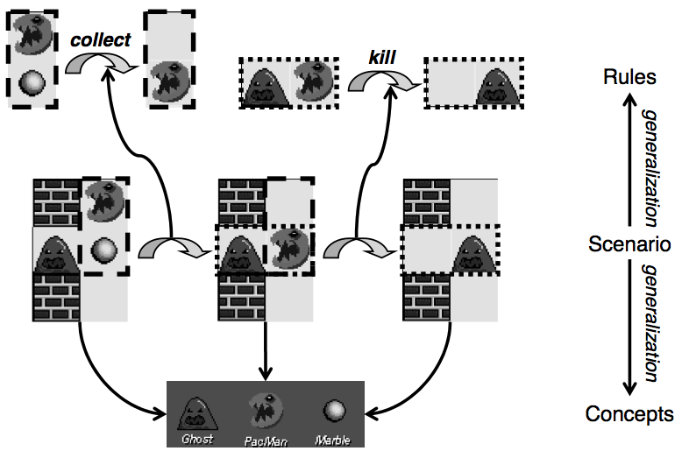
Example: PacMan
Show more details about the generalization?

Slide 11
Typed graphs
The relation between concepts and their occurrences in snapshots is formally captured by the notion of typed graphs.
A fixed type graph (TG) represents the type (concept) level and its instance graphs.

Slide 12
Notations
o: C – a vertex o (an object) of type C (a class)
a: T – a is the name of attribute, T is the data type
a = v – attribute a is assigned value v

Slide 13
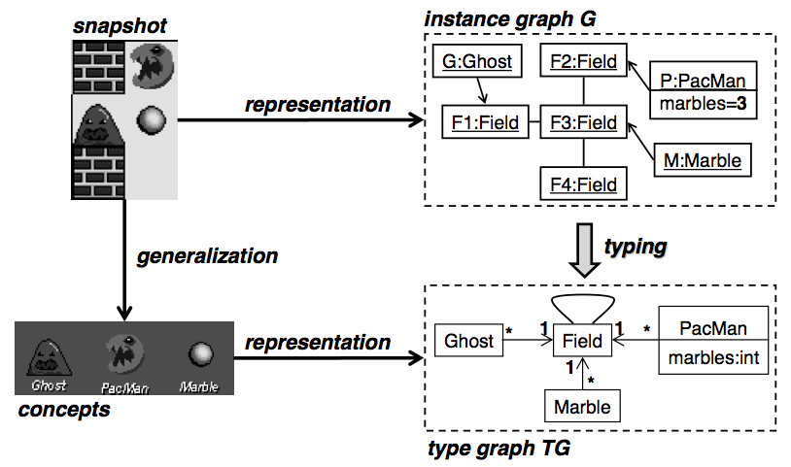
Type and instance graph

Slide 14
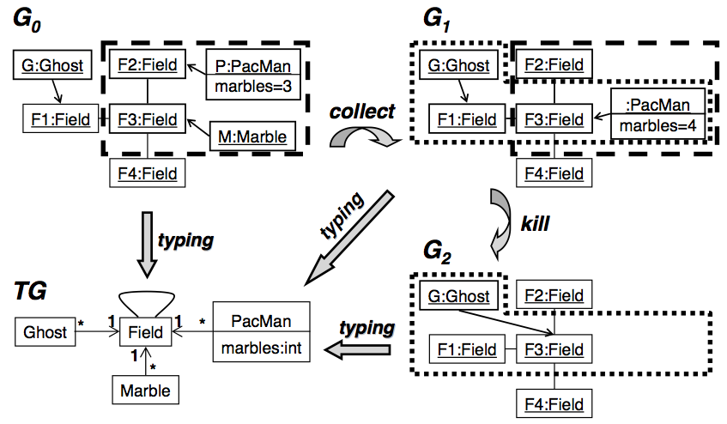
Graph transformation
How to find rules?

Slide 15
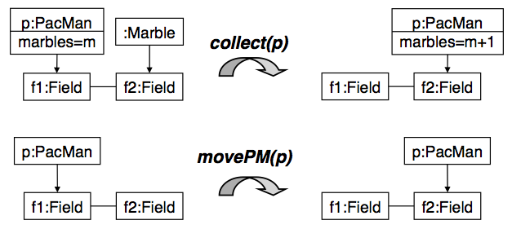
Extract rules from GT (cont. )
Rules for PacMan

Slide 16
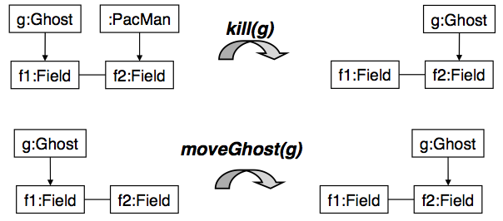
Extract rules from GT
Rules for ghost

Slide 17

Transformation procedure
A graph transformation from a pre-state G to a post-state H, denoted by :
  Find an occurrence o_{L} of the left-hand size L in the given graph G.
  Delete from G all vertices and edges match by L\ R.
  Paste to the result a copy of R\L, yielding the derived graph H.

Slide 18
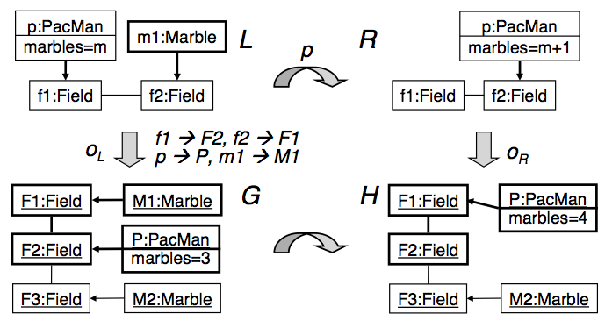
Transformation steps

Slide 19
Role in software engineering
In software engineering, modeling is a basic tool used at abstraction levels and during the whole software development process.
Models and in particular diagrammatic models based on graphs are used to represent and analyze software procedures, processes, components, functioning and so on.

Slide 20
Features of GT in SE
Ability to provide an intuitive diagrammatic representation of modeling concepts
Suitability to formally specify graph languages and mechanisms to guarantee that a graph is a valid language production
Flexibility in modeling and reasoning about graph evolution.

Slide 21
Applications of GT in SE
Modeling
Defining visual languages and their tools
Modeling transformation and mappings
Checking and providing the consistency of dynamic systems
However: GT system had not attained wide spread practical use.

Slide 22
Hindering factors (Blostein et al.)
Lack of education and tools → lack of experimental data
Lack of graph GT system modularization, grammar evolution, and graph inspections support.

Slide 23
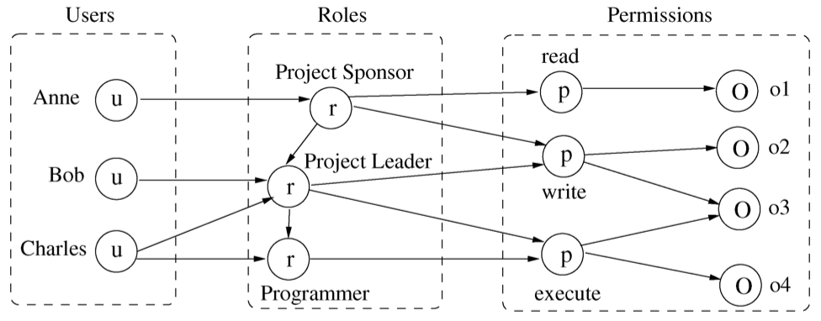
Application example – modeling
Role-based access control (RBAC)
  Challenge: how to verify that a complex set of evolving rules is consistent and complete.
  Solution: graph transformation

Slide 24
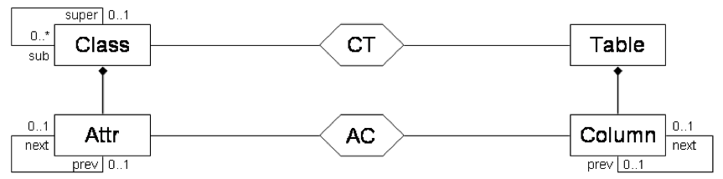
Application example – model evolution
Challenge: Maintain consistency across heterogeneous models at different abstraction levels.
Solution: TGG (triple graph grammars)
  Source, target, correspondence

Slide 25
Application example – visual languages
Challenge: lack of formalisms for defining their syntax and semantics.
Solution: graph transformation system
Editors generated from GT
  Free-hand editor: users can edit freely
  Syntax directed
    Grammar-based: specify the language independently from the editor using a grammar
    Transformation-based: the language is defined by its editing rules.

Slide 26
Academic and industrial impact
(industrial)The project on mechatronic carried on in the University of Paderborn. Relies on GT to describe and analyze combination of heterogeneous components, evolution and self-adapting behavior of train.
(academic)GT are directly applied to study program behaviors discovery and verification.

Slide 27
Conclusion
Graph transformation systems are a powerful tool to deal with syntax semantics and transformation of diagrammatic / visual notations.
The industrial success of graph transformation does not depend on technical issues, but on commercial aspects.
A bright future.

Slide 28
References
Giovanni Toffetti, Mauto Pezze, Graph transformation and software engineering: success stories and lost chances – highlights
Reiko Heckel, Graph transformation in a nutshell
M. Koch, L. V. Mancini, F. Parisi-Presicce, A graph-based formalism for RBAC

Slide 29
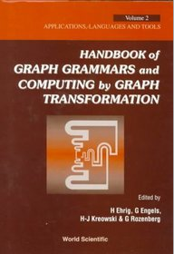
Book
Handbook of graph transformation and computing by graph transformation. G. Rozenberg, H. Ehrig.

Slide 30
Thank you!
Q & A

