Slide 1
Collaboration Technologies
Stan Jedrus
Compunetix, Inc.

Slide 2
:: Agenda
Introduction
Conferencing – Big Picture
System Components
How does all of this fit together?

Slide 3
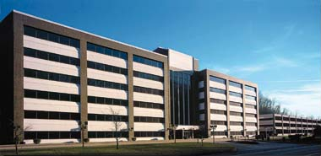
:: About Compunetix
Compunetix
  CSD – Communications Systems Division
    Audio Conferencing Platforms
      Contex 240/480
      Summit
    Data Collaboration Software
      Contex Presenter
  VSD – Video Systems Division
    Video Conferencing Platforms
      Orchestrator
      Virtuoso
  FSD – Federal Systems Division
    Mission Critical Systems (NASA, DoD)
    Emergency Management Systems (911 systems)
  ISD – Instrumentation Systems Division
    Surface Mount Circuits
    Through Hole Circuits
    Sister-Company Compunetics: Printed Circuit Boards

Slide 4
:: What do we do?
Collaboration technologies with Compunetix
  Voice conferencing
    Overview
    VoIP
    PSTN
    Supporting Applications
  Video conferencing
  Data conferencing

Slide 5
:: Agenda
Introduction
Conferencing – Big Picture
  Voice Conferencing – Overview
  Attended and Unattended Conferencing
  Event Calls
System Components
How does all of this fit together?

Slide 6
:: Voice Conferencing - Overview
Attended and Unattended
Bridge – the “heart” of the system
Not just the bridge – supporting applications
  Conferencing Service Provider Software:
    Operator Console
    Management Console
    Billing Applications
    Unattended Access Management – Passcode Servers
    Spanning – Automated Conference Linking
  Unattended (Personal) Software
    ContexWeb
    ContexMobile
    ContexMessenger
    Integration with data conferencing

Slide 7
:: Unattended Conferencing
Handles large volume of simultaneous calls
Types
  On-Demand or Reserved
  Meet-Me/Chairperson Dial-Out
  Preset Blast
Host and Guest Passcodes
Participant Name Record
  Roll Call / Entry and Exit Announcements
  Participant Management
    Sub-conferencing / Individual Participant Disconnect

Slide 8

:: Attended Conferencing
Operator Assisted—high performance
Handles large volume of simultaneous calls
Personalized, High-Quality Service
Controlled Meetings
Large Conference Management
Advanced Functionality
  Q&A
  Voting/Polling
*0 Assistance

Slide 9
:: Event Calls
Personalized “High Touch” Calls
Question and Answer (Q&A) Sessions
  Participant Name Record (PNR) at *1
  Speed Matching
Voting/Polling Capabilities
Quality Monitoring by Operators
Web Integration (CONTEX Web)
  Q&A View
  Custom skins for individual customers
High Performance
High Audio Quality

Slide 10
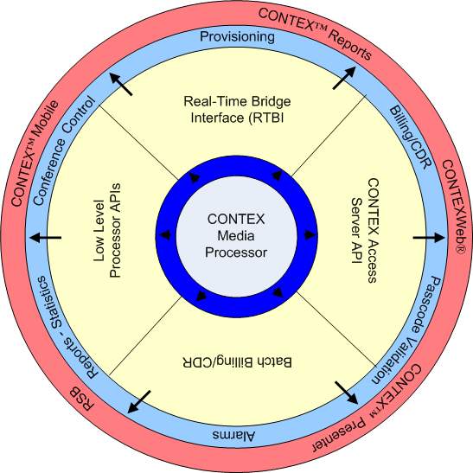
:: Integration with Existing Systems
EASY Integration through Open APIs
  Passcode Validation
  CONTEXWeb
  Reservations
  Billing (CDR)
  Passcode Usage Reports
  Port Utilization
  Statistics

Slide 11
:: Agenda
Introduction
Conferencing – Big Picture
System Components
  Audio Conferencing Bridge
  Tightly Integrated Applications – WOC, MC, CAS, Billing Downloader, Linking Server
  Loosely Integrated Applications – Passcode Server, Billing Processor, Billing Collector, CCM, RSB, CONTEXWeb, CONTEX Presenter
How does all of this fit together?

Slide 12
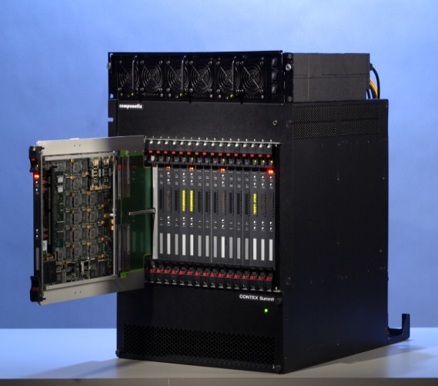
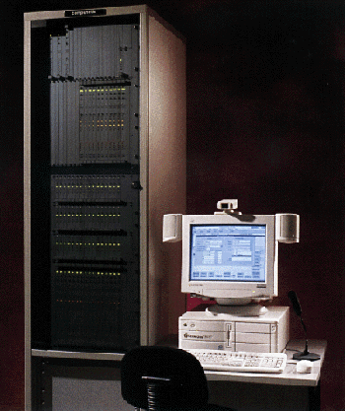
:: Audio Conferencing Bridges
Summit
  1920 lines
  VoIP, E1, T1, ISDN
  Attended and Unattended
CONTEX 240
  240 lines
  E1, T1, ISDN
  Attended and Unattended

Slide 13
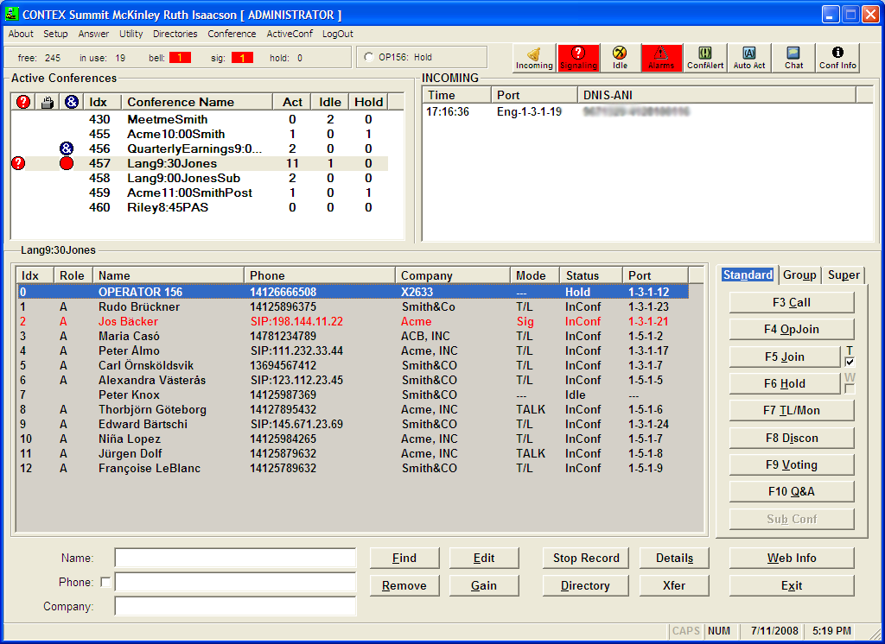
:: Windows Operator Console

Slide 14
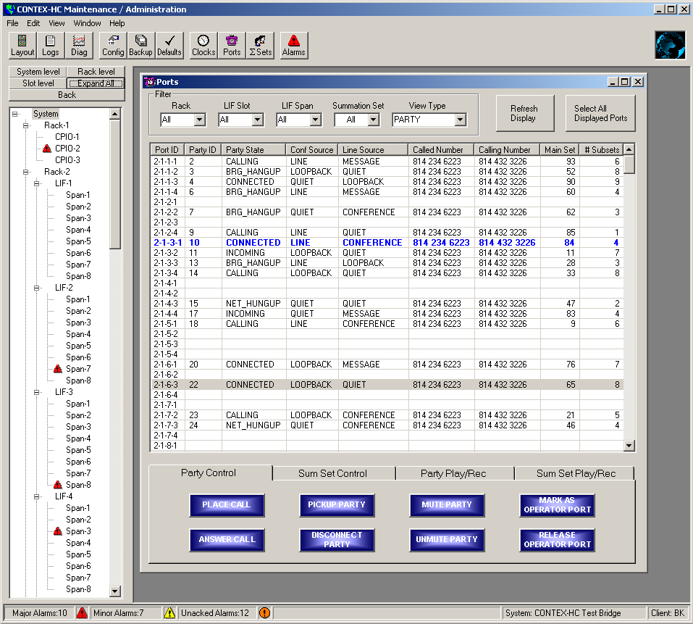
:: Maintenance Client

Slide 15
:: CONTEX Access Server
Middle-ware application
Open API to manage ongoing conferences in real-time
Used by customers and in-the-house to develop custom-tailored solutions integrating with the bridge

Slide 16
:: Billing Downloader
Most customers download the billing data daily or monthly from the bridge, import it into their billing systems and perform their own billing
Billing downloader – command line tool to download the billing log for a given date

Slide 17
:: Linking Server
“Automatic Conference Linking” feature
Some customers have bridges deployed all over the world
Linking Server automates building spanning lines between bridges and manages playing of messages in real-time
Peer-to-peer architecture, redundancy, self-healing topology

Slide 18
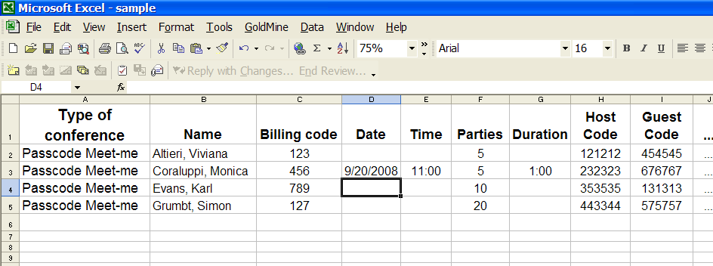
:: Passcode Server
Normally unattended calls are authenticated against internal database
Passcode server allows CSPs to authenticate calls against large databases
Text protocol, redundancy, fail-over, flexibility

Slide 19
:: Billing Processor
Command line tool to convert billing logs downloaded from the bridge into customer-specific “Conference Data Records” (CDRs)
Bridge billing log lists conferencing events (new conference, conference ended, new participant, participant removed…)
CDRs are compiled reports about conferences used by customers to import the data into their billing systems

Slide 20
:: Billing Collector
Receives billing events from the bridge in real-time and processes them to compile CDRs in SQL server database
“Real-Time Billing” – maximum several minutes between end of the conference and a CDR record for it

Slide 21
:: Conference Complete Monitor
A “real-time billing” application that receives billing events from the bridge in real-time, compiles a CDR for each conference in XML
Does not use a database
Uses customer-specific XSL transforms to create customer-specific reports
Can save reports to the disk and/or post them using HTTP POST to configured URL

Slide 22
:: Reservation/Scheduling/Billing
A complex system to provide complete solution for both provisioning, customer data management, and billing
Newer version – web based
  Tomcat/MyFaces/Spring/Hibernate3/BIRT
Older version – Windows based, developed in Delphi, Java, and Paradox consisting of 7 different components in itself

Slide 23
:: Award-Winning CONTEXWeb
Turnkey Solution with Options for Customization
Add and Edit Conferences
View Participant Information
  Name, Phone, Status
Control Participants
  Talk/Listen or Monitor
  Hold, Disconnect, Sub-Conference
View/Manage Conferences
  Q&A
  Polling

Slide 24
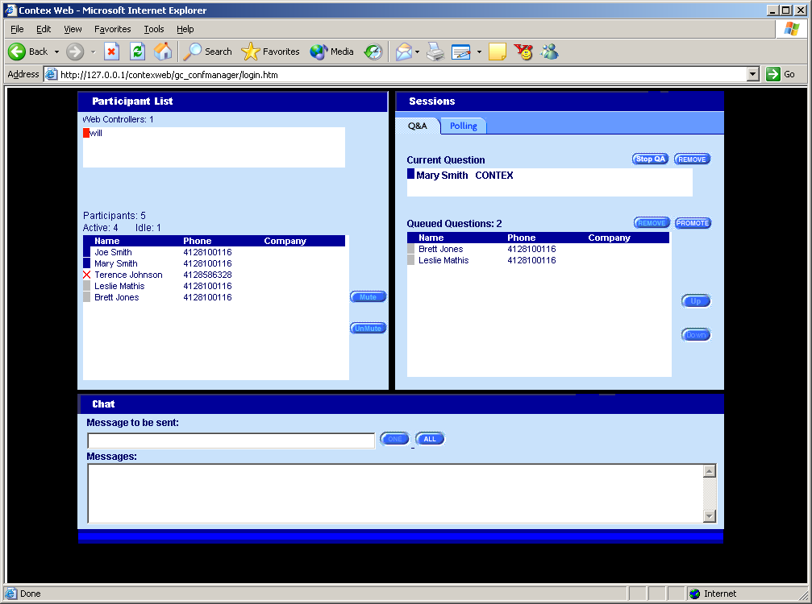
:: CONTEXWeb for Events (example)

Slide 25
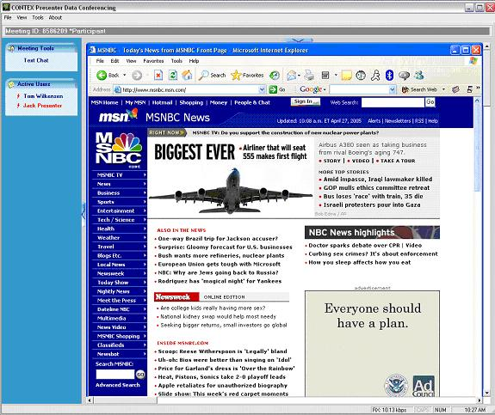
:: CONTEX Presenter

Slide 26
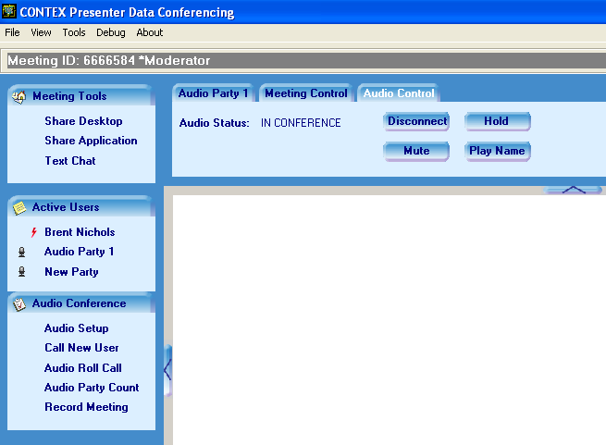
:: Presenter – Participant Audio
Individual participant audio controls are accessible by clicking on the participant’s name in the roster.
This will activate the participant’s Action Window including the Audio Control Action Tab.

Slide 27
:: Agenda
Introduction
Conferencing – Big Picture
System Components
How does all of this fit together?

Slide 28
:: Talking to Summit
CSAPI
WOC
WOC
MC
WOC
CAS
RTBI
Passcode
Server
Billing
Collector
Passcode
Server
RSB
CCM

Slide 29
:: Integration via CAS
Presenter Server
Presenter
Client
TCP/IP
CAS
API
(TCP/IP)
CAS
HTTP
Ajax
CONTEXWeb Client
CONTEXWeb
.NET
COM
WebEx Integration
.NET
COM
CAS
Plugins
OCS Integration

Slide 30
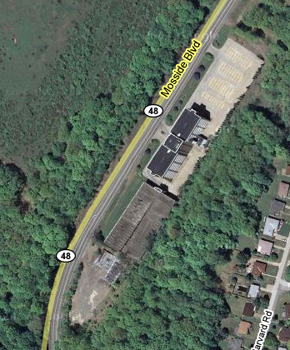
Come Visit Us!
Compunetix
2420 Mosside Blvd
Monroeville, PA

Slide 31

Questions?
Thank You

