Slide 1
Speech: Fundamentals
CS 3710 / ISSP 3565
(Slides modified from D. Jurafsky)

Slide 2
Outline
Acoustic Phonetics and Signals
Prosodic Analysis

Slide 3
The Big Picture
Chapter 7: The idea that the spoken word is composed of smaller units of speech is implicit in sound-based writing systems
Phonetics is the study of linguistic sounds
How they are produced by the articulators of the human vocal tract
How they are realized acoustically
How this acoustic realization can be digitized and processed (computational perspective)

Slide 4
The Big Picture (continued)
Chapter 7: The idea that the spoken word is composed of smaller units of speech is implicit in sound-based writing systems
  7.1: Speech Sounds and Phonetic Transcription
    Can represent the pronunciation of words in terms of phones
  7.2: Articulatory Phonetics
    Phones can be described by how they are produced articulatorily by the vocal organs
  7.4 Acoustic Phonetics and Signals (today’s topic)
    Sound waves can be described in terms of frequency/amplitude, or their perceptual correlates pitch/loudness

Slide 5
Why do we care?
Decomposing speech and words into smaller units of speech is useful for…
  Chapter 8: Text-to-Speech (aka TTS, speech synthesis)
    Converting strings of text words into acoustic waverorms
  Chapter 9: Automatic Speech Recognition (aka ASR)
    Transcribing acoustic waveforms into strings of text words
  Descriptive and predictive statistical analyses

Slide 6
Speech Production Process
Respiration:
  We (normally) speak while breathing out. Respiration provides airflow.
Phonation
  Airstream sets vocal folds in motion. Vibration of vocal folds produces sounds. Sound is then modulated by:
Articulation and Resonance
  Shape of vocal tract, characterized by:
  Oral tract
    Teeth, soft palate (velum), hard palate
    Tongue, lips, uvula
  Nasal tract
Text adopted from Sharon Rose

Slide 7
Acoustic Phonetics and Signals
Acoustic properties of speech sounds
Sound Waves
  http://www.kettering.edu/~drussell/Demos/waves-intro/waves-intro.html

Slide 8
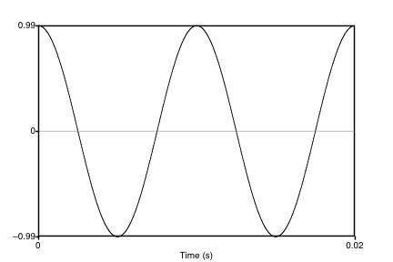
Simple Period Waves (sine waves)
Characterized by:
  period T
    time for 1 cycle to complete
  amplitude A
    maximum value on Y axis
Fundamental frequency in cycles per second, or Hz
  F₀=1/T
1 cycle

Slide 9
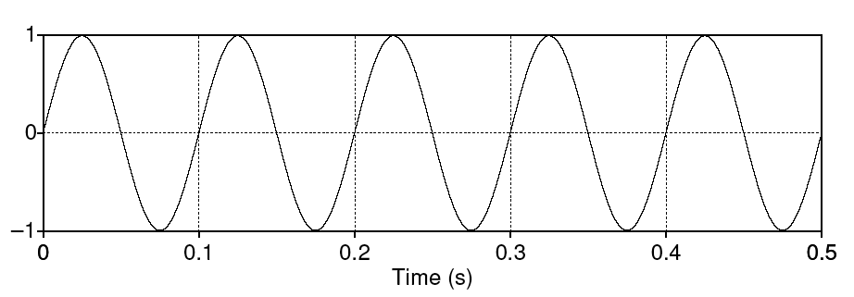
Simple periodic waves
Computing the frequency of a wave:
  5 cycles in .5 seconds = 10 cycles/second = 10 Hz (hertz)
Amplitude:
  1
Period
  .1
Equation:
  Y = A sin(2πft)

Slide 10
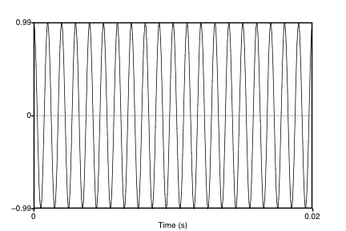
Waves have different frequencies
100 Hz
1000 Hz

Slide 11
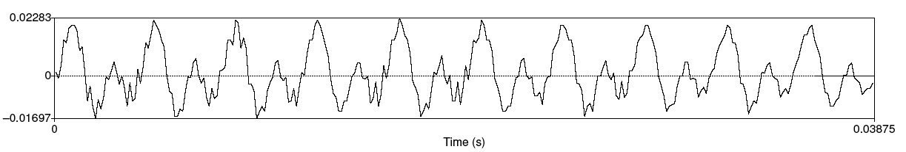
Speech sound waves
The input to a speech recognizer, or to the human ear, is a complex series of changes in air pressure
A little piece from the waveform of the vowel [iy], plotted as change in air pressure over time
Y axis:
  Amplitude = amount of air pressure at that time point
    Positive is compression
    Zero is normal air pressure,
    negative is uncompression
X axis: time.

Slide 12
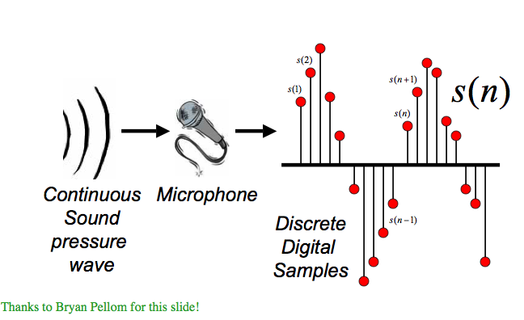
Digitizing Speech

Slide 13
Digitizing Speech
Analog-to-digital conversion
Or A-D conversion.
Two steps
  Sampling
  Quantization

Slide 14
Sampling
Measuring amplitude of a signal at time t
The sample rate needs to have at least two samples for each cycle
  One for the positive, and one for the negative half of each cycle
  More than two samples per cycle increases accuracy
  Less than two samples will cause frequencies to be missed
So the maximum frequency that can be measured is one that is half the sampling rate.

Slide 15
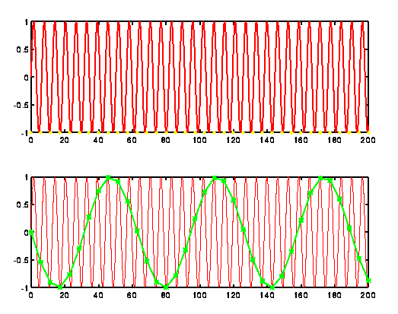
Sampling
Original signal in red:
If measure at green dots, will see a lower frequency wave and miss the correct higher frequency one!

Slide 16
Sampling
In practice we use the following sample rates
  16,000 Hz (samples/sec), for microphones, “wideband”
  8,000 Hz (samples/sec), for telephone
Why?
  Need at least 2 samples per cycle
  Max measurable frequency is half the sampling rate
  Human speech < 10KHz, so need max 20K
  Telephone is filtered at 4K, so 8K is enough.

Slide 17
Quantization
Efficiency needed because even telephone sampling requires 8000 measurements for each second
Quantization
  Representing real value of each amplitude as integer
  8-bit (-128 to 127) or 16-bit (-32768 to 32767)
Formats for storing quantized data
  Number of channels per file
  16 bit PCM (linear/unlogged)
  8 bit mu-law; log compression (hearing is more sensitive at small intensities)
Headers
  Raw (no header)
  Microsoft wav
  Apple aiff
  Sun .au

Slide 18
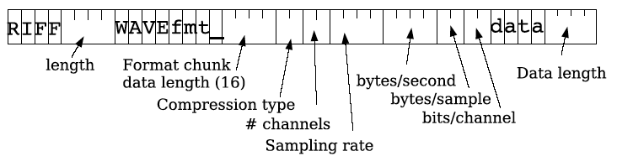
WAV format

Slide 19
Fundamental frequency
Waveform of the vowel [iy]
Although not exactly a sine, still periodic
Frequency: repetitions/second of a wave
Above vowel has 10 reps in .03875 secs
So freq is 10/.03875 = 258 Hz
  This is speed that vocal folds move
  Each peak corresponds to an opening of the vocal folds
The frequency of the complex wave is called the fundamental frequency of the wave or F0

Slide 20

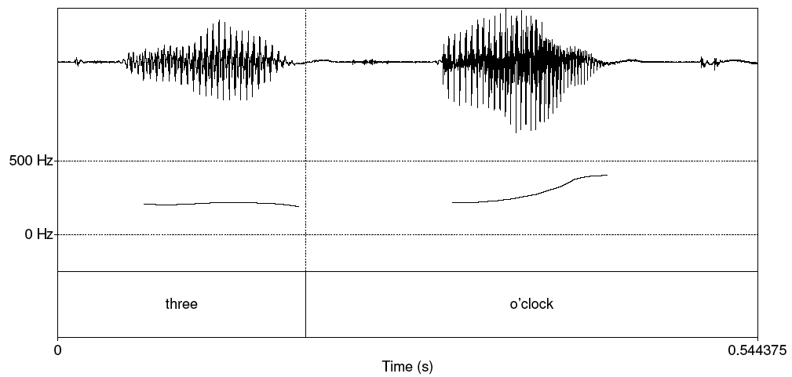
Pitch track
(plot of F0 over time)
Panes from top to bottom are waveform, pitch track (note rise at end typical of questions), and transcription

Slide 21
Amplitude
We need a way to talk about the amplitude of a region of a signal over tune
We can’t just average all the values.
Why not? Values cancel.
So we often talk about RMS amplitude
  Square before averaging (making positive)

Slide 22
Power and Intensity
Power: related to square of amplitude (N is sample number)
Intensity in air: power normalized to auditory threshold, given in dB. P0 is auditory threshold pressure = 2x10⁻⁵ pa

Slide 23
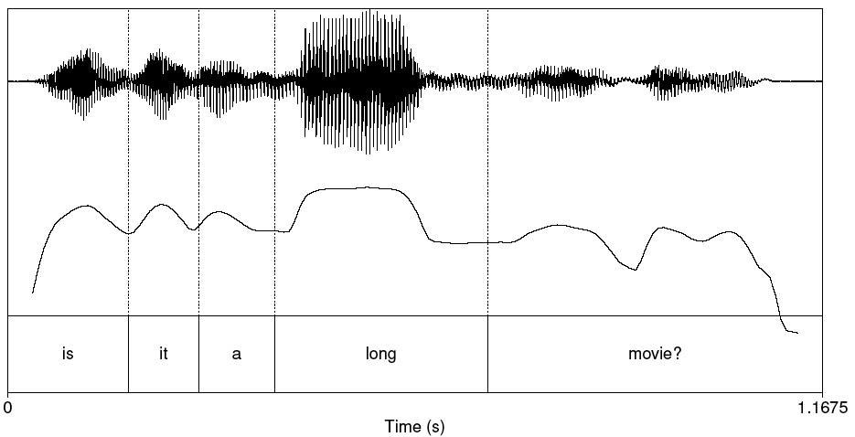
Plot of Intensity

Slide 24
Pitch and Loudness
Pitch is the mental sensation or perceptual correlate of F0
Relationship between pitch and F0 is not linear;
  human pitch perception is most accurate between 100-1000Hz.
    Linear correlation between pitch and frequency in this range
    Logarithmic above 1000Hz (as hearing represents this range less accurately)
Mel scale is one model of this F0-pitch mapping
  A mel is a unit of pitch defined so that pairs of sounds which are perceptually equidistant in pitch are separated by an equal number of mels
  Frequency in mels (computed from acoustic f) = 1127 ln (1 + f/700)
  MFCC representation of speech used in ASR
Loudness is the perceptual correlate of power; again not linear

Slide 25
Summary so far
Acoustic Phonetics
  Waves, sound waves
  Some broad phonetic features can be interpreted directly from speech waveforms
    F0, pitch, intensity
  Note that many computional applications (e.g. ASR) are based on a different representation of sound in terms of component frequencies
    Not covered: Spectra and the Frequency Domain
Tools and resources
  PRAAT
  OpenSmile
  labeled corpora (including my ITSPOKE data – potential for course project)

Slide 26
Prosody
The study of the intonational & rhythmic aspects of language
Example Application: TTS
    Input: Text
    Text Analysis
      Text Normalization
      Phonetic Analysis
      Prosodic Analysis
    Output: Phonemic Internal Representation
    Input: Phonemic Internal Representation
    Waveform Synthesis
  Output: Waveform

Slide 27
Defining Intonation (Ladd, 1996)
“The use of suprasegmental phonetic features
  Suprasegmental = above and beyond the segment/phone
  F0
  Intensity (energy)
  Duration
  Especially the use of acoustic features independently of the phone string
to convey sentence-level pragmatic meanings”
  I.e. meanings that apply to phrases or utterances as a whole, that have to do with the relation between a sentence and its discourse or external context (e.g. discourse structure, salience, emotion)

Slide 28
Three aspects of prosody
Prominence: some syllables/words are more prominent than others
Structure/boundaries: sentences have prosodic structure
  Some words group naturally together
  Others have a noticeable break or disjuncture between them
Tune: the intonational melody of an utterance.
From Ladd (1996)

Slide 29

Prosodic Prominence: Pitch Accents
A: What types of foods are a good source of vitamins?
B1: Legumes are a good source of VITAMINS.
B2: LEGUMES are a good source of vitamins.
Prominent syllables are (in English):
  Louder, Longer, Have higher F0 and/or sharper changes in F0
Pitch accent: a linguistic marker associated with prominent words
Pitch accent is part of the phonological description of a word in context in a spoken utterance (TTS markup)
Slide modified from Jennifer Venditti

Slide 30
Prosodic Boundaries
I met Mary and Elena’s mother at the mall yesterday.
I met Mary and Elena’s mother at the mall yesterday.
French [bread and cheese]
[French bread] and [cheese]
Slide from Jennifer Venditti

Slide 31
Prosodic Tunes
Legumes are a good source of vitamins.
Are legumes a good source of vitamins?
Slide from Jennifer Venditti

Slide 32
Prosody Part I
Thinking about F0

Slide 33
Graphic representation of F0
F0 (in Hertz)
legumes are a good source of VITAMINS
time
Slide from Jennifer Venditti

Slide 34
The ‘ripples’
[ s ]
[ s ]
[ t ]
legumes are a good source of VITAMINS
F0 is not defined for consonants without vocal
fold vibration.
Slide from Jennifer Venditti

Slide 35
The ‘ripples’
[ g ]
[ z ]
[ g ]
[ v ]
legumes are a good source of VITAMINS
... and F0 can be perturbed by consonants with
an extreme constriction in the vocal tract.
Slide from Jennifer Venditti

Slide 36
Abstraction of the F0 contour
legumes are a good source of VITAMINS
Our perception of the intonation contour abstracts
away from these perturbations.
Slide from Jennifer Venditti

Slide 37
The ‘waves’ and the ‘swells’
‘wave’ = accent
‘swell’ = phrase
legumes are a good source of VITAMINS
Slide from Jennifer Venditti

Slide 38
Prosody Part II:
Prominence:
Placement of Pitch Accents

Slide 39
Stress vs. accent
Stress is a structural property of a word
  it marks a potential (arbitrary) location for an accent to occur, if there is one.
Accent is a property of a word in context
  it is a way to mark intonational prominence in order to ‘highlight’ important words in the discourse.
Slide from Jennifer Venditti

Slide 40
Stress vs. accent (2)
The speaker decides to make the word vitamin more prominent by accenting it.
Lexical stress tell us that this prominence will appear on the first syllable, hence VItamin.
So we will have to look at both the lexicon and the context to predict the details of prominence
I’m a little surPRISED to hear it CHARacterized as upBEAT

Slide 41
Which word receives an accent?
It depends on the context.
  The ‘new’ information in the answer to a question is often accented
    while the ‘old’ information is usually not.
  Q1: What types of foods are a good source of vitamins?
  A1: LEGUMES are a good source of vitamins.
  Q2: Are legumes a source of vitamins?
  A2: Legumes are a GOOD source of vitamins.
  Q3: I’ve heard that legumes are healthy, but what are they a good source of ?
  A3: Legumes are a good source of VITAMINS.
Slide from Jennifer Venditti

Slide 42
Same ‘tune’, different alignment
LEGUMES are a good source of vitamins
The main rise-fall accent (= “I assert this”) shifts locations.
Slide from Jennifer Venditti

Slide 43
Same ‘tune’, different alignment
Legumes are a GOOD source of vitamins
The main rise-fall accent (= “I assert this”) shifts locations.
Slide from Jennifer Venditti

Slide 44
Same ‘tune’, different alignment
legumes are a good source of VITAMINS
The main rise-fall accent (= “I assert this”) shifts locations.
Slide from Jennifer Venditti

Slide 45
Levels of prominence
Most phrases have more than one accent
The last accent in a phrase is perceived as more prominent
  Called the Nuclear Accent
Emphatic accents like nuclear accent often used for semantic purposes, such as indicating that a word is contrastive, or the semantic focus.
  The kind of thing you use ***s in IM, or capitalized letters
  ‘I know SOMETHING interesting is sure to happen,’ she said to herself.
Can also have words that are less prominent than usual
  Reduced words, especially function words.
Often use 4 classes of prominence:
  Emphatic accent, pitch accent, unaccented, reduced

Slide 46
Pitch accent prediction from text
With two levels of prominence, pitch accent prediction (e.g. from text, for TTS) can be modeled as a binary classification task
Which words in an utterance should bear accent?
  What features are the best predictors?
  How much do sophisticated linguistic features (e.g. Given/New) help over simple features (e.g. POS)?

Slide 47
What about pitch accent detection from speech and text?
Sridhar, Nenkova, Narayanan, Jurafsky. Speech Prosody 2008
Nenkova and Jurafsky 2007. ASRU 2007.
  How best to combine acoustic and lexical cues?
  How useful is contextual information (from neighboring words)?

Slide 48
Experiment
12 Switchboard conversations
14,555 word tokens
The task is predicting whether a word is accented, using
  Text features (e.g. POS)
  Acoustic features
Evaluated by how well classifiers match human accent labels

Slide 49
Some of the acoustic features tested
Duration of word
Pitch
  F0 mean of word
  F0 std dev
  Max F0 in word
  Min F0 in word
  F0 slope
  Raw and normalized
Energy
  Mean RMS energy in word
  Energy std dev
  Energy slope across word
  RMS energy in first half of word
  RMS energy in second half of word

Slide 50
Prosody Part III: Structure
Intonational phrasing/boundaries
Some words in a spoken sentence seem to group naturally together,
while others have a noticeable break between then
Utterances have a prosodic phrase structure in a similar way to having a syntactic phrase structure

Slide 51
A single intonation phrase
legumes are a good source of vitamins
Broad focus statement consisting of one intonation phrase
(that is, one intonation tune spans the whole unit).
Slide from Jennifer Venditti

Slide 52
Multiple phrases
legumes are a good source of vitamins
Utterances can be ‘chunked’ up into smaller phrases
in order to signal the importance of information in each unit.
Slide from Jennifer Venditti

Slide 53
I wanted to go to London, but could only get tickets for France

Slide 54
I wanted to go to London, but could only get tickets for France
2 main intonation phrases (boundary at comma)
Lesser (intermediate) phrase boundaries possible too
  (I wanted | to go | to London)
TTS Implications
  Often insert a pause after a phrase
  FO drops from the beginning to the end of a phrase, then resets at the beginning of a new phrase
  Again, often formulated as binary classification

Slide 55
Phrasing can disambiguate
Global ambiguity:
    The old men and women stayed home.
    The old men % and women % stayed home.
    Sally saw % the man with the binoculars.
    Sally saw the man % with the binoculars.
    John doesn’t drink because he’s unhappy.
    John doesn’t drink % because he’s unhappy.
Slide from Jennifer Venditti

Slide 56
Phrasing sometimes helps disambiguate
Mary & Elena’s mother
mall
I met Mary and Elena’s mother at the mall yesterday
One intonation phrase with relatively flat overall pitch range.
Slide from Jennifer Venditti

Slide 57
Phrasing sometimes helps disambiguate
Elena’s mother
mall
Mary
I met Mary and Elena’s mother at the mall yesterday
Separate phrases, with expanded pitch movements.
Slide from Jennifer Venditti

Slide 58
Intonational tunes
Two utterances with the same prominence and phrasing patterns can still differ prosodically by having different tunes
The tune of an utterance is the rise and fall of its F0 over time
Example: English statements (final fall) versus yes-no questions (final rise)
English makes wide use of tune to express meaning, although complex mapping
  TTS typically just uses continuation rise (at commas), question rise (at y/n ?), and final fall otherwise

Slide 59
Yes-No question tune
are LEGUMES a good source of vitamins
Rise from the main accent to the end of the sentence.
Slide from Jennifer Venditti

Slide 60
Yes-No question tune
are legumes a GOOD source of vitamins
Rise from the main accent to the end of the sentence.
Slide from Jennifer Venditti

Slide 61
Yes-No question tune
are legumes a good source of VITAMINS
Rise from the main accent to the end of the sentence.
Slide from Jennifer Venditti

Slide 62
WH-questions
[I know that many natural foods are healthy, but ...]
WHAT are a good source of vitamins
WH-questions typically have falling contours, like statements.
Slide from Jennifer Venditti

Slide 63
Broad focus
“Tell me something about the world.”
legumes are a good source of vitamins
In the absence of narrow focus, English tends to mark the first
and last ‘content’ words with perceptually prominent accents.
Slide from Jennifer Venditti

Slide 64
Rising statements
“Tell me something I didn’t already know.”
legumes are a good source of vitamins
[... does this statement qualify?]
High-rising statements can signal that the speaker
is seeking approval.
Slide from Jennifer Venditti

Slide 65
Yes-No question
are legumes a good source of VITAMINS
Rise from the main accent to the end of the sentence.
Slide from Jennifer Venditti

Slide 66
‘Surprise-redundancy’ tune
[How many times do I have to tell you ...]
legumes are a good source of vitamins
Low beginning followed by a gradual rise to a high at the end.
Slide from Jennifer Venditti

Slide 67
‘Contradiction’ tune
“I’ve heard that linguini is a good source of vitamins.”
linguini isn’t a good source of vitamins
[... how could you think that?]
Sharp fall at the beginning, flat and low, then rising at the end.
Slide from Jennifer Venditti

Slide 68
Advanced:
Intonational
Transcription Theories:
ToBI
(a linguistic model of prosody)

Slide 69
ToBI: Tones and Break Indices
Pitch accent tones
  H* “peak accent”
  L* “low accent”
  L+H* “rising peak accent” (contrastive)
  L*+H ‘scooped accent’
  H+!H* downstepped high
Boundary tones
  L-L% (final low; Am Eng. Declarative contour)
  L-H% (continuation rise)
  H-H% (yes-no queston)
Break indices
  0: clitics, 1, word boundaries, 2 short pause
  3 intermediate intonation phrase
  4 full intonation phrase/final boundary.

Slide 70
Examples of the TOBI system
I don’t eat beef.
L* L* L*L-L%
Marianna made the marmalade.
H* L-L%
L* H-H%
“I” means insert.
H* H* H*L-L%
1
H*L- H*L-L%
3
Slide from Lavoie and Podesva

Slide 71
Want a fuller treatment of speech topics?
Courses in linguistics, EE, CMU…

