Slide 1
Emotion
CS 3710 / ISSP 3565
(Slides modified from D. Jurafsky)

Slide 2
Scherer’s typology of affective states
Emotion: relatively brief eposide of synchronized response of all or most organismic subsystems in response to the evaluation of an external or internal event as being of major significance
  angry, sad, joyful, fearful, ashamed, proud, desparate
Mood: diffuse affect state, most pronounced as change in subjective feeling, of low intensity but relatively long duration, often without apparent cause
  cheerful, gloomy, irritable, listless, depressed, buoyant
Interpersonal stance: affective stance taken toward another person in a specific interaction, coloring the interpersonal exchange in that situation
  distant, cold, warm, supportive, contemptuous
Attitudes: relatively enduring, affectively colored beliefs, preferences predispositions towards objects or persons
  liking, loving, hating, valueing, desiring
Personality traits: emotionally laden, stable personality dispositions and behavior tendencies, typical for a person
  nervous, anxious, reckless, morose, hostile, envious, jealous

Slide 3
Extracting social/interactional meaning
Emotion
  Annoyance in talking to dialog systems
  Uncertainty of students in tutoring
Mood
  Detecting Trauma or Depression
Interpersonal Stance
  Romantic interest, flirtation, friendliness
  Alignment/accommodation/entrainment
Attitudes = Sentiment (positive or negative) – won’t cover
Personality Traits
  Open, Conscienscious, Extroverted, Anxious

Slide 4
Outline
Theoretical background on emotion
Extracting emotion from speech and text: case studies

Slide 5
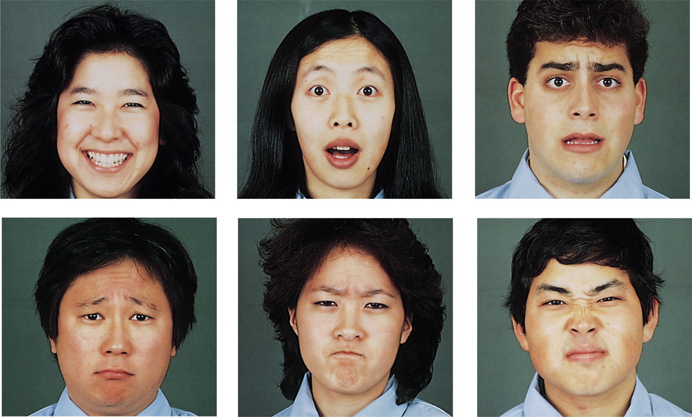
Ekman’s 6 basic emotions
    Surprise, happiness, anger, fear, disgust, sadness

Slide 6
Ekman and colleagues
Hypothesis: certain basic emotions are universally recognized across cultures; emotions are evolutionarily adaptive and unlearned.
  Ekman, Friesen, and Tomkins: showed facial expressions of emotion to observers in 5 different countries (Argentina, US, Brazil, Chile, & Japan) and asked the observers to label each expression. Participants from all five countries showed widespread agreement on the emotion each of these pictures depicted.
  Ekman, Sorenson, and Friesen: conducted a similar study with preliterate tribes of New Guinea (subjects selected a story that best described the facial expression). The tribesmen correctly labeled the emotion even though they had no prior experience with print media.
  Ekman and colleagues: asked tribesman to show on their faces what they would look like if they experienced the different emotions. They took photos and showed them to Americans who had never seen a tribesman and had them label the emotion. The Americans correctly labeled the emotion of the tribesmen.
  Ekman and Friesen conducted a study in the US and Japan asking subjects to view highly stressful stimuli as their facial reactions were secretly videotaped. Both subjects did show exactly the same types of facial expressions at the same points in time, and these expressions corresponded to the same expressions that were considered universal in the judgment research.

Slide 7
Dimensional approach.
(Russell, 1980, 2003)
Arousal
High arousal, High arousal,
Displeasure (e.g., anger) High pleasure (e.g., excitement)
Valence
Low arousal, Low arousal,
Displeasure (e.g., sadness) High pleasure (e.g., relaxation)
Slide from Julia Braverman

Slide 8
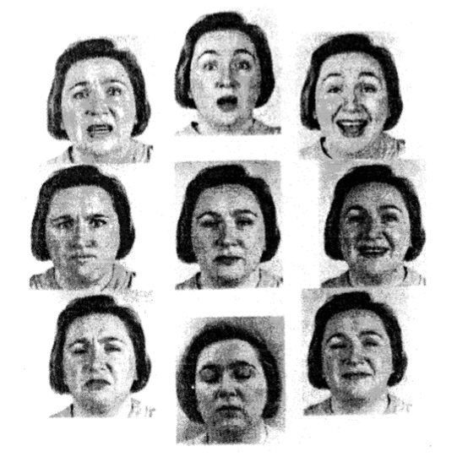
Image from Russell 1997
Image from
Russell, 1997
valence
-
+
-
arousal
Notes:
Engagement
Learning (memory, problem-solving, attention)
Motivation

Slide 9
Distinctive vs. Dimensional approach of emotion
Distinctive
Emotions are units.
Limited number of basic emotions.
Basic emotions are innate and universal
Methodology advantage
  Useful in analyzing traits of personality.
Dimensional
Emotions are dimensions.
Limited # of labels but unlimited number of emotions.
Emotions are culturally learned.
Methodological advantage:
  Easier to obtain reliable measures.
Slide from Julia Braverman

Slide 10


Emotional communication
Example:
Loud voice
High pitched
Frown
Clenched fists
Shaking
Vocal cues
cues
Facial cues
Gestures
Other cues …
Expressed emotion
Emotional attribution
expressed anger ?
perception of
anger?
encoder
decoder
slide from Tanja Baenziger

Slide 11
Implications
cues
Expressed emotion
Emotional attribution
relation of the cues to the expressed emotion
relation of the cues to the perceived emotion
Important for Extraction
matching
Important for Agent generation
Generation (Conversational agents): relation of cues to perceived emotion
Recognition (Extraction systems): relation of the cues to expressed emotion
slide from Tanja Baenziger

Slide 12
Four Theoretical Approaches to Emotion
Darwinian (natural selection)
Jamesian: Emotion is bodily experience
  “we feel sorry because we cry… afraid because we tremble"’
  “our feeling of the … changes as they occur IS the emotion“
Cognitive Appraisal
  An emotion is produced by appraising (extracting) elements of the situation. (Scherer)
    Fear: produced by the appraisal of an event or situation as obstructive to one’s central needs and goals, requiring urgent action, being difficult to control through human agency, and lack of sufficient power or coping potential to deal with it.
Social Constructivism
  Emotions are cultural products (Averill)
  Explains gender and social group differences
  anger is elicited by the appraisal that one has been wronged intentionally and unjustifiably by another person.
    don’t get angry if you yank my arm accidentally
    or if you are a doctor and do it to reset a bone
    only if you do it on purpose

Slide 13
Why Emotion Detection from Speech or Text?
Detecting frustration of callers to a help line
Detecting stress in drivers or pilots
Detecting (dis)interest, (un)certainty in on-line tutors
  Pacing/Content/Feedback
Hot spots in meeting browsers
Synthesis/generation:
  On-line literacy tutors in the children’s storybook domain
  Computer games

Slide 14
Hard Questions in Emotion Recognition
How do we know what emotional speech is?
  Acted speech vs. natural (hand labeled) corpora
What can we classify?
    Distinguish among multiple ‘classic’ emotions
    Distinguish
      Valence: is it positive or negative?
      Activation: how strongly is it felt? (sad/despair)
What features best predict emotions?
What techniques best to use in classification?
Slide from Julia Hirschberg

Slide 15
Accuracy of facial versus vocal cues to emotion (Scherer 2001)

Slide 16
Data and tasks for Emotion Detection
Scripted speech
  Acted emotions, often using 6 emotions
  Controls for words, focus on acoustic/prosodic differences
  Features:
    F0/pitch
    Energy
    speaking rate
Spontaneous speech
  More natural, harder to control
  Dialogue
  Kinds of emotion focused on:
    frustration,
    annoyance,
    certainty/uncertainty
    “activation/hot spots”

Slide 17
Quick case studies
Acted speech
    LDC’s EPSaT
Uncertainty in natural speech
    Pitt ITSPOKE
Annoyance/Frustration in natural speech
    Ang et al (assigned reading)

Slide 18
Example 1: Acted speech; emotional Prosody Speech and Transcripts Corpus (EPSaT)
Recordings from LDC
  http://www.ldc.upenn.edu/Catalog/LDC2002S28.html
8 actors read short dates and numbers in 15 emotional styles

Slide 19

EPSaT Examples
happy
sad
angry
confident
frustrated
friendly
Interested
Etc.

Slide 20
Liscombe et al. 2003 (Detection)
Automatic Acoustic-prosodic Features
  Global characterization
    pitch
    loudness
    speaking rate

Slide 21
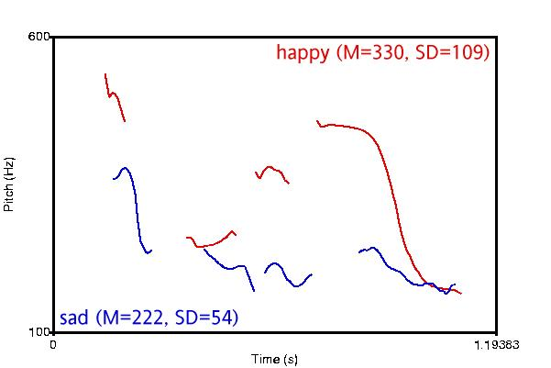
Global Pitch Statistics
Different Valence/Different Activation

Slide 22
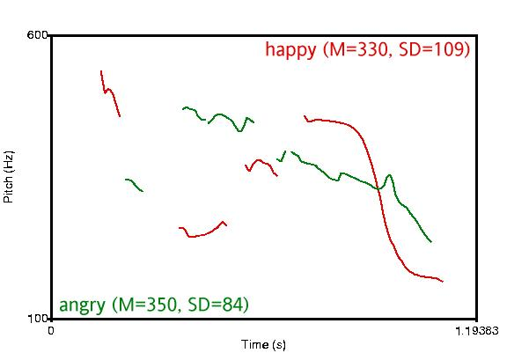
Global Pitch Statistics
Different Valence/Same Activation

Slide 23
Liscombe et al. Features
Automatic Acoustic-prosodic
ToBI Contours
Spectral Tilt

Slide 24
Liscombe et al. Experiments
Binary Classification for Each Emotion
  Ripper, 90/10 split
Results
  62% average baseline
  75% average accuracy
Most useful features:

Slide 25
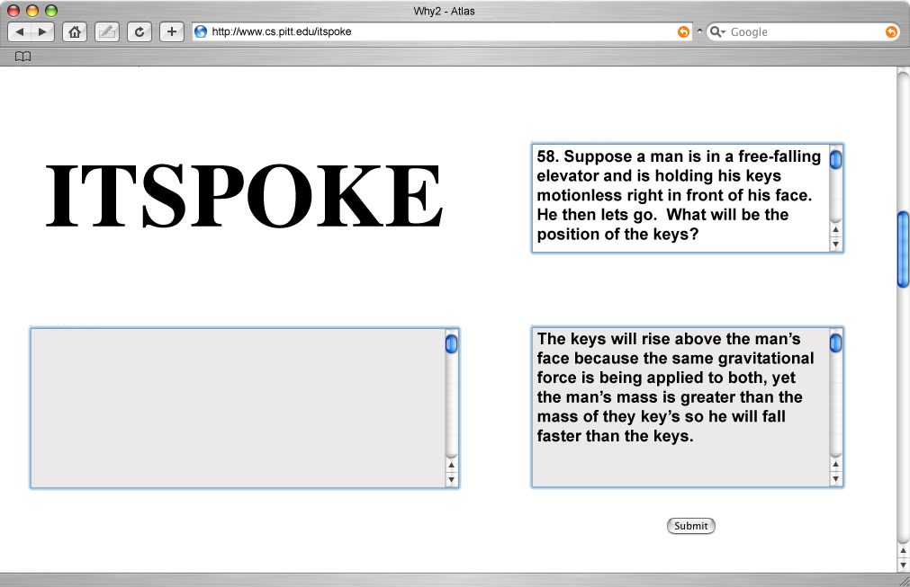
[pr01_sess00_prob58]

Slide 26
Task 1
Negative
  Confused, bored, frustrated, uncertain
Positive
  Confident, interested, encouraged
Neutral

Slide 27
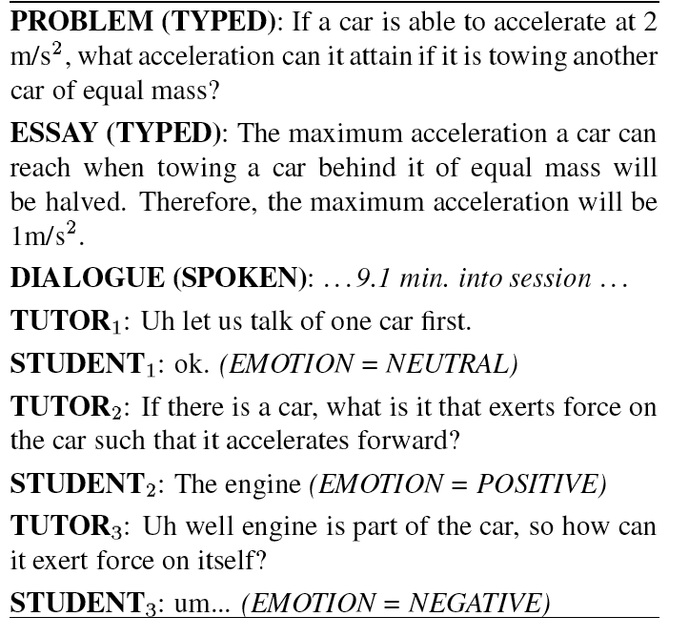

Slide 28
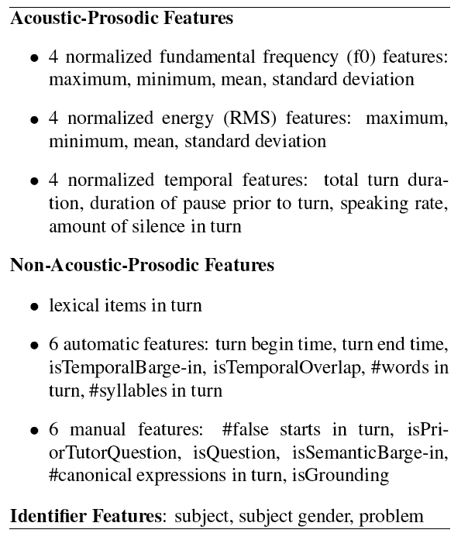

Slide 29
Task 2: Uncertainty
um <sigh> I don’t even think I have an idea here ...... now .. mass isn’t weight ...... mass is ................ the .......... space that an object takes up ........ is that mass?
um <sigh> I don’t even think I have an idea here ...... now .. mass isn’t weight ...... mass is ................ the .......... space that an object takes up ........ is that mass?
um <sigh> I don’t even think I have an idea here ...... now .. mass isn’t weight ...... mass is ................ the .......... space that an object takes up ........ is that mass?
um <sigh> I don’t even think I have an idea here ...... now .. mass isn’t weight ...... mass is ................ the .......... space that an object takes up ........ is that mass?
um <sigh> I don’t even think I have an idea here ...... now .. mass isn’t weight ...... mass is ................ the .......... space that an object takes up ........ is that mass?
um <sigh> I don’t even think I have an idea here ...... now .. mass isn’t weight ...... mass is ................ the .......... space that an object takes up ........ is that mass?
[71-67-1:92-113]
Notes:
One ‘.’ corresponds to 0.25 seconds.

Slide 30
Liscombe et al: ITSpoke Experiment
Human-Human Corpus
AdaBoost(C4.5) 90/10 split in WEKA
Classes: Uncertain vs Certain vs Neutral
Results:
Features | Accuracy
Baseline | 66%
Acoustic-prosodic | 75%

Slide 31
Current ITSpoke Experiment(s)
Human-Computer
  (Binary) Uncertainty and (Binary) Disengagment
  Wizard and fully automated
Be a pilot subject!

Slide 32
Scherer summaries re: Prosodic features

Slide 33
Juslin and Laukka metastudy

Slide 36
Ang et al 2002
Prosody-Based detection of annoyance/ frustration in human computer dialog
DARPA Communicator Project Travel Planning Data
  NIST June 2000 collection: 392 dialogs, 7515 utts
  CMU 1/2001-8/2001 data: 205 dialogs, 5619 utts
  CU 11/1999-6/2001 data: 240 dialogs, 8765 utts
Considers contributions of prosody, language model, and speaking style
Questions
  How frequent is annoyance and frustration in Communicator dialogs?
  How reliably can humans label it?
  How well can machines detect it?
  What prosodic or other features are useful?

Slide 37
Data Annotation
5 undergrads with different backgrounds
Each dialog labeled by 2+ people independently
  2nd “Consensus” pass for all disagreements, by two of the same labelers

Slide 38
Data Labeling
Emotion: neutral, annoyed, frustrated, tired/disappointed, amused/surprised, no-speech/NA
Speaking style: hyperarticulation, perceived pausing between words or syllables, raised voice
Repeats and corrections: repeat/rephrase, repeat/rephrase with correction, correction only
Miscellaneous useful events: self-talk, noise, non-native speaker, speaker switches, etc.

Slide 39

Emotion Samples
Neutral
  July 30
  Yes
Disappointed/tired
  No
Amused/surprised
  No
Annoyed
  Yes
  Late morning (HYP)
Frustrated
  Yes
  No
  No, I am … (HYP)
  There is no Manila...
3
1
2
8
6
4
5
9
7
10

Slide 40

Emotion Class Distribution
To get enough data, grouped annoyed and frustrated, versus else (with speech)

Slide 41
Prosodic Model
Classifier: CART-style decision trees
Downsampled to equal class priors
Automatically extracted prosodic features based on recognizer word alignments
Used 3/4 for train, 1/4th for test, no call overlap

Slide 42
Prosodic Features
Duration and speaking rate features
  duration of phones, vowels, syllables
  normalized by phone/vowel means in training data
  normalized by speaker (all utterances, first 5 only)
  speaking rate (vowels/time)
Pause features
  duration and count of utterance-internal pauses at various threshold durations
  ratio of speech frames to total utt-internal frames

Slide 43
Prosodic Features (cont.)
Pitch features
  F0-fitting approach developed at SRI (Sönmez)
  LTM model of F0 estimates speaker’s F0 range
  Many features to capture pitch range, contour shape & size, slopes, locations of interest
  Normalized using LTM parameters by speaker, using all utts in a call, or only first 5 utts
Fitting
LTM
F₀
Time
Log F₀

Slide 44
Features (cont.)
Spectral tilt features
  average of 1st cepstral coefficient
  average slope of linear fit to magnitude spectrum
  difference in log energies btw high and low bands
  extracted from longest normalized vowel region

Slide 45
Language Model Features
Train two 3-gram class-based LMs
  one on frustration, one on other.
Given a test utterance, chose class that has highest LM likelihood (assumes equal priors)
In prosodic decision tree, use sign of the likelihood difference as input feature

Slide 46
Results (cont.)
H-H labels agree 72%
H labels agree 84% with “consensus” (biased)
Tree model agrees 76% with consensus-- better than original labelers with each other
Language model features alone (64%) are not good predictors

Slide 47
Prosodic Predictors of Annoyed/Frustrated
Pitch:
  high maximum fitted F0 in longest normalized vowel
  high speaker-norm. (1st 5 utts) ratio of F0 rises/falls
  maximum F0 close to speaker’s estimated F0 “topline”
  minimum fitted F0 late in utterance (no “?” intonation)
Duration and speaking rate:
  long maximum phone-normalized phone duration
  long max phone- & speaker- norm.(1st 5 utts) vowel
  low syllable-rate (slower speech)

Slide 48
Ang et al ‘02 Conclusions
Emotion labeling is a complex task
Prosodic features:
  duration and stylized pitch
  Speaker normalizations help
Language model not a good feature

